Slide 1
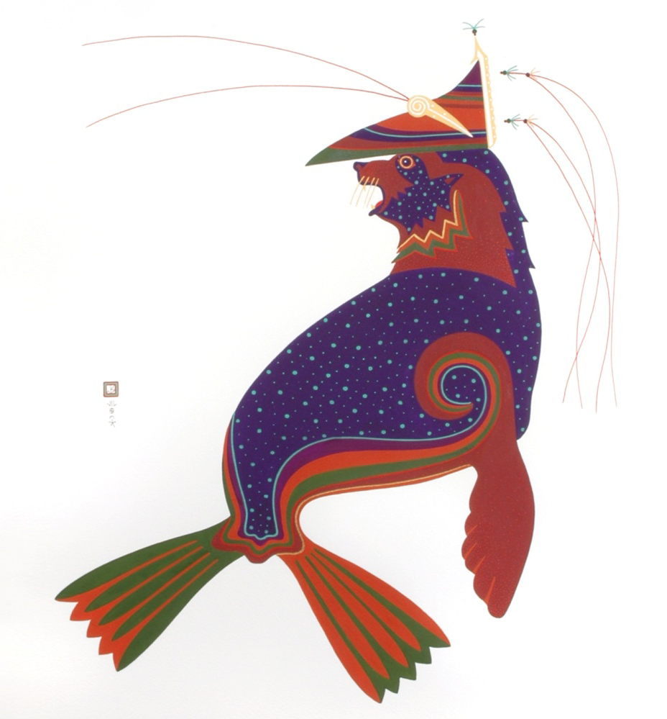

Laaquda{: The Northern Fur Seal
Lesson 6:
Where do
fur seals go in the winter?
© Thomas Stream Northern Fur Seal
Notes:
Lesson 6 provides an overview of the winter migration of fur seals, where different age groups of seals go, what traditional knowledge, archaeology and current science can tell us about fur seal migration, and what we can learn from the information.

Slide 2
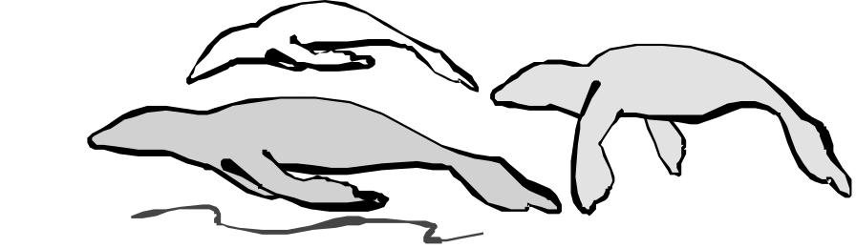
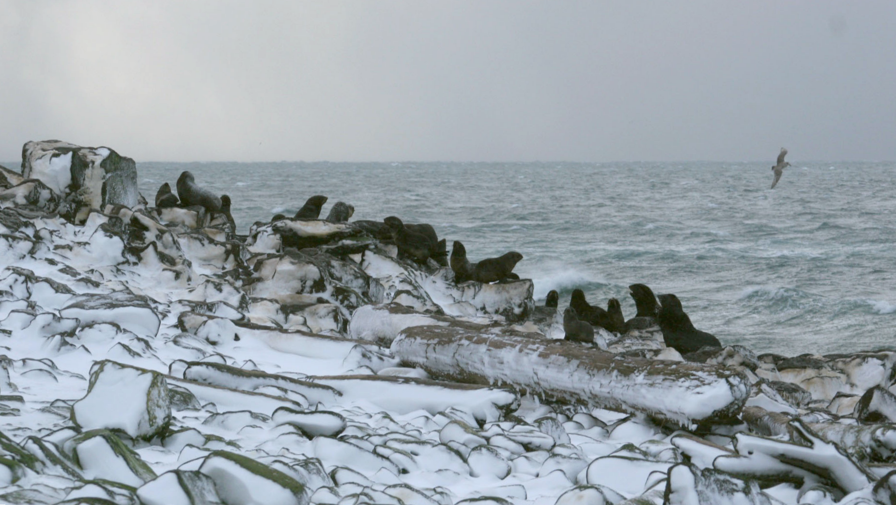
What will you learn?
Why do fur seals leave the rookery?
Where do they go?
How do we know?
Lesson 5: Where do fur seals go in the winter?
Notes:
Photo: Jeremy Sterling, NOAA/AFSC/MML

Slide 3
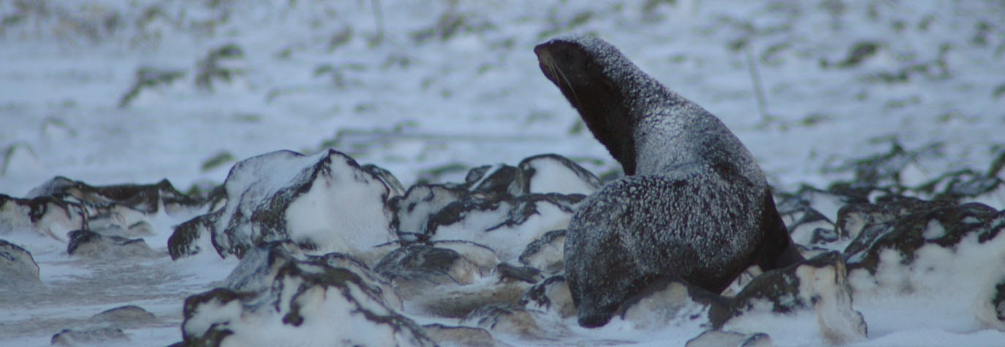
Why do fur seals leave?
  Adult males have been fasting since they arrived
  Adult females are thin after feeding themselves
  and a pup for 4 months
  Pups need to forage for their own food
  All seals have molted
  Winter storms
Lesson 5: Where do fur seals go in the winter?
Notes:
Northern fur seals use the winter months to feed and gain energy reserves for the following summer and the next year’s breeding season.
Adult males do not feed while they are on the rookery defending their territory. Once the males have mated with the last female, they head to sea for the winter.
Adult females have been feeding themselves and their pups for about 4 months.
Pups actually wean themselves. They stop nursing just before heading out to sea. Once at sea pups have to learn how to forage for food on their own. The pups that quickly learn how to forage will survive the best. Most pups are at sea for 18-20 months before returning to the Pribilofs.
All fur seals must come to land to molt (shed old fur and grow new fur).
The Pribilof Islands are often surrounded by ice in the winter and spring, making the rookeries inaccessible to the seals.
Photo: Jeremy Sterling, NOAA/AFSC/MML

Slide 4
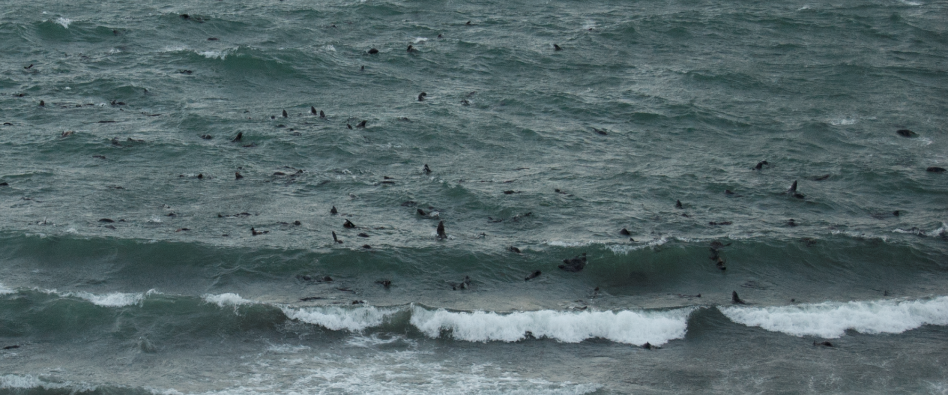
Fur seals at sea
  Pups are at sea for the first 2 years
  Most of the other fur seals are at sea (pelagic) for the next 8-10 months.
Lesson 5: Where do fur seals go in the winter?
Notes:
The pups who have just weaned and are headed to sea for the first time will stay at sea for 18-20 months and return to the rookery as a 2 year old.
Some of these juveniles will come to shore during that time but not many.
All other fur seals stay at sea for eight to ten months until the following spring/summer when they return to the rookery.
Photo: Lisa Hiruki-Raring: NOAA/AFSC/MML; northern fur seals playing in the surf at Reef Rookery, St. Paul Island, Alaska.

Slide 5
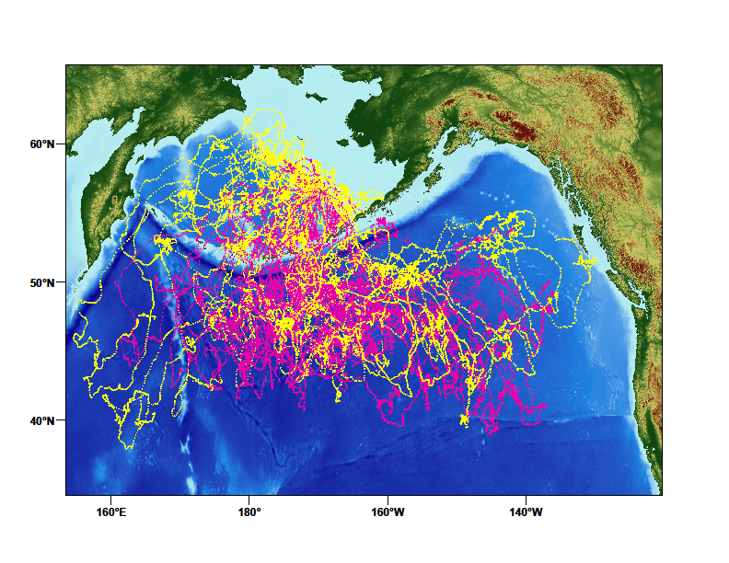
Where do pups go?
RUSSIA
USA
Alaska
CANADA
Yellow = males
Pink = females
Lesson 5: Where do fur seals go in the winter?
Notes:
Scientists at NOAA have been tagging pups for years trying to figure out where they go in the winter. The next four slides display geographical data collected by satellite tags placed on northern fur seals by NOAA scientists. Almost all of the animals headed south of the Aleutian Islands.
Slide 1: Pups
Pups leave the rookery when they are 4 months old. In their first year, pups’ tracks are not very directed. They are at the mercy of the weather much of the time. As the seals get older and stronger, their tracks are more directed. Less than half of the pups who leave the Pribilofs will return. The mortality (death) rate for pups is very high.
See the next three images for tracks of juveniles, adult females, and adult males.
Source: NOAA/AFSC/NMML Alaska Ecosystem Program

Slide 6
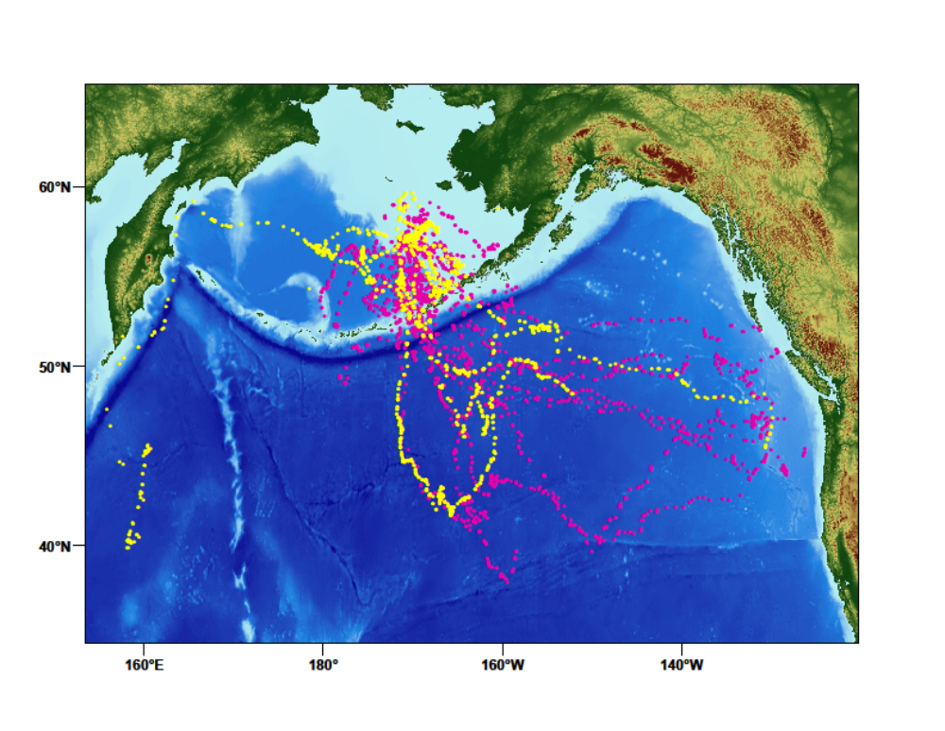
Where do juveniles go?
RUSSIA
USA
Alaska
CANADA
Yellow = males
Pink = females
Lesson 5: Where do fur seals go in the winter?
Notes:
Slide 2
Juvenile males and females start to become more directed in their winter migrations. Compared to the pups’ tracks, the majority of juvenile tracks are headed toward the eastern North Pacific and the west coast of the U.S. Only a selection of tagged seals are displayed on this chart.
Source: NOAA/AFSC/NMML Alaska Ecosystem Program

Slide 7
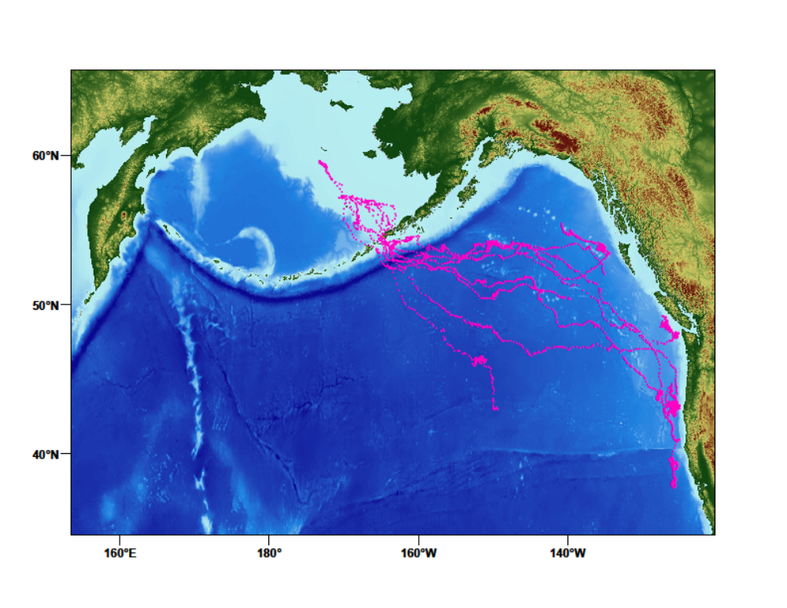
Where do adult females go?
RUSSIA
USA
Alaska
CANADA
Lesson 5: Where do fur seals go in the winter?
Notes:
Slide 3
Adult female fur seals’ tracks are very consistent in their movements toward the west coast of North America.
Source: NOAA/AFSC/NMML Alaska Ecosystem Program

Slide 8
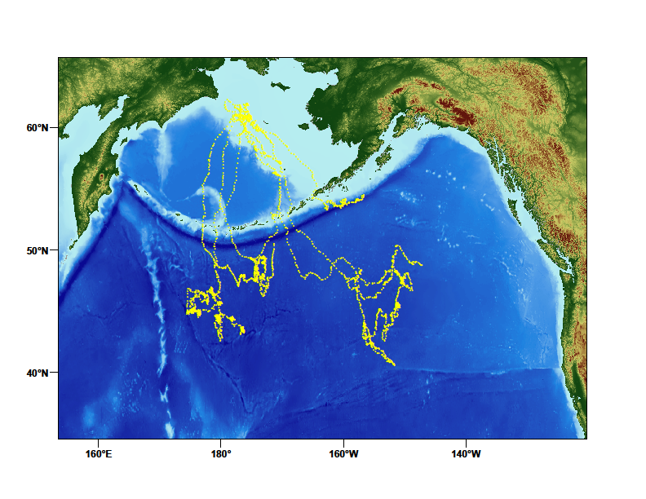
Where do adult males go?
RUSSIA
USA
Alaska
CANADA
Lesson 5: Where do fur seals go in the winter?
Notes:
Slide 4
Adult male winter migrations go more toward the middle of the north Pacific Ocean. Note that the males’ migration areas are generally separate from the females’ migration areas.
Source: NOAA/AFSC/NMML Alaska Ecosystem Program

Slide 9
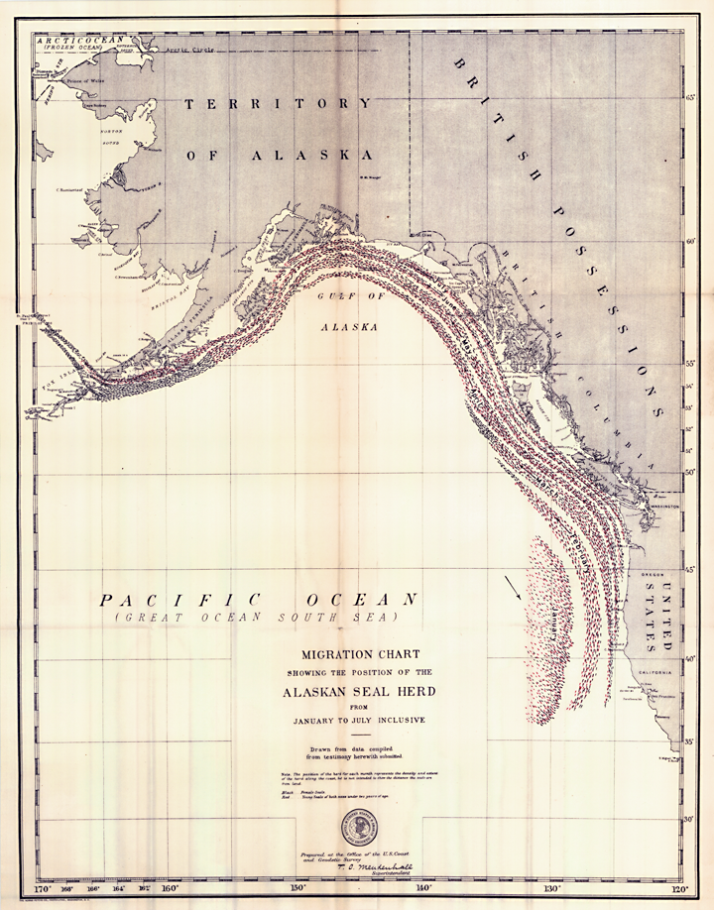
Traditional knowledge of migration from 1890s
  Fur seals use Unimak pass because it has weaker currents
  Most adult females, juveniles, and pups migrate to waters south of the Aleutian Islands or near western North America
  Adult males remain in Alaska waters during the winter
  Weather plays a strong part in fur seal migration; seals dislike traveling against the seas and wind
Lesson 5: Where do fur seals go in the winter?
Notes:
In the 1890s, Unangam hunters and northwest tribal hunters were interviewed to document their knowledge of the migration routes of northern fur seals. Several patterns emerged from these interviews that have been confirmed by current scientific research.
The term “Alaska waters” in the interviews may simply mean waters that are not coastal to North America.
Sterling AFSC Quarterly Report, July 2011 (http://www.afsc.noaa.gov/Quarterly/jas2011/divrptsNMML1.htm)
Map: Henry Wood Elliott, 1884

Slide 10
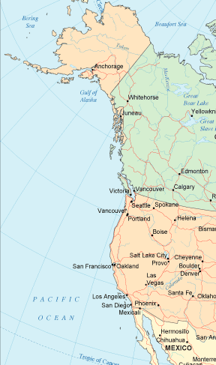
Archaeological evidence
of migration
Northern fur seal bones found in middens on the coast of Washington and California
Evidence that fur seal was a major component of Northwest Coast Indian diet
Pribilofs
Washington
California
Lesson 5: Where do fur seals go in the winter?
Notes:
Northern fur seal remains have been found in Native American settlements in Washington and California, indicating there has been a reliance on northern fur seals by native people over a wider geographic area than the Aleutian Islands, where Unangan have been hunting fur seals for thousands of years.
Northern fur seal bones were found in middens from the Makah village of Ozette on the coast of Washington when the village was excavated in the 1970s.
A midden is a mound or deposit containing shells, animals bones and other trash that indicate the presence of humans.
Northern fur seal bones have also been found on the Farallon Islands off the California coast.
Many First Nations Tribes of Canada hunted fur seals during the seals’ winter migration off the coast of North America.
Source http://www.washington.edu/news/archive/2044
Michael Etnier, PhD Thesis
http://www.calacademy.org/science_now/archive/academy_research/doug_long.php

Slide 11
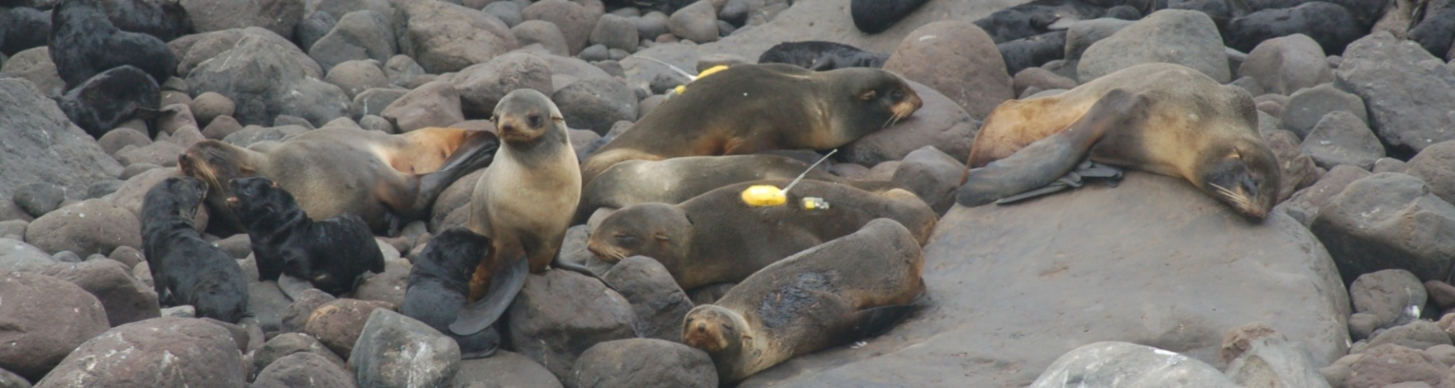
Scientific knowledge of migration
Radio tags tracked fur seals from St. Paul
through Unimak Pass
Satellite tags tracked fur seals south to California and west to Russia
Recent science confirmed what Unangam hunters knew for hundreds of years
Lesson 5: Where do fur seals go in the winter?
Notes:
Current scientific research has confirmed much of the information documented in the 1890s from Unangam hunters.
For many years, the information gathered from Unangam hunters was ignored. Current satellite data has confirmed the Unangam traditional knowledge. Today scientists often work closely with native communities to gather information about traditionally hunted animals.
Photo: NOAA/AFSC/NMML

Slide 12
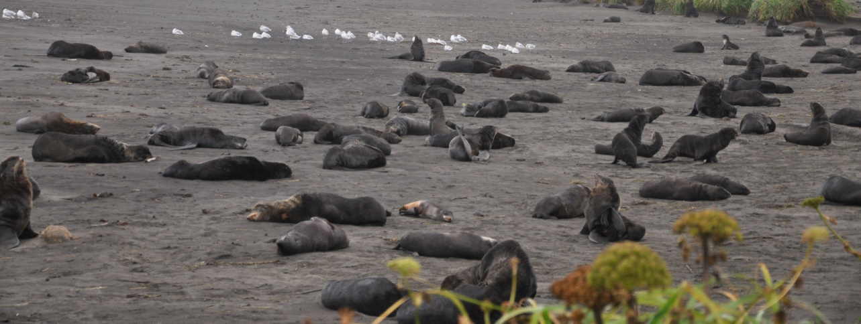
Summary
Fur seals migrate to find food
They migrate as far south as California
and as far west as Russia
Age and sex determine where and
how long a fur seal migrates
Lesson 5: Where do fur seals go in the winter?
Notes:
Photo: Pam Goddard: Thalassa; resting northern fur seals, St. Paul Island

