Slide 1
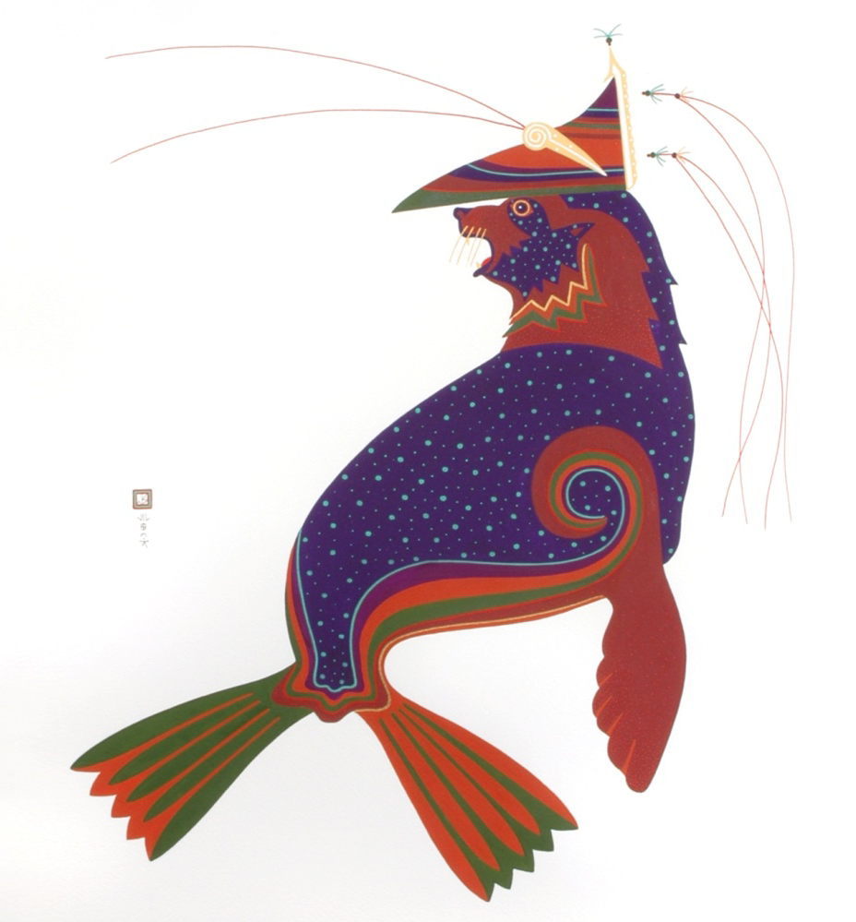
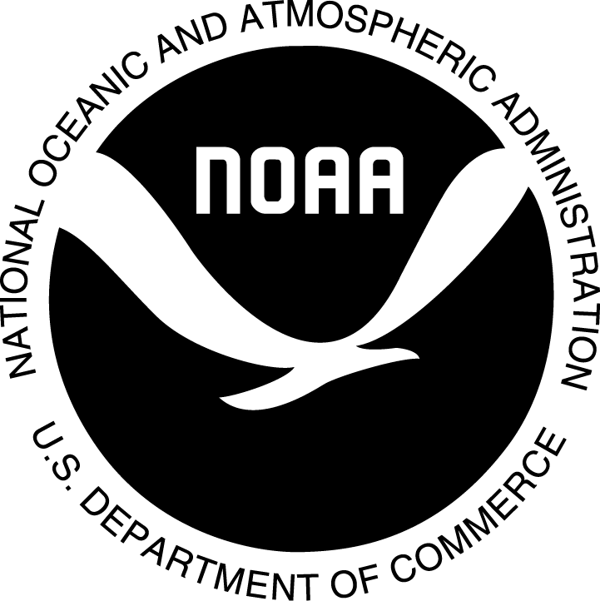
Laaquda{: The Northern Fur Seal
Lesson : 8
Marine Mammal Protection Act
© Thomas Stream Northern Fur Seal
Notes:
Lesson 8 gives a summary of the Marine Mammal Protection Act. Students will explore history leading up to the MMPA, an overview of the MMPA, and compare case studies of gray whales and northern fur seals.

Slide 2
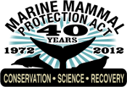
Topics
What was happening in the 1960s and 1970s?
  Environmental movement
  Legislative history
What is the Marine Mammal Protection Act?
MMPA case studies
  Gray whales
  Northern fur seals

Slide 3
Environmental Movement
1960s
1962 Silent Spring by Rachel Carson
  Highlighted dangers of chemicals in the environment, particularly DDT
Mid-1960s Canadian harp seal hunt
  Prompted public reaction against fur industry
1969 Cuyahoga River fire
  Photos raised awareness of industrial waste, pollution
Notes:
This slide lists just three of the many issues that started the environmental movement in the 1960s. Many historians believe that the publication of Silent Spring was the catalyst that started the movement.
Rachel Carson wrote Silent Spring based on 13 years of research on DDT, and came under attack from the chemical industry for her views. Pesident John F. Kennedy assigned the President’s Science Advisory Committee to investigate Carson’s claims, resulting in a report that agreed with Carson’s assessment and caused Americans to take a closer look at the environmental damage caused by DDT and other pesticides.
www.rachelcarson.org
- Awakened the American public to the dangers of chemicals in the environment, particularly DDT
The Canadian harp seal hunt became very controversial after images of white pups being clubbed were televised in the mid-1960s. Harp seal pups (age 10-14 days) were hunted for their white fur. Information about the harp seal hunt: http://www.dfo-mpo.gc.ca/fm-gp/seal-phoque/index-eng.htm
The images of the Cuyahoga River fire in Time Magazine in 1969 helped to inspire Congress to pass the National Environmental Protection Act in 1970. Time Magazine article and photos of Cleveland’s Cuyahoga River on fire brought the public’s attention to industrial waste and pollution.
http://www.ohiohistorycentral.org/entry.php?rec=1642

Slide 4
Environmental Movement
1970s
TV shows Flipper, Sea Hunt, and The Undersea World of Jacques Cousteau changed people’s view of marine mammals
President Richard Nixon signs the following acts
  National Environmental Protection Act (1970)
  Clean Water Act (1972)
  Coastal Zone Management Act (1972)
  Ocean Dumping Act (1972)
  Marine Mammal Protection Act (1972)
  Endangered Species Act (1973)
  Safe Drinking Water Act (1974)
Notes:
Too many significant environmental conservation events occurred in the 1970s to list on this slide. The 1970s produced environmental activism and legislation. Below are just a few more examples.
Anti-Fur movement begins
1970 first Earth Day
1970 Natural Resources Defense Council founded
1970 Environmental Protection Agency formed
1971 Greenpeace founded in Canada
The Daily Green
http://www.thedailygreen.com/environmental-news/latest/greenest-presidents-460808#ixzz2KM4oSOdD
Nixon’s Presidency: 1969-1974
The 1960s began the environmental movement in the United States.

Slide 5
Events leading up to the Marine Mammal Protection Act
Tuna-dolphin issue
  Thousands of dolphins killed in purse-seine nets targeting tuna
Canadian harp seal hunt
  Harp seal pups killed for their white fur
Continued commercial whaling despite declines in whale populations
Notes:
It is generally believed that the mortality of dolphins in the tuna purse-seine fishery, Canadian harp seal harvest, and International Whaling Commission’s inability to reduce commercial whaling led to the creation of the MMPA.
In the 1950s and 1960s, hundreds of thousands of dolphins were being killed in yellowfin tuna (Thunnus albacares) purse-seines, large nets that encircled pods of dolphins to catch the schools of tuna swimming underneath. As the nets were hauled in, the dolphins often became entangled in the netting and suffocated.
NOAA Southwest Fisheries Science Center website: http://swfsc.noaa.gov/textblock.aspx?Division=PRD&ParentMenuId=228&id=1408
The Canadian harp seal hunt became controversial after images of the hunt were shown on television in the mid-1960s. Pups with white coats, less than 14 days old, were the focus of the harp seal hunt.
http://www.cbc.ca/archives/entry/seal-hunt-barbaric-and-cruel
The International Whaling Commission (IWC) was founded in 1946 to provide for proper conservation of worldwide whale populations and to regulate whaling. Despite its mandate to regulate whaling and conserve populations, large whale populations continued to decline in the 1960s. The IWC did not restrict commercial whaling despite declining whale populations. World Wildlife Fund, formed in 1961, began “Save the Whales” campaigns around the world.
International Whaling Commission: http://iwc.int/iwcmain
World WildLife Fund: http://wwf.panda.org/what_we_do/endangered_species/cetaceans/cetaceans/iwc/history/

Slide 6
Marine Mammal Protection Act Summary
MMPA: Marine Mammal Protection Act of 1972
  Nation-wide program to conserve marine mammals
Makes it illegal to “harass, hunt, capture, or kill” any marine mammal within 200 miles of the US coast
  Specific exceptions (e.g., scientific research, incidental catch during fishing)
  Exemptions for “Indians, Aleut, and Eskimos (who dwell on the coast of the North Pacific Ocean)” for subsistence purposes
Notes:
The initial Marine Mammal Protection Act (MMPA) was passed by Congress in 1972 and signed by President Nixon based on findings that certain species and populations of marine mammals were or had the potential to be in danger of extinction or depletion as a result of man's activities.
The MMPA established a national policy to prevent marine mammal species and populations from declining beyond the point where they are a significant part of their ecosystems. It was the first legislation that protected all marine mammal species in their ecosystems and took an ecosystem-based approach to managing wild populations. The legislation addressed all populations, not just harvested populations.
For a list of Representative who voted for or against the MMPA go to Govtrack.us: http://www.govtrack.us/congress/votes/92-1972/h362

Slide 7
Subsistence Rights & MMPA
With respect to Indian treaty rights and Alaska Native subsistence, the MMPA states the following: (Sect. 14 of Public Law 103-238, the MMPA Amendments of 1994)
The MMPA, including any amendments—
Does not alter any treaty between the United States and one or more Indian tribes;
(2) Does not affect the provisions of section 101(b) of the Marine Mammal Protection Act of 1972, which says that Alaska Natives can hunt marine mammals for subsistence and can use marine mammal parts for articles of handicraft and clothing, and can sell edible parts in Alaska Native communities, provided that the marine mammal is not used in a wasteful manner
Notes:
Public Law 103-238 is the “Marine Mammal Protection Act Amendments of 1994” and was passed to authorize funding for the Act, reduce the incidental catch of marine mammals in commercial fisheries, and provide grants to Alaska Native organizations to develop co-management structures for marine mammal populations taken for subsistence purposes. https://www.gpo.gov/fdsys/pkg/STATUTE-108/pdf/STATUTE-108-Pg532.pdf
Original text of MMPA Amendments of 1994:
Indian Treaty Rights and Alaska Native Subsistence:
“Nothing in this Act including any amendments to the Marine Mammal Protection Act of 1972 made by this Act—
1. alters or is intended to alter any treaty between the United States and one or more Indian tribes; or
2. affects or otherwise modifies the provisions of section 101(b) of the Marine Mammal Protection Act of 1972…”
In other words, the MMPA:
- Doesn’t alter any treaty between the US and a Native American tribe
Doesn’t affect section 101(b) – which says that the MMPA does not apply with respect to Alaska Native subsistence hunting of marine mammals, or the use of marine mammal parts for Alaska Native articles of handicraft and clothing (e.g. weaving, carving, stitching, etc.) and that edible portion of marine mammals can be sold within Alaska Native communities for Native consumption, provided that the marine mammal is not used in a wasteful manner.
The legal language is in the slide – class can discuss why the language has to be so formal for legal documents, and can look up section 101(b) of the MMPA of 1972 (listed in Appendix X, page 101, about halfway down the page, starting with the text “The provisions of this Act shall not apply with respect to the taking of any marine mammal by any Indian, Aleut, or Eskimo who dwells on the coast of the North Pacific Ocean or the Arctic Ocean…”).

Slide 8
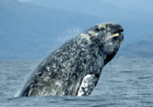
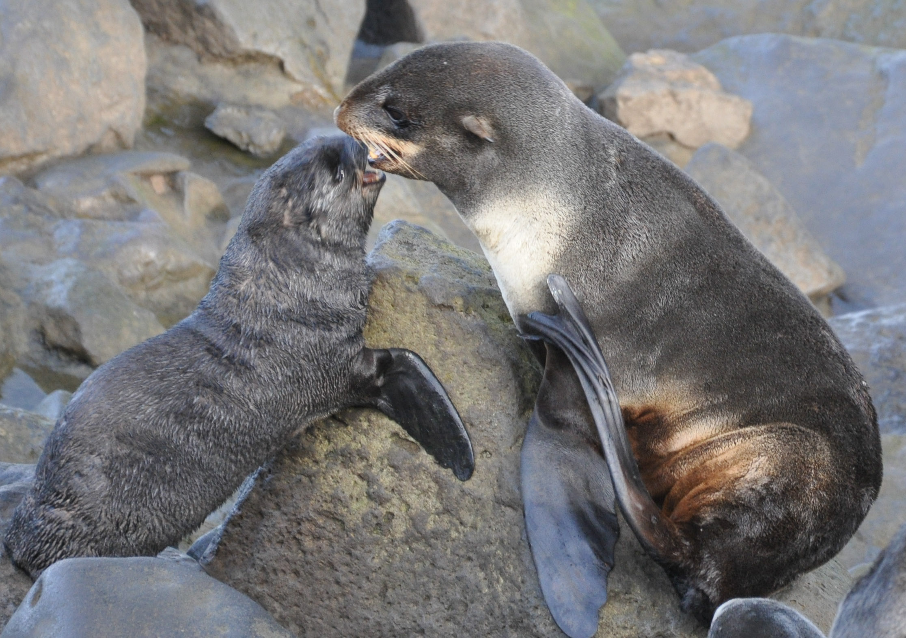
MMPA Case Studies
Makah Nation and gray whales
  Washington
Unangam communities of St. Paul Island and St. George Island (Pribilof Islanders) and northern fur seals
  Alaska
Photo: Merrill Gosho, NOAA
Photo: Lisa Hiruki-Raring, NOAA
7
Notes:
7
We will consider two case studies with respect to the Marine Mammal Protection Act –
Makah Nation and gray whales in Washington state
Unangam communities of St. Paul Island and St. George Island in the Pribilof Islands and northern fur seals in Alaska
Labs 8.3 and 8.4 compare and contrast these cases.

Slide 9
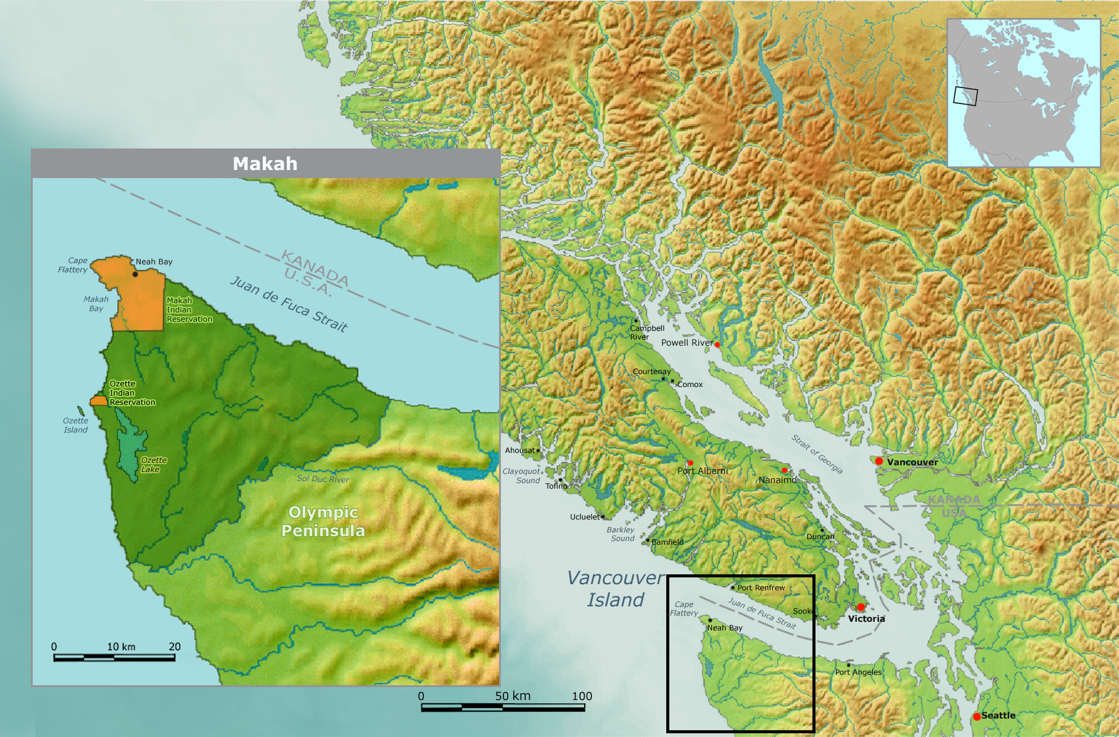
MMPA Case Study:
Makah and Gray Whales
Makah Nation – northwest Washington state
Whales and whaling are central to Makah culture
Makah tradition of hunting whales dates back over 2000 years
Map: Wikicommons, Nikater-Demis
8
Notes:
8
Background information –Makah Whaling and Whale hunt – Makah Tribe website
http://makah.com/makah-tribal-info/whaling/
“For the Makah Tribe, whale hunting provides a purpose and a discipline which benefits their entire community. It is so important to the Makah, that in 1855 when the Makah ceded thousands of acres of land to the government of the United States, they explicitly reserved their right to whale within the Treaty of Neah Bay.
Makah whaling tradition provides oil, meat, bone, sinew and gut for storage containers: useful products, though gained at a high cost in time and goods.
The relationship between Makah and whales is very old. Ozette deposits dating from 2,000 years ago hold humpback and gray whale bones and barbs from harpoons.”

Slide 10
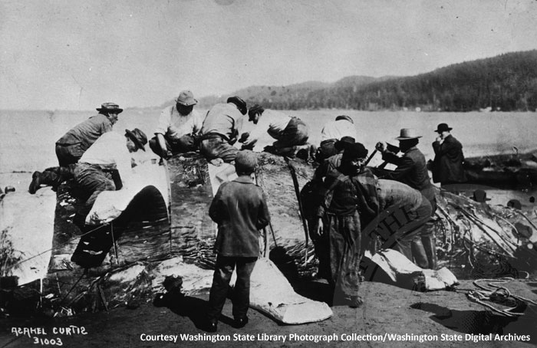
MMPA Case Study:
Makah and gray whales
Makah Treaty of 1855 states: “The right of taking fish and of whaling or sealing at usual and accustomed grounds and stations is further secured to said Indians…” It was the only treaty in the U.S. to protect whaling.
Gray whale population declined through the 1800s due to commercial whaling
1920s - Makah voluntarily stopped hunting gray whales
9
Notes:
9
“The only treaty in the United States that protects whaling was secured with Makah Indians in 1855.”
“On the beaches of Neah Bay ca. 1910, Makah capture a giant of the sea. The prized gray whale symbolizes the heart of Makah culture and a long history. In 1970, archeologists began an 11-year dig at the tribe’s ancient whaling village of Ozette. They uncovered 56,000 artifacts, including hunting equipment and whale bones dating back 2,000 years.”
https://www.sos.wa.gov/_assets/legacy/ExhibitPanelOutlineforMuseums.pdf
NOAA West Coast Regional Office Chronology of Makah Tribal Gray Whale Hunt webpage - http://www.westcoast.fisheries.noaa.gov/protected_species/marine_mammals/cetaceans/chronology.html
“Ozette had been occupied by the Makah, probably continuously for at least two thousand years, until the 1920s. Makah oral history recalls centuries of a rich whale-hunting culture centered at the village. They had no choice but to abandon their ancient home when the federal government insisted that children at the site must enroll in school.”
https://magazine.wsu.edu/2015/11/06/ozette-excavating-a-makah-whaling-village/

Slide 11
MMPA Case Study:
Makah and gray whales
Gray whales
  Listed as endangered in 1970
  Population recovered in the 1980s-90s
  Removed from the Endangered Species List in 1994
1995 - Makah sought permission to resume treaty rights to hunt gray whales
1997 - NOAA reviewed data, found the gray whale hunt would not significantly impact the population
1997 - IWC set a catch limit of 20 gray whales over 5 years for the Makah
10
Notes:
10
NOAA = National Oceanic and Atmospheric Administration; NOAA Fisheries = National Marine Fisheries Service (the agency within NOAA who reviewed data)
IWC = International Whaling Commission

Slide 12
MMPA Case Study:
Makah and gray whales
1998 - District court: Makah can resume whaling
1999 - Makah hunted, struck, and landed their first gray whale in over 70 years
Animal rights organizations strongly opposed the Makah hunt, filed a suit in court to stop it
2000 - Ninth Circuit Court of Appeals reverses 1998 court decision; halts whaling until NOAA Fisheries can do an Environmental Assessment (EA) under the National Environmental Protection Act (NEPA)
11
Notes:
11
In 2000, the Ninth Circuit Court of Appeals ruled that NOAA fisheries failed to take a “hard look” under the National Environmental Protection Act at the proposed whaling.

Slide 13
MMPA Case Study:
Makah and gray whales
2001 - NOAA Fisheries completes EA
2002 - District Court: summary judgment in favor of Makah
2002 Ninth Circuit Court of Appeals overturned District Court ruling:
  Makah must comply with process prescribed in MMPA for authorizing a take of marine mammals otherwise prohibited by a moratorium
  NOAA must complete an Environmental Impact Statement (EIS) under National Environmental Protection Act
12
Notes:
12
EA – Environmental Assessment
16 U.S. Code 1371 – Moratorium on taking and importing marine mammals and marine mammal products https://www.law.cornell.edu/uscode/text/16/1371
What is an EIS?
https://www.epa.gov/nepa/national-environmental-policy-act-review-process

Slide 14
MMPA Case Study:
Makah and gray whales
2005 – Makah requests a waiver of the MMPA’s take moratorium
2005 – NOAA Fisheries begins preparation of an Environmental Impact Statement (EIS) with public meetings
2008 – NOAA Fisheries terminates their 2005 draft EIS and begins a new draft EIS in light of new information on gray whale population
2015 – NOAA Fisheries releases a new draft EIS
13
Notes:
13
NOAA 2005 Draft EIS for Makah gray whale harvest
http://www.westcoast.fisheries.noaa.gov/protected_species/marine_mammals/cetaceans/whale_hunt.html
One event that is not covered on this timeline:
Sept. 8, 2007: Five members of the Makah Tribe hunt and kill a gray whale in the Strait of Juan de Fuca in a hunt that was not authorized by the tribe or NOAA. This unauthorized hunt did not comply with numerous provisions and restrictions defined in the tribe's application, and both the tribe and NOAA make statements condemning the unlawful hunt.
October & November 2007: The five tribal members involved in the September 2007 killing of a gray whale are indicted in federal court on Oct. 5, 2007, for unauthorized whaling, unauthorized take of a marine mammal, and conspiracy to engage in unlawful whaling. On Nov. 16, 2007, the five are charged in tribal court for violating the tribe's gray whale management plan, violating state and federal laws, and reckless endangerment.
March & April 2008: Three of the tribal members enter guilty pleas on March 27, 2008, to unlawful taking of a marine mammal in violation of the MMPA. On April 7, 2008, after a bench trial on stipulated facts, the court finds the remaining two tribal members guilty of conspiracy and unlawful taking of a marine mammal in violation of the MMPA.

Slide 15
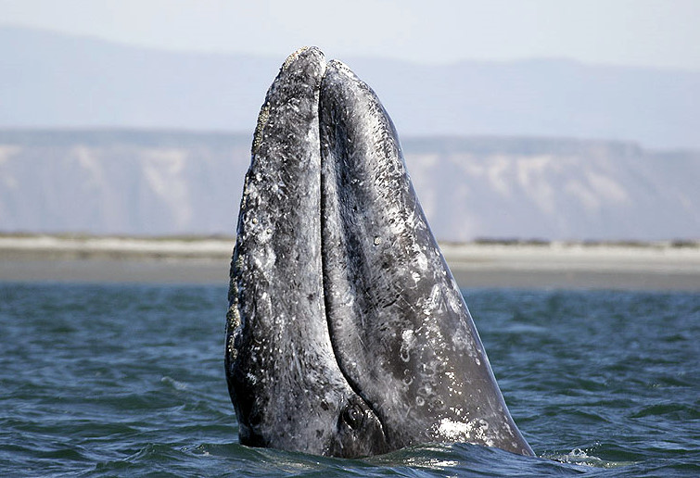
MMPA Case Study:
Makah and gray whales
What do you think are the issues?
What are the perspectives of the different groups involved?
  Makah
  U.S. Government (NOAA)
  U.S. Government (Courts)
  Animal rights groups
  Others?
What are possible courses of action?
Photo: Chris Johnson, NOAA
14
Notes:
14
NOAA – National Oceanic and Atmospheric Administration
Image Source: Photo: Chris Johnson, NOAA, Southwest Fisheries Science Center
http://www.westcoast.fisheries.noaa.gov/stories/2016/17_02182016_gray_whale_migration.html

Slide 16
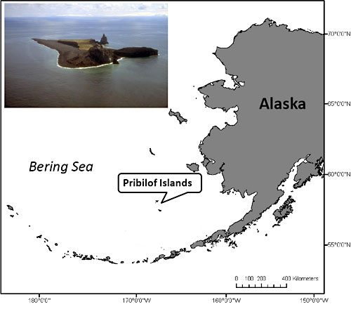
MMPA Case Study: Pribilof Islanders and Northern fur seals
Pribilof Islands – in the central Bering Sea, Alaska
Unangan have hunted northern fur seals and other marine mammals in the Aleutian Islands for thousands of years
Russian fur traders forcibly relocated Unangan in mid-1700s to the Pribilof Islands to harvest fur seals on land
15
Notes:
15
Background information - For over two-hundred years the Unangan of the Pribilof Islands were forced to harvest northern fur seals first for the Russian fur trading companies and then for the private U.S. companies and finally for the U.S. Government. During this time northern fur seal became a staple in the Unangam diet. Life on the Pribilofs was fur seal centric. Both the economy and the diet were dependent upon the harvest of fur seals.
Map: NOAA/AFSC/MML

Slide 17
MMPA Case Study: Pribilof Islanders and Northern fur seals
Land-based subsistence harvests by the Unangan on the Pribilof Islands provided food necessary for survival through the Bering Sea winters
Late 1800s - Numbers of fur seals declined dramatically due to pelagic sealing after the U.S. purchased Alaska from Russia
1891 - Unangan voluntarily ended pup harvests on the Pribilof Islands to help recover the fur seal herd
Notes:
Unangan harvested northern fur seals at sea for thousands of years as they migrated through the Aleutian Islands. This harvest included fur seal juveniles and pups, whose bones were found in middens.
Subsistence harvests on the Pribilof Island took place on land during the summer and fall. Subsistence harvests provided the main staple for survival since the Russians forced the first Unangam harvesters to live on the Islands in 1767.
The summer subsistence harvest consisted of young male fur seals killed during the commercial fur harvest. Of the thousands of fur seals killed, only a fraction were kept for food consumption.
In October and November, just before the pups began their winter migration, a pup-only harvest occurred. The fall pup harvest provided an important staple of the Unangam winter diet on the Pribilof Islands.
After the U.S. purchased Alaska from Russia, pelagic sealing increased dramatically, resulting in steep declines in numbers of fur seals, since seals taken in pelagic sealing were primarily females and resulted in a loss of the breeding stock of the population. Pelagic sealing was also very inefficient in that only one seal was recovered for every three shot (see Lesson 7).
Residents of both Islands agreed to forego the pup harvests in 1891 if it would aid the government to protect the fur seal herds. Although they agreed to the conservation method, they felt it was extremely harsh. Islanders depended on the fall pup harvest to stock their cupboards for the winter.

Slide 18
MMPA Case Study: Pribilof Islands and Northern fur seals
Fur Seal Treaty of 1911 ends pelagic sealing and fur seal population begins to recover
Treasury Agents permanently end the pup harvest despite the fact that the stock is recovering
Fur Seal Act of 1966 grants “Indians, Aleuts, and Eskimos, who dwell on the coast of the North Pacific Ocean” the right to take fur seals and dispose of their skins
Notes:
Even though the fur seal stocks recovered after the end of pelagic sealing and the Fur Seal Treaty of 1911, Treasury Agents permanently terminated the pup harvest.
Source: Williams, Michael and Juan Leon Guerrero, 2010. History of Northern Fur Seal Subsistence Harvests on the Pribilof Islands.

Slide 19
MMPA Case Study: Pribilof Islands and Northern fur seals
After the commercial harvests ended in 1973 and 1984, Pribilof Islanders were allowed to continue a subsistence harvest under an emergency rule of the 1966 Fur Seal Act
1988 Pribilof Island fur seals listed as depleted under the MMPA giving NOAA the authority to regulate the harvest
Pribilof Islanders and NOAA enter into a co-management agreement for the harvest

Slide 20
MMPA Case Study: Pribilof Islands and Northern fur seals
The Unangam communities of St. George (2006) and St. Paul (2007) submit a petition to NOAA asking to revise the regulations and allow a fall fur seal pups harvest
2014 – NMFS created a second harvest season on St. George Island (from September 16-November 30), authorizing the harvest of up to 150 male pups
St. Paul petition still being negotiated
Notes:
St. Paul’s petition asks for up to 1,500 male young of the year (<1 year) fur seals.
Source: NOAA Fisheries, Alaska Regional Office, https://alaskafisheries.noaa.gov/pr/fur-seal

Slide 21
MMPA Case Study: Pribilof Islanders and Fur Seals
What do you think are the issues?
What are the perspectives of the different groups involved?
  Pribilof Islanders
  U.S. Government (NOAA)
  Animal rights groups
  Others?
What are possible courses of action?
20
Notes:
20

Slide 22
Summary
MMPA created to protect marine mammal stocks in US waters
Created an ecosystem approach to managing populations
Created permitting process for exceptions
Many stocks such as the gray whale have recovered under the MMPA
Northern fur seal population is still declining
Not all decisions are made based on biological data
Killing marine mammals is a very emotional issue
21
Notes:
21

