Slide 1
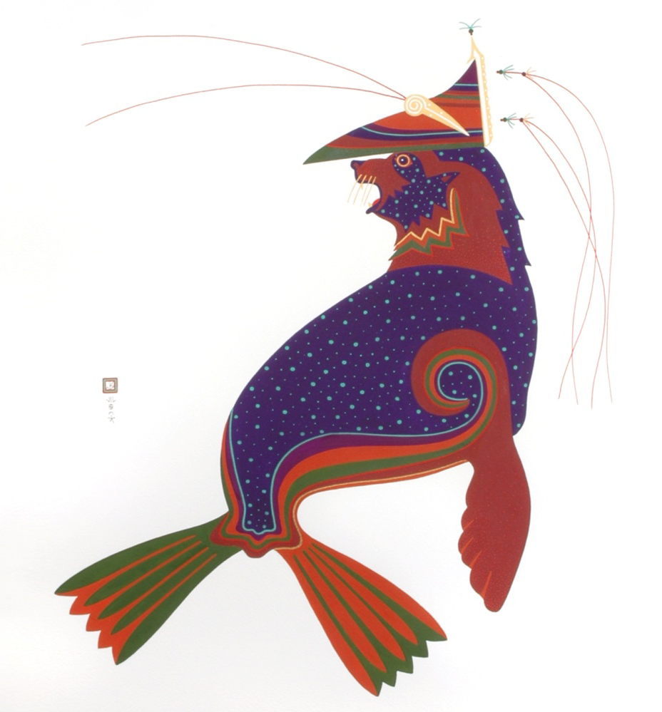

Laaquda{: The Northern Fur Seal
Lesson 5:
How do fur seals dive?
© Thomas Stream Northern Fur Seal
Notes:
Lesson 5 contains a brief overview of how seals are adapted to the water and how they are adapted to dive, how deep they dive, and what we can learn from the information.

Slide 2
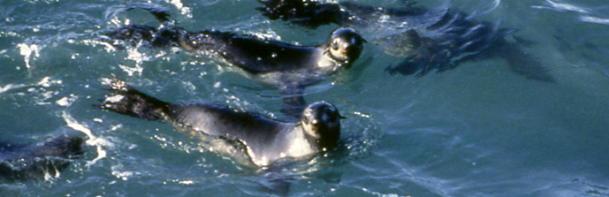
What will you learn?
Why do fur seals dive?
How are fur seals adapted to the water?
How do fur seals dive?
When and how deep do fur seals dive?
What can we learn from diving behavior?
Notes:
Photo: NOAA/AFSC/MML, Observer Training PowerPoint

Slide 3
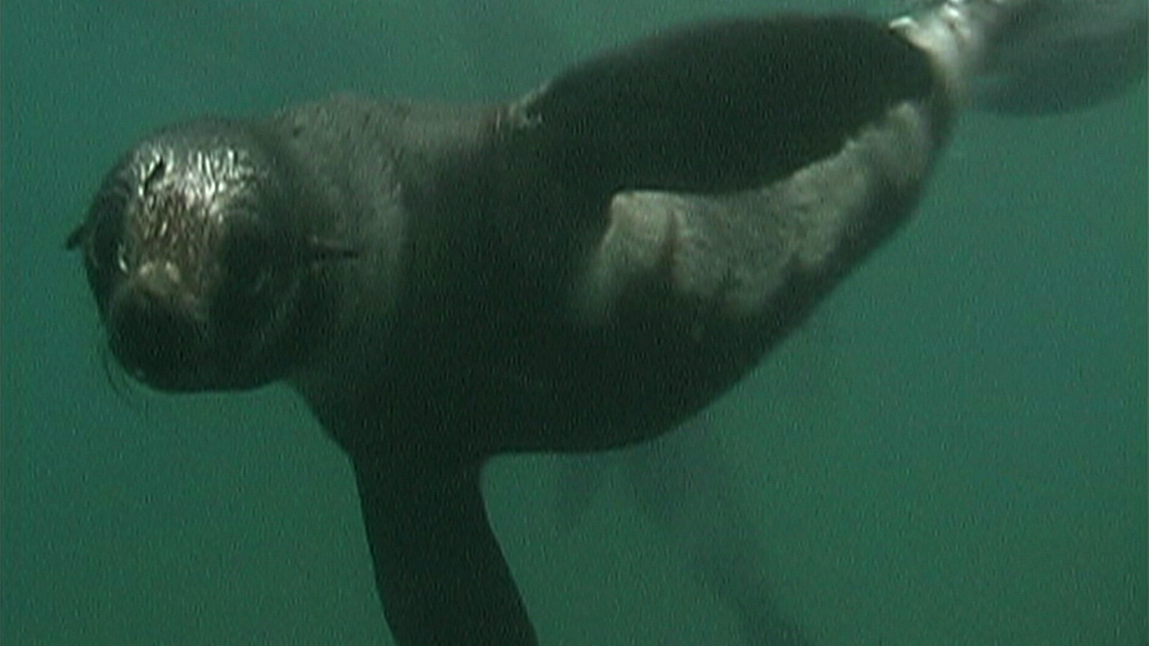
Why do fur seals dive?
Search for food (forage)
Traveling and migrating
Notes:
Fur seals dive primarily to search for food, and while traveling.
Photo: Paul Hillman, NOAA Ocean Media Center

Slide 4
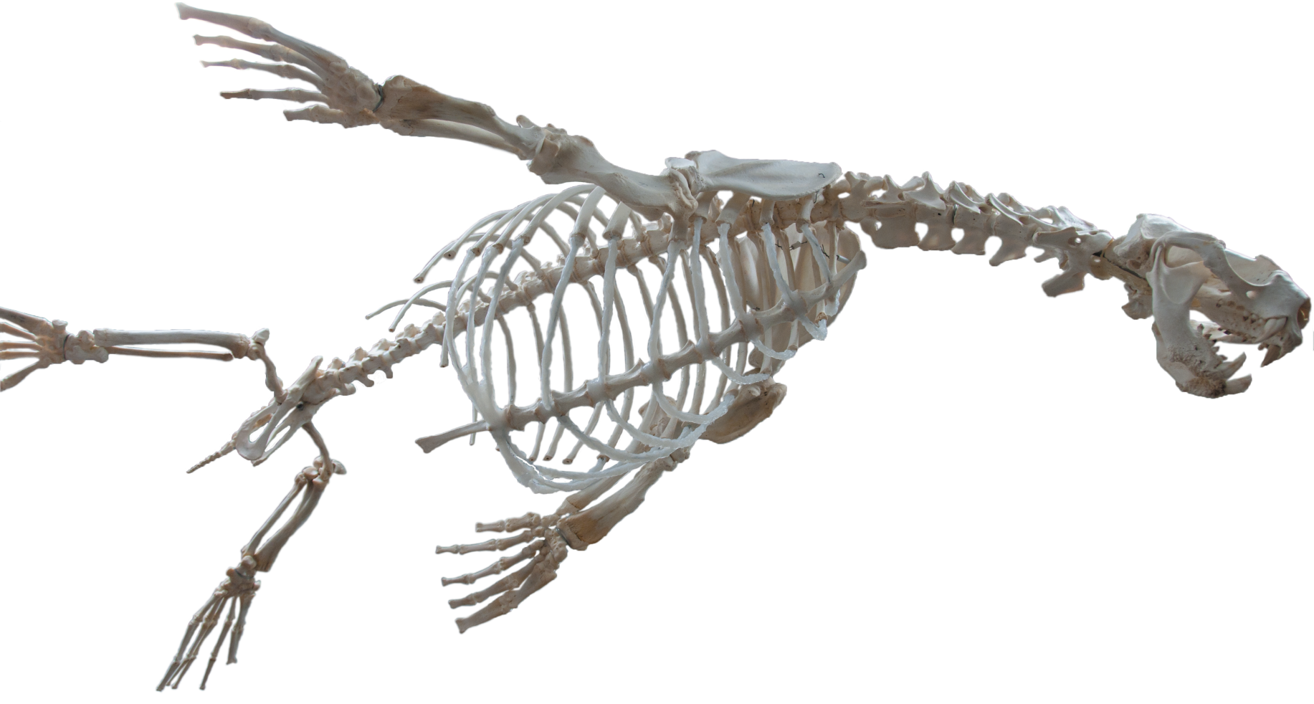
How are fur seals adapted to the water?
Body Shape
  Streamlined shape
  Flippers – used to swim efficiently
  Flexibility – seals have no collarbone
3
Notes:
3
Pinnipeds spend over half their lives in the water, so their bodies are adapted to the water in many ways. The next several slides give an overview of some of the major adaptations to the water: body shape, ability to stay warm in water and cool on land, ability to see and hear underwater.
Pinnipeds have a streamlined body shape with relatively short, wide flippers (compared to the legs of a terrestrial animal like a horse). The body is also very flexible.
Because of the sleek, streamlined body, seals can move swiftly through the water with little drag. The ears and tail are small so that they don’t cause resistance in the water.
Flippers help efficiently propel the body through water, which is denser than air (and therefore requires more effort to move through).
Because the seal’s body is extremely flexible, it can maneuver easily when swimming underwater. This flexibility also helps seals be effective underwater predators.
Source: Riedman, M. 1990. The Pinnipeds.
Photo by: Lisa Hiruki-Raring, NOAA/AFSC (edited by Rebecca White NOAA/AFSC)

Slide 5
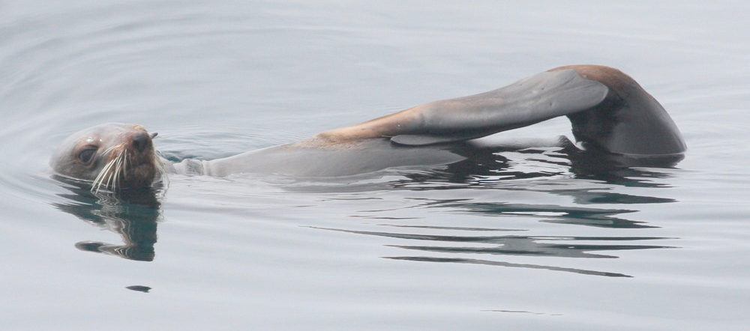
How are fur seals adapted to the water?
Physiology – how the body stays warm
in the water
  Body shape: compact body, short limbs; retain body heat
  Insulation: blubber under skin, dense fur that traps air
  Behavior: holding flippers out of the water to conserve heat (jughandling)
4
Notes:
4
Ocean water is cold – the body loses heat 25 times faster in water than it does in air. Pinnipeds must keep their body temperature close to 100 degrees F (38 degrees C) in ocean water that may be only 30-40 degrees F (0-5 degrees C).
To allow pinnipeds to regulate their temperature in water and to conserve heat, they have the following adaptations:
Compact body and short limbs – body size is also relatively large (there are no seals as small as a mouse), as large bodied mammals chill less quickly than small ones. Less heat is lost from a compact body with short limbs.
Blubber and dense fur – minimizes heat loss in the water. Fat insulates animals from cold and stores energy for when seals fast. Fur seals have two layers of fur: flattened protective outer guard hairs and thick, fine underfur to protect against cold. The underfur traps air, which insulates the body from cold.
Behavior – fur seals hold their flippers out of the water (called “jughandling”) to conserve heat in the cold water. Seals also have a network of small blood vessels in their flippers that allow heat to be kept close to the core of the body.
Source: Riedman, M. 1990. The Pinnipeds.
Photo : NOAA/AFSC/MML Observer training PowerPoint
Photo: Robert Pitman, Protected Resource Division/NOAA/SWFSC

Slide 6
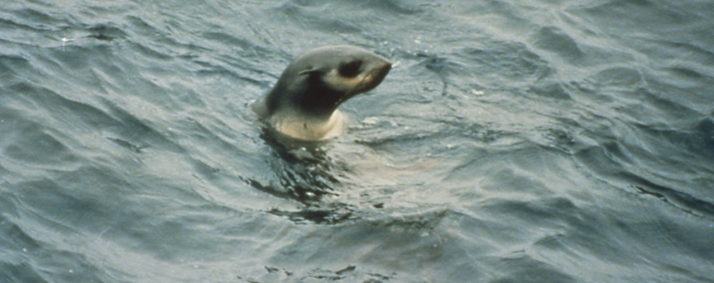
How do fur seals see and hear underwater?
Senses
  Eyes are large – adapted to see in low light underwater as well as in air
  Ears can detect direction of sound underwater
  Whiskers can detect vibrations from prey
5
Notes:
5
Seals can see well both underwater and in air. Their eyes are large in relation to their body size and are adapted to seeing in low light levels.
Seals have good underwater hearing. They can tell which direction a sound is coming from, the same way that people do.
Long, sensitive whiskers appear to help pinnipeds “feel” vibrations of prey in the water, especially when visibility is poor. Whiskers may also help seals navigate underwater.
Source: Riedman, M. 1990. The Pinnipeds.
Photo: NOAA/AFSC/MML Observer training PowerPoint

Slide 7
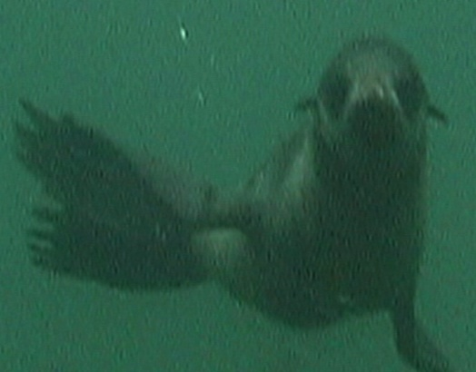
How do fur seals dive?
Seals exhale and hold their breath during dives
Nostrils automatically close
Heartbeat slows
Eyes stay open
Ears close
Picture of seal
in water
6
Notes:
6
Air-breathing mammals like pinnipeds must be able to take in enough oxygen while they dive for food. Most eared seals dive to relatively shallow depths of 150-200 meters (compared with 1000-1200 meters for other seals and cetaceans). Seals have to adapt to the pressure of deep dives (as depth increases, the water pressure increases) and conserve oxygen while diving.
A seal exhales at the beginning of a dive and hold its breath during a dive. That way, its lungs are only partially filled with air, and it can dive more easily. A seal also does not have many air spaces in its body, and its ribs are flexible and can flatten the lungs during a dive.
The seal’s nostrils automatically close.
The seal’s blood circulation becomes restricted to only essential organs and tissues: the brain, the heart, and a few other vital organs, and the heartbeat slows down.
The seal’s muscles have a large amount of myoglobin, a substance that stores oxygen.
The seal’s eyes stay open so that it can see prey underwater.
Ears close during a dive.
Source: Riedman, M. 1990. The Pinnipeds.
Photo: Paul Hillman, NOAA Ocean Media Center

Slide 8
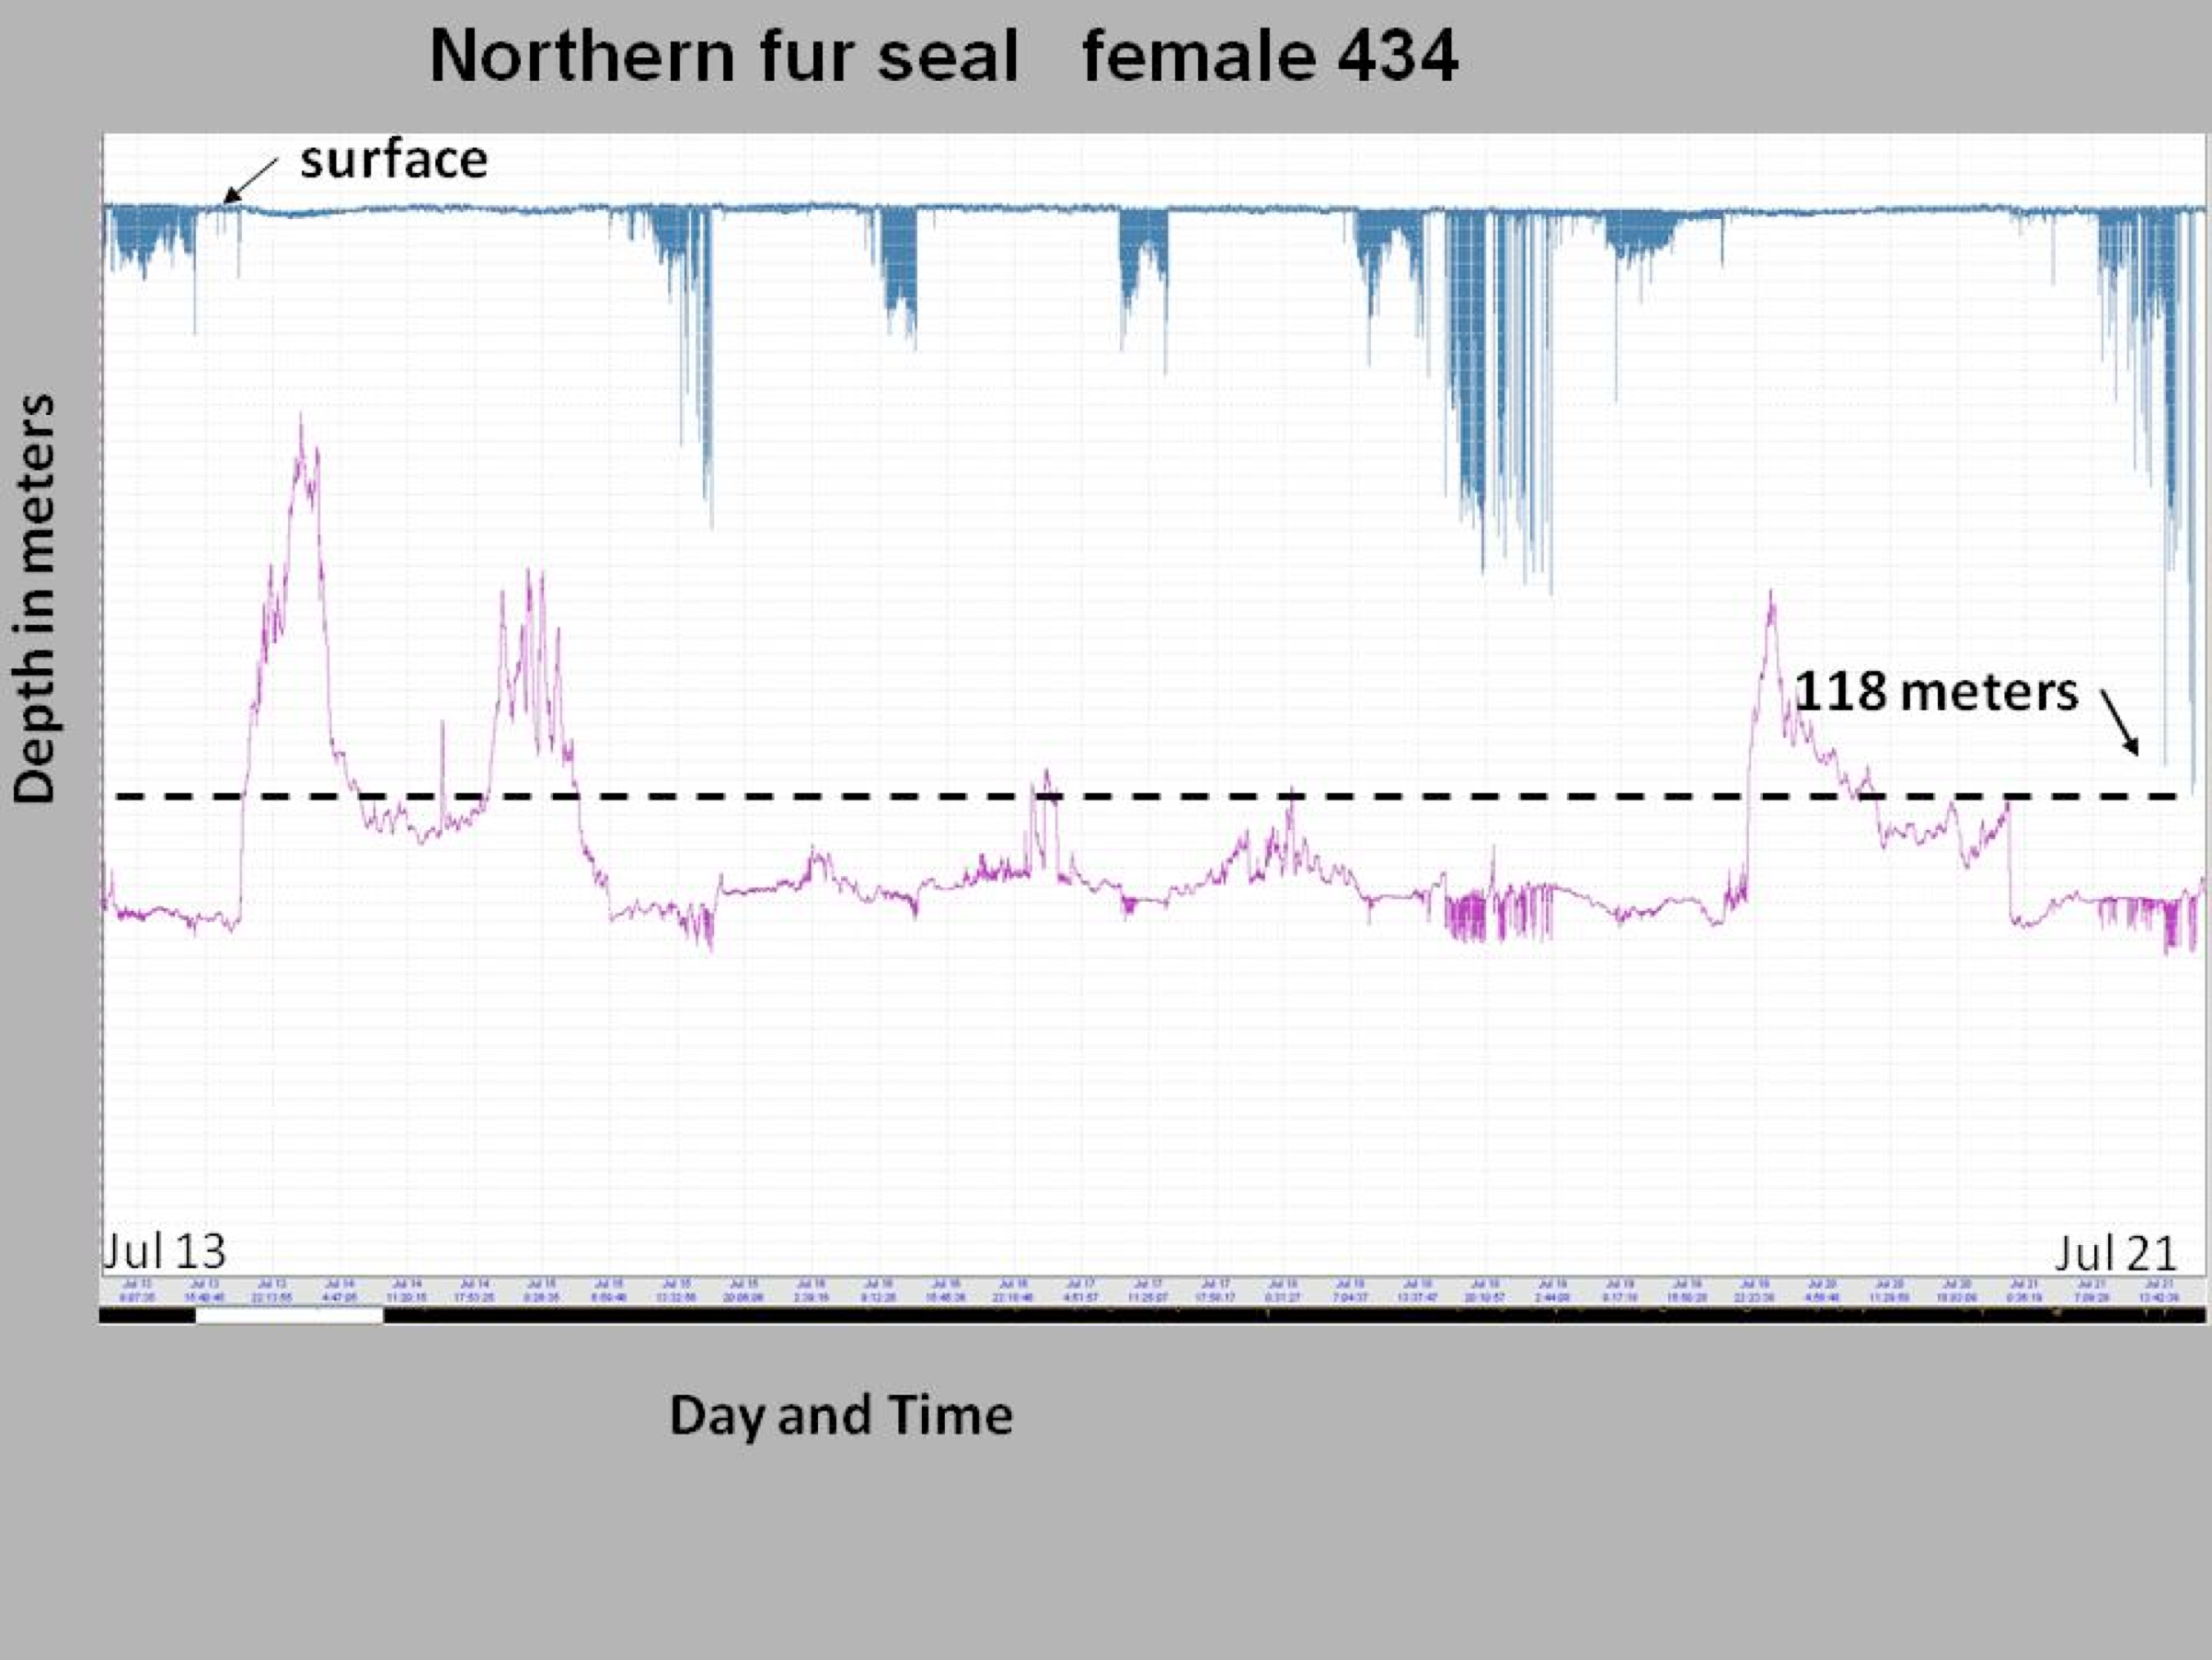
When and how deep do fur seals dive?
Fur seals dive to 150-200 m (492-656 ft)
Average dives are 2.2 minutes
Longest dive is 7.6 minutes
At night most fur seals dive to shallow depths
Dive information
Image of dive record
118 meters
Notes:
Fur seals dive to different depths depending on their prey.
This graph shows dive data from a recorder placed on a female northern fur seal. The x-axis along the bottom is date and time. The y-axis is depth in meters with the surface (0 meters) at the top. The data show that this fur seal dove mostly at night.
Source: Gentry, R. 1998. Behavior and ecology of the northern fur seal.

Slide 9
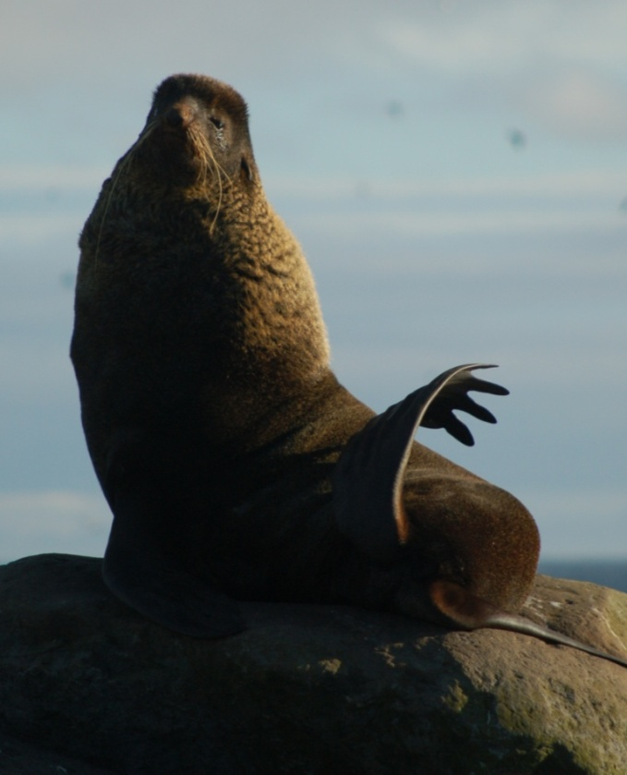
How do fur seals stay cool on land?
  Seals are adapted to stay warm in the water.
  On land they need to cool themselves.
  Pant to cool
  Flippers have no insulating fur
  Hind flippers are very long –
  more surface area to lose heat
  Hind flippers are held up in the air
  and waved
  Flippers are waved to cool the
  blood, not to fan the body
8
Notes:
8
On land, pinnipeds have the problem of keeping cool, while still having all the adaptations that allowed them to stay warm in the water.
Fur seals cool off in several ways:
Panting - Most mammals have sweat glands which allow them to cool the body by evaporation of sweat. Panting is a form of sweating. The tongue is cooled as water evaporates off the surface. Northern fur seals are the only marine mammal that pants.
Flippers – the hindflippers are very long, and both hind flippers and foreflippers do not have fur. A fine network of blood vessels in the flippers allows for exchange of heat; when the seal is in cold water, heat in the blood can be kept near the core of the body, but when the seal is hot, the warmth in the blood goes out to the flippers and can be released to the environment when the seal waves its flipper in the air. When the seal waves its flipper, the blood is cooled and heat is released from the body. The cooled blood then goes back into the body from the flipper.
Source: Riedman, M. 1990. The Pinnipeds., p. 19 (panting), 20 (flippers)
Photo: Rolf Ream NOAA/AFSC/MML

Slide 10
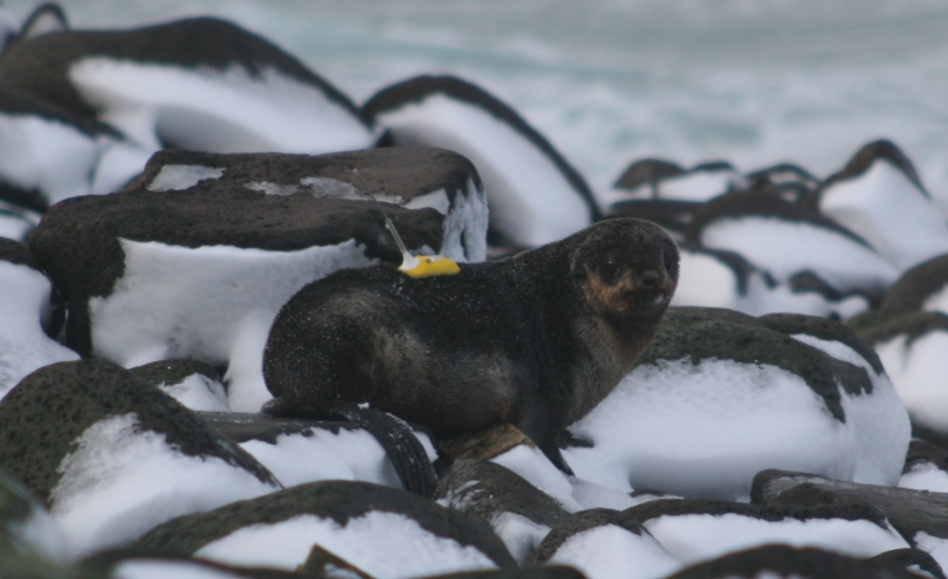
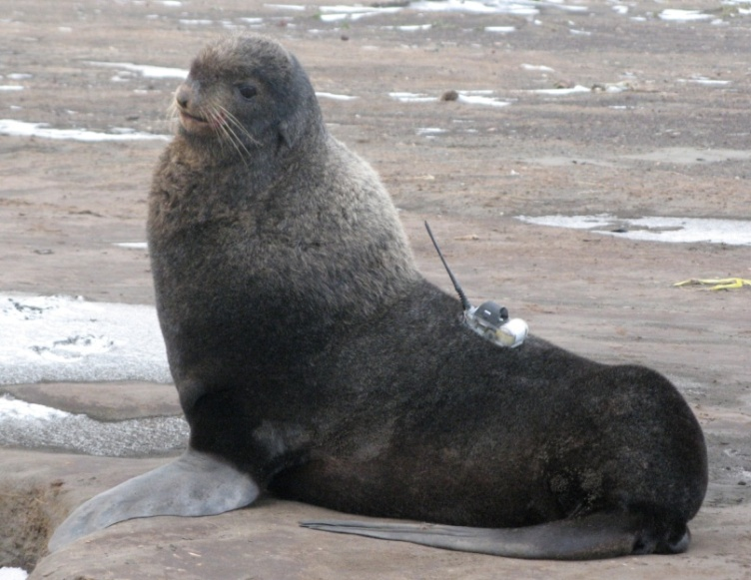
What can we learn from diving?
When, where, how often, and how deep seals are diving
Competition with fisheries and risk of bycatch of seals in fisheries
9
Notes:
9
By attaching instruments to seals, scientists can find out location of dives (where seals are foraging, or where they travel), time of day (when seals are diving), frequency of diving (some seals dive more often at night than during the day), depth of dives (depth can give information on the prey targeted by seals).
From dive locations and depths, scientists and managers can see if seals are feeding in areas where fisheries are active.
Photos: adult male — Jeremy Sterling, NOAA/AFSC/MML;
pup – Jason Baker, NOAA/AFSC/MML

Slide 11
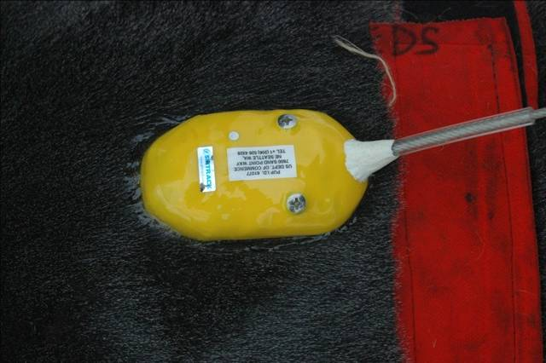
How do we know?
Instruments on seals
  Time-depth recorders (TDRs) give time and the depth of dives
    instrument must be retrieved
    less expensive but doesn’t collect location information
  Satellite-linked instruments transmit dive and location data
  via satellites to computers
    no instrument retrieval
    more expensive
  GPS tags record location
    Must be combined with TDR
  Cell phone tags
    Can be used in more populated areas (not the Bering Sea!)
10
Notes:
10
Things to think about when putting an instrument on an animal:
Size of instrument compared to the size of the animal (scientists couldn’t tag pups until the tags were small enough that they wouldn’t affect the pup’s ability to swim). If the tag is too big, the animal’s ability to move around (swim, walk) is affected.
Attachment method. The first instruments were attached by harnesses on the animals, which were bulky and caused a lot of drag in the water. Currently, instruments are attached with glue to the fur of the seal.
Image by Rolf Ream, NOAA/AFSC/MML

Slide 12
Summary
Fur seals dive to eat
Fur seals can see and hear underwater
Their bodies are adapted to being in cold water
The average dive is 2.2 minutes
11
Notes:
11

