Slide 1
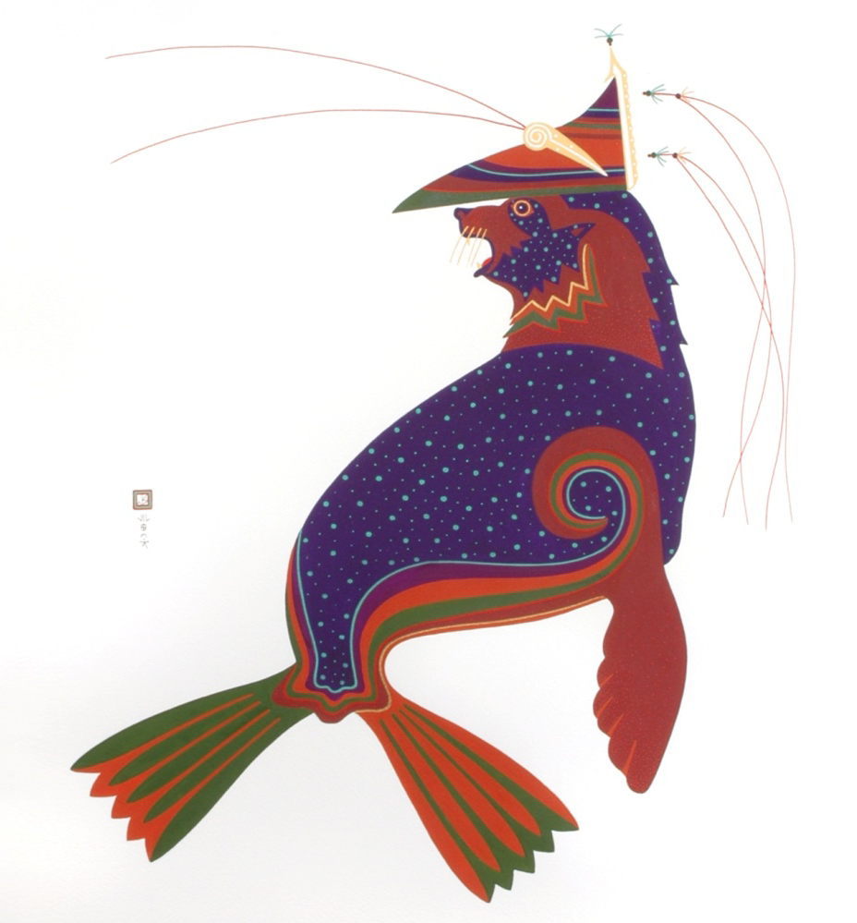

Laaquda{: The Northern Fur Seal
Lesson 2:
Who are the Unangan?
© Thomas Stream Northern Fur Seal
Notes:
Lesson 2 gives brief background information on the Unangan, their relationship to the Pribilof Islands, and how fur seals and sea lions are part of their culture, both historically and present-day.

Slide 2
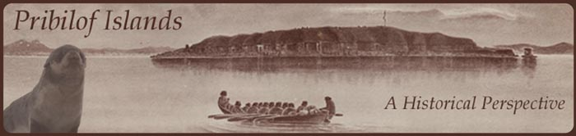
What will you learn?
Who are the Unangan?
Where do the Unangan live?
  How did the Unangan come to the Pribilof Islands?
How were marine mammals a part of their culture?
Notes:
Image from NOAA: Pribilof Islands Preserving the Legacy; NMML collection

Slide 3
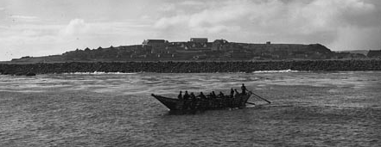
Who are the Unangan?
Unangan: “Islanders” or “People of the shore” who inhabit the Aleutian, Commander, and Pribilof Islands
  Historically called Aleut by Russians and Americans
Notes:
The Unangan traveled to the Aleutian Islands from Asia, across the Bering Land Bridge. The term “Aleut” was first used by the Russians, but they also used the term “Aleut” to refer to other, non-Unangan people (Koniag Eskimos from Kodiak Island and other southern Eskimos, who had a different culture and language).
The Unangan lived in the Aleutian Islands for thousands of years, had a rich material culture in which each Unangan owned many possessions, and a complex intellectual culture that included their own written language and a detailed knowledge of human anatomy. Unangan were skilled sailors and navigators, and traveled among the Aleutian Islands for hundreds of miles in their kayaks (ulluxtaq).
Source: Laughlin, W. 1980. Aleuts: Survivors of the Bering Land Bridge; Torrey, B. 1978. Slaves of the Harvest.
Photo from NOAA: Pribilof Islands Preserving the Legacy; NMML collection; Baidar near East Landing, St. Paul Island, Alaska

Slide 4
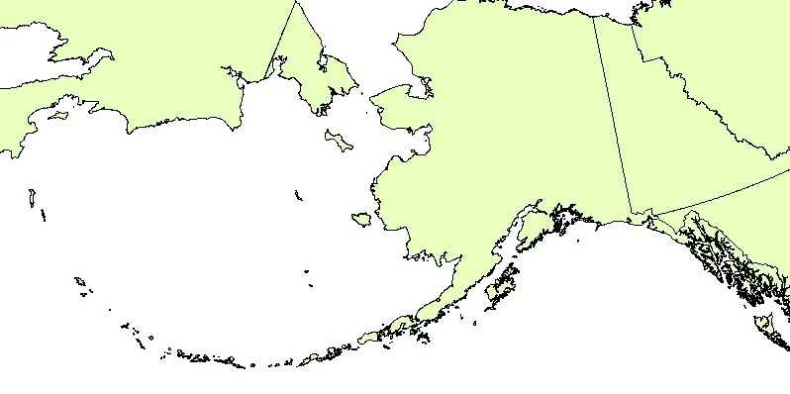
Where did
Unangan traditionally live?
  Aleutian and Commander Islands
  Beginning in the 1780s, Unangan lived on the Pribilof Islands
  Unangan called the Pribilof Islands Tana{-Ami{
RUSSIA
USA
CANADA
Alaska
Commander
Islands
Pribilof
Islands
Attu
Umnak
Unangan tanangin - Aleutian Islands
3
Notes:
3
The Unangan originally arrived in the Aleutian Islands on Umnak Island, then migrated in two groups: west towards Attu Island and east towards the Alaska Peninsula.
Archeological evidence indicates that the Unangan lived on the Aleutian Islands for at least 4,000 years. Disease and and outright slaughter by the Russians reduced the population of Unangan from 16,000 in 1740 to 4,000 in 1866.
Today Unangan live all over Alaska and the lower 48 states.
Source: Laughlin, W. 1980. Aleuts: Survivors of the Bering Land Bridge.
Source: Alaska Native Knowledge Network: http://www.ankn.uaf.edu/ancr/aleut/culturalchange/stu-glossary.html

Slide 5
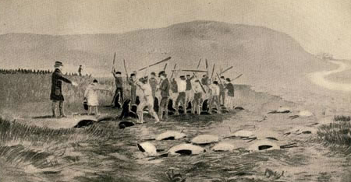
Unangan and the
Pribilof Islands
Brought to the Pribilof Islands by Russian
fur traders in 1788
Forced to harvest fur seals for Russians and Americans
Notes:
Russians arrived in the Aleutian Islands in 1741, and fought with the Unangan. Russian fur hunters forced the Unangan to hunt sea otter for Russian markets after they captured Unangam villages. 3,000-5,000 Unangan were killed in the Umnak-Unalaska area, and overall almost half of the original population of 16,000 Unangan had died by 1778. Source: Laughlin, W. 1980. Aleuts: Survivors of the Bering Land Bridge.
Gerasim (Gavriil) Pribylov discovered St. George Island (1786) and its fur seal rookeries, and his men discovered St. Paul Island in 1787. Unangan were taken to the Pribilof Islands from Atka and Unalaska in 1788 and forced to harvest fur seals. Source: Hanna, G.D (2008) The Alaska Fur Seal Islands. Torrey, B. 1978. Slaves of the Harvest
Image from NOAA: Pribilof Islands Preserving the Legacy, Henry Wood Elliott illustration

Slide 6
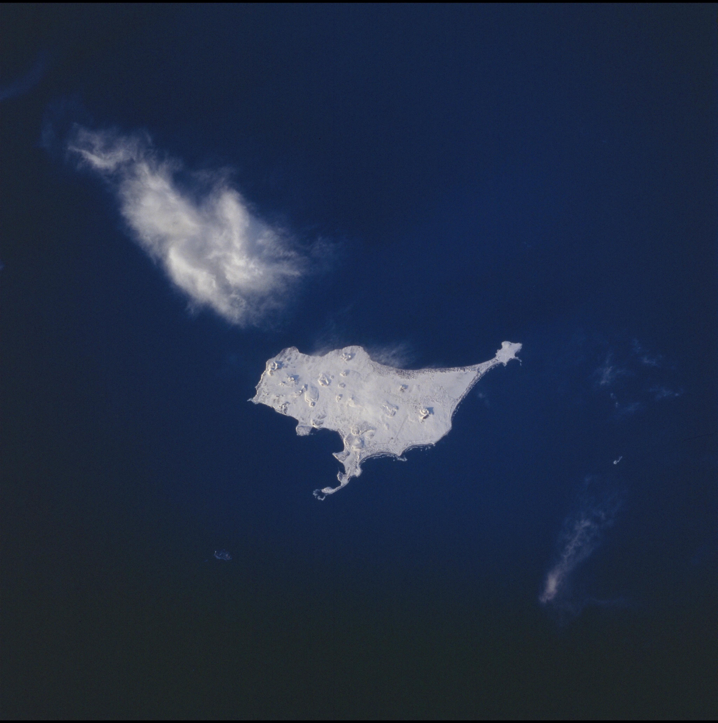
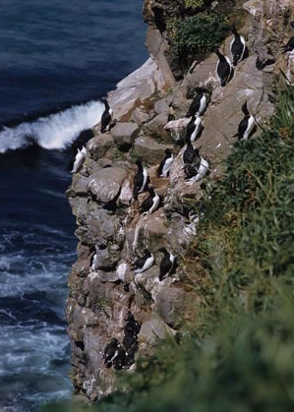
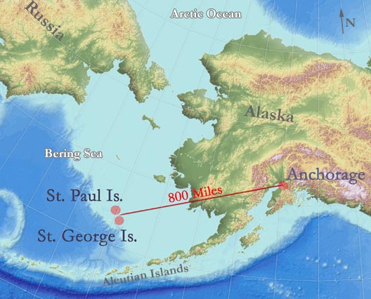
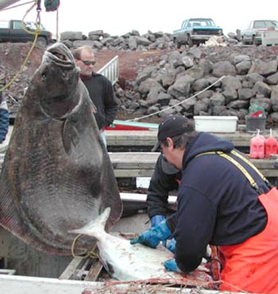
Life on The Pribilof Islands
Before the Fur Trade
Pribilofs were uninhabited by people until 1788
Challenges for People
  No fresh water streams
  No protected bays for boat landings
  Harsh weather conditions
  Very far from other villages
Benefits
  Abundant wildlife:
  fur seals, harbor seals, sea lions, walrus, birds, halibut, crab
Notes:
The Pribilof Islands are flat, treeless, volcanic islands covered in grass and sedge. Wind, rain, and fog are common throughout the year. The Pribilof Islands sit in the middle of the Bering Sea at the edge of the continental shelf. In the 1700s neither island provided a good harbor or protected bay for anchoring or landing a vessel. The islands are roughly 800 miles from Anchorage and 250 miles from Unalaska Island in the Aleutian chain.
Source: Laughlin, W. 1980. Aleuts: Survivors of the Bering Land Bridge
Marine Exchange of Alaska: http://www.mxak.org/ports/northern_west/st_paul/st_paul.html
Map from NOAA Office of Response and Restoration: Pribilof Island Restoration Project http://archive.orr.noaa.gov/pribilofs
Photo of Halibut from NOAA: Pribilof Islands, Preserving the Legacy. Pribilof Islands Environmental Restoration Project Photographs
Pribilof Islands General Interest Photographs
http://docs.lib.noaa.gov/noaa_documents/NOS/ORR/TM_NOS_ORR/TM_NOS-ORR_17/HTML/Pribilof_html/Images/Gallery/Gallery_PPO_General_Interest/halibut.html
Photo of Bird from NOAA: Pribilof Islands, Preserving the Legacy.

Slide 7
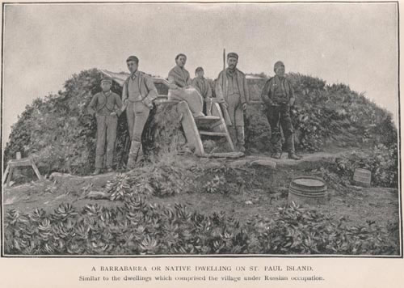
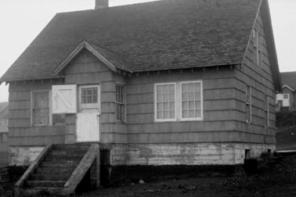
Unangan Life on the Pribilof Islands
1787-1900s
1787-1867 Russian Period
  Lived in ula{/barabara (traditional underground dwelling)
  Considered to be citizens of Russia
  Converted to Russian Orthodox religion
1867- 1986 U.S. Government Period
  Moved into un-insulated wooden houses
  Designated as “Indians” and wards of the U.S. Government
  Government agents controlled all aspects of life
  Forbidden to speak native language
Notes:
1787-Russian fur traders first brought Unangan to the Pribilof Islands to harvest seals for the fur trade. Hunters were brought to the islands on a seasonal basis until 1820 when permanent encampments were established.
Unangan lived during the winter in subterranean houses called ulax or barabara. The houses had a framework of driftwood or whale bone. Family members entered through a portal in the roof. Theses dwellings were large, warm, and safe during the long Aleutian winters. It was not uncommon for several related families to live in one ulax.
Under Russian rule the Unangan were considered Russian citizens. They were allowed to keep their community based governing and to speak Unangan. Russian orthodox religion was introduced. Most Unangan were bilingual.
1867-US purchases Alaska from Russian. Private companies manage the fur seal harvest.
1911 –US government takes over managing the harvest and life on the Pribilofs. All aspects of the lives of the people on the islands are controlled by the government including marriage, housing, food, laws, travel, work, and socializing.
1960 US govt begins to phase out its administrative duties.
1983 Pribilofs become independent from US govt.
For more information see the Aleutian Pribilof Island Association (APIA) website: http://www.apiai.com/culture.asp?page=culture
Image of House from NOAA: NOAA Preserving the Legacy
Image of ulaˆx from NOAA, Orr: http://docs.lib.noaa.gov/noaa_documents/NOS/ORR/TM_NOS_ORR/TM_NOS-ORR_17/HTML/Seal_Islands.htm

Slide 8
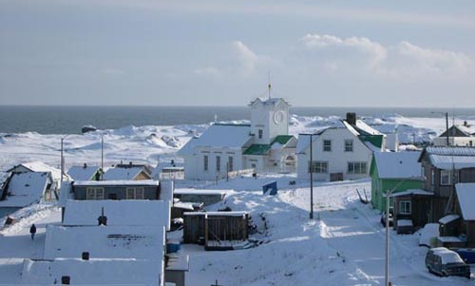
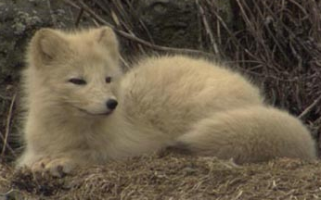
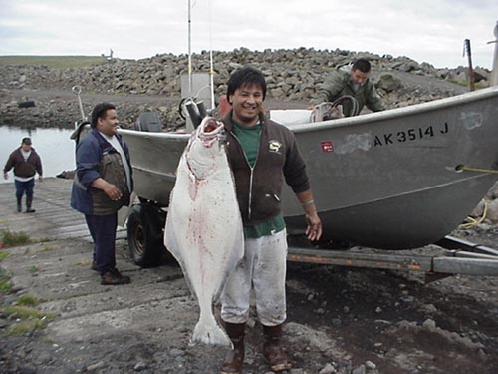
Life on the
Pribilof Islands Today
Current Challenges
  No agriculture or manufacturing
  Weather affects travel
  Hospital in Anchorage
  Freshwater from wells
Current Advantages
  New harbor
  Tourist economy
  Halibut & king crab fishery quotas
  Abundant wildlife
Notes:
Challenges –
Everything must be shipped to the Islands by plane or boat. The only food available on the Islands is seal, birds, fish, crab, berries, shellfish, and native plants.
Weather can also be a challenge – fog, wind, snow, and ice can affect air travel, and the islands can go for a week or longer without planes being able to land (affects food availability as well as travel to and from the islands).
Only basic medical care is provided on the islands.
Advantages
Two types of fishing quotas
CDQ- The Western Alaska Community Development Quota (CDQ) Program allocates a percentage of all Bering Sea and Aleutian Islands quotas for groundfish, prohibited species, halibut, and crab to eligible communities. The purpose of the CDQ Program is to (i) to provide eligible western Alaska villages with the opportunity to participate and invest in fisheries in the Bering Sea and Aleutian Islands Management Area; (ii) to support economic development in western Alaska; (iii) to alleviate poverty and provide economic and social benefits for residents of western Alaska; and (iv) to achieve sustainable and diversified local economies in western Alaska.
https://alaskafisheries.noaa.gov/cdq/
IFQ- individual fishing quotas go to individual fisherman who are involved in the fixed gear (ie: longline or pots) for halibut or sablefish in Alaska.
Photos from NOAA: Pribilof Islands, Preserving the Legacy. Pribilof Islands Environmental Restoration Project Photographs

Slide 9
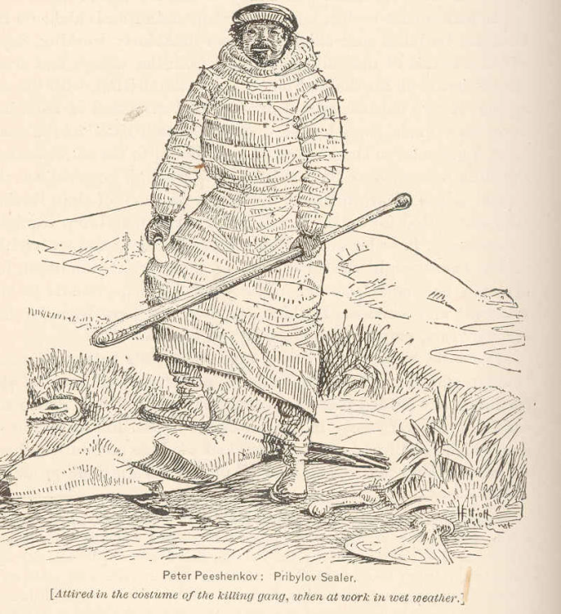
How are marine mammals part of the culture?
Hunted marine mammals for thousands of years for food
and clothing
Resources from marine mammals were shared in the community
Stories and songs told
about the fur seal islands (Tana{-Ami{, the Pribilof Islands)
8
Notes:
8
Emphasize the concepts of subsistence hunting vs. commercial harvesting, which are two very different activities:
Subsistence hunting: hunting for the sake of survival and community sharing rather than for entertainment or monetary gain.
Commercial harvest: to catch, shoot, trap, etc. (fish or wild animals) usually in an intensive, systematic way as for commercial purposes. Benefits go to individuals or companies, not to the community.
Unangan hunted marine mammals for subsistence for thousands of years but were forced to harvest sea otters and fur seals for the Russians starting in the 1740s, and fur seals for the Americans after 1867, for monetary gain. The number of animals harvested was determined by Russians and Americans.
Based on the stories and songs, the Unangan knew about the Pribilof Islands from long ago.
Source: Torrey, B. 1978. Slaves of the Harvest
Illustration by Henry Wood Elliot, 1884, University of Washington, University of Washington Libraries, Freshwater and Marine Image Bank

Slide 10
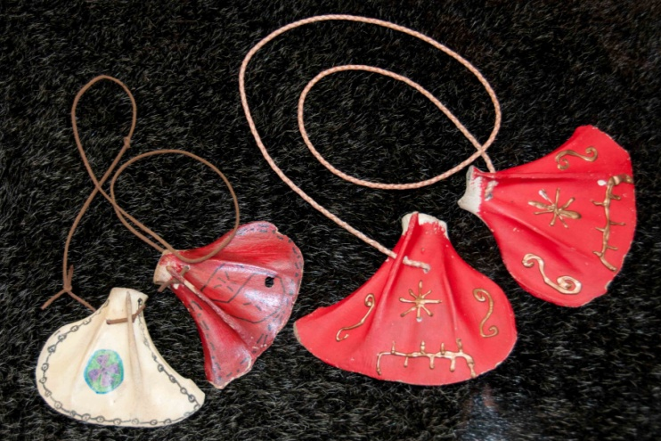
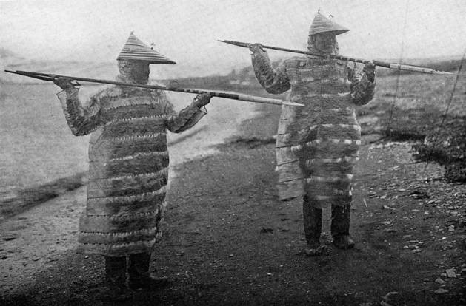
How are seals and sea lions part of everyday life?
Animal parts used in clothing, hunting, and ceremonies
  Flippers - soles of boots
  Fur – trim on clothing, not used for coats
  Stomach, intestines – waterproof clothing and floats
  Teeth - fish hooks and decorations
  Shoulder blades (scapulas) –
  musical instruments
  Bones – toys
scapula instruments
gut parkas
9
Notes:
9
The Unangan never used marine mammal fur for coats. Marine mammal fur was used for trim and decoration. Due to the very wet environment in the Aleutians, fur was not a practical choice for a coat. Waterproof coats were made from marine mammal gut or intestine.
See Aleut Corporation for good definition of clothing (http://www.aleutcorp.com/index.php?option=com_content&view=section&layout=blog&id=6&Itemid=24)
Image of gut parkas: From Waldemar Jochelson, “History, Ethnology, and Anthropology of the Aleut.” Smithsonian Institution, Alaska Native Collections
Image of Scapulas by Pam Goddard: www.thalassa-education.com

Slide 11
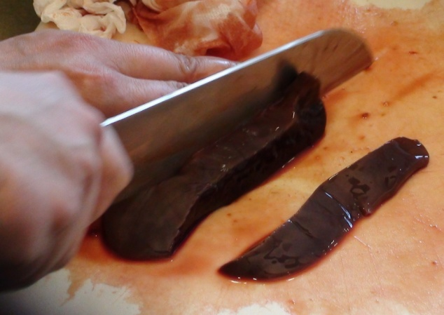
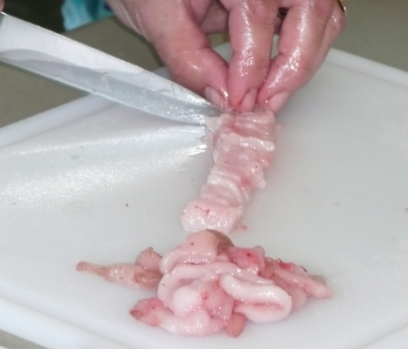
How are seals and sea lions part of everyday life?
Food
  Lusta – salted fur seal flipper
  Braided seal meat – seal meat braided with intestines
  Salted seal meat stew
  Seal tongue soup
  Seal pie
  Alagnosa – salted seal
  Stuffed seal stomachs
  Kukleetka – sea lion meatballs
  Piroshki – meat filled pastry
  Hearts and livers
  Stinky oil
  Sea lion soup
  Studen – sea lion flipper in a jellied salad
10
Notes:
10
All parts of the fur seal were used including the internal organs and flippers.
Source: Alaska’s Child 1985. Fur Seal Flippers and other Delicacies – The Aleut People of Saint Paul Island Cookbook
Images by Millie McKeown: Aleutian Pribilof Islands Association (APIA), used with permission.

Slide 12
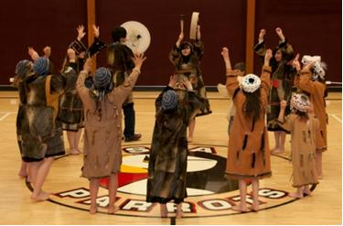
Fur Seals in
Stories and Songs
Stories and Songs
  Harvest dance
  Aleut Tales and Narratives
  Tana{-Ami{ – Legend of the Fur Seal Islands
11
Notes:
11
See video of Ms. Edna, Aleut culture and dance teacher: http://www.youtube.com/watch?v=ZWGpO5eChGk&feature=related.
Aleut Tales & Narratives by Waldemar Jochelson; edited by Knut Bergsland and Moses L. Dirks, 1990.
Tanax Amix: Legend of the Fur Seal Islands, Reprinted from Slaves of the Harvest by Barbara Boyle Torrey, Tanadgusix Corporation, St. Paul Island, 1978.
http://www.ankn.uaf.edu/ancr/aleut/culturalchange/chap.1-5.html
Image by Lisa Hiruki-Raring, NOAA/AFSC

Slide 13
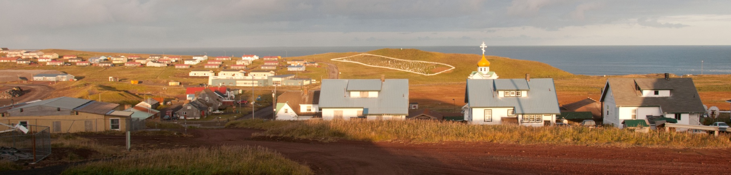
Summary
Unangan traditionally lived on the Aleutian
and Commander Islands
Russians forced the Unangan to live on the Pribilof Islands and harvest fur seals in the 1780s
Unangan used marine mammals for food, clothing, tools, and boats
Today, the Unangan live all over the world
Insert photo of st. paul
12
Notes:
12
Image by Pam Goddard: www.thalassa-education.com

