Slide 1
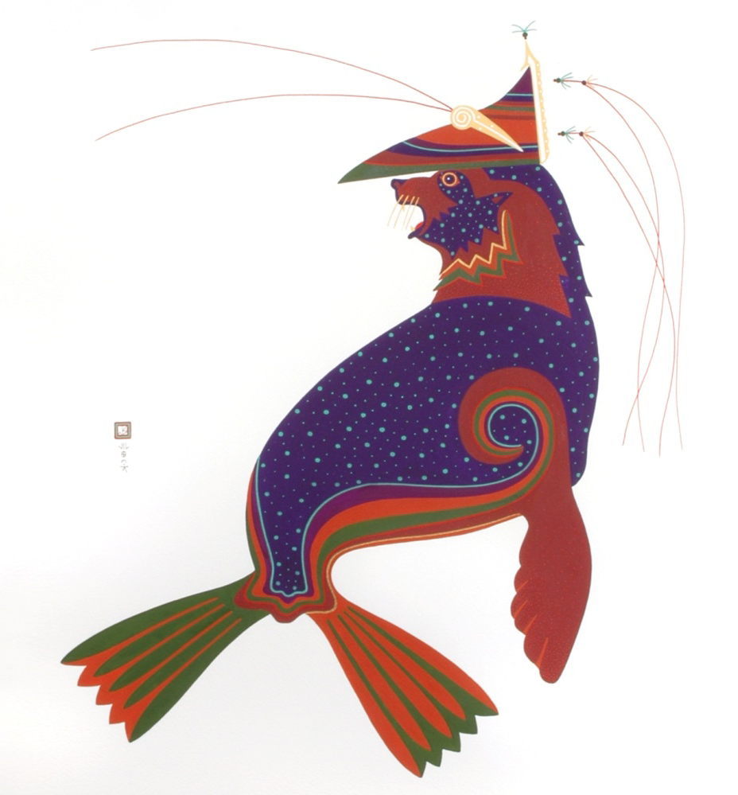

Laaquda{: The Northern Fur Seal
Lesson 4:
What do fur seals eat?
© Thomas Stream Northern Fur Seal
Notes:
Lesson 4 gives an overview of what fur seals eat when they are at the rookery, traditional knowledge, and current scientific methods of studying fur seal food habits.

Slide 2
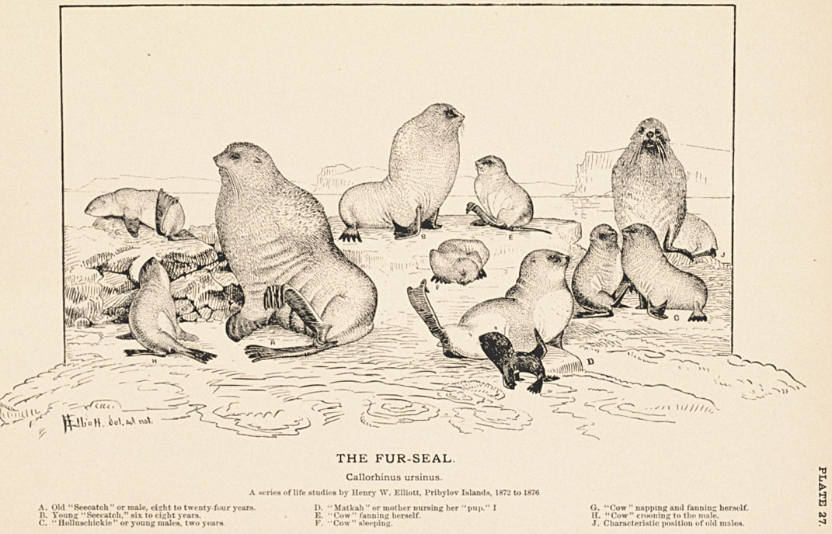
What will you learn?
How do fur seals find their food?
What do fur seals eat?
Notes:
Image: Henry Wood Elliott illustration, The Fur Seal, University of Washington Library.
Seal and Salmon Fisheries and General Resources of Alaska, vol.3

Slide 3
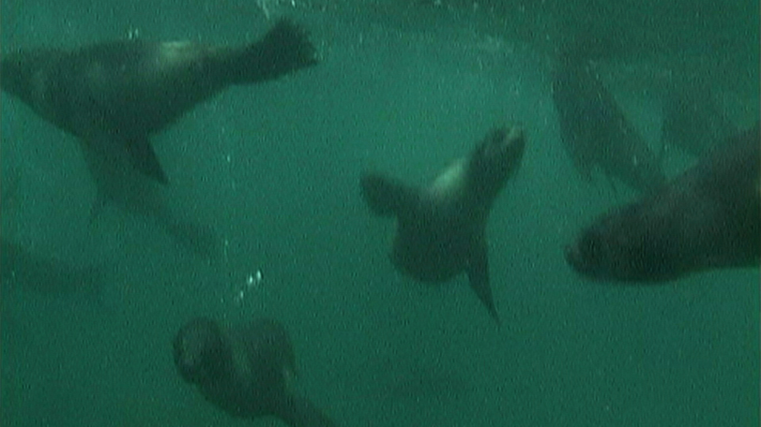
How do they find their food?
Foraging: searching and hunting for food
  Forage for food at sea by diving
  Dive as deep as 200 meters
  (650 feet) to find fish and squid
  Detect prey by sight and by feeling vibrations with whiskers
Notes:
Fur seals find their food by foraging and diving while at sea. Most fur seal feed at night when fish and squid move closer to the surface.Fur seals large eyes are well suited for seeing under water and in low light condidions. Their wiskers detect vibrations caused by prey moving in the water and they can hear very well.
Listen to sounds created by sea creatures at Discovery of Sound in the Sea. www.dosits.org/audio/interactive

Slide 4
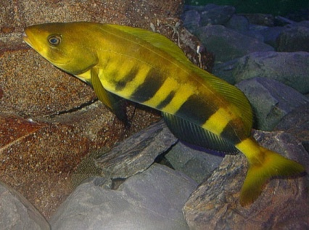
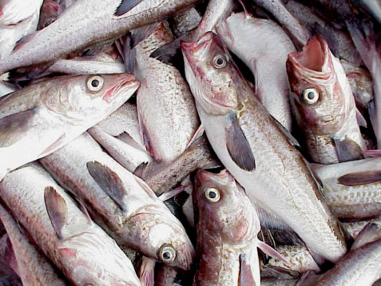
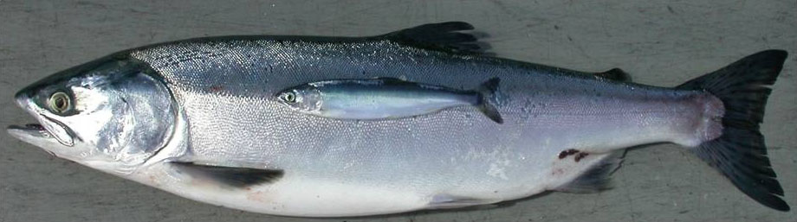
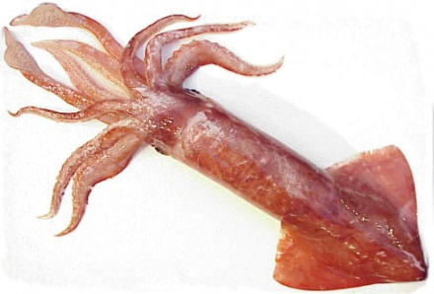
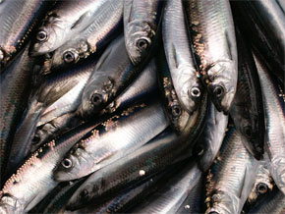
What do fur seals eat?
Diet depends on what is available
As fish populations change, so does fur seal diet
Smaller fur seals eat smaller fish, larger seals eat larger fish
Humans and seals
eat some of the same fish
Atka
mackerel
tmadgi{
Pollock
taaqa{
Pink salmon
adgayu{
Pacific
herring
sildi{
Squid
adi{
Notes:
Fur seals eat different fish in different places. The scat from St. Paul Island and St. George Island contain mostly pollock. Other prey species are squid, herring, salmon, and atka mackerel.
It is important to note that seals and humans are consuming the same species of fish and squid.
Photos: NOAA/AFSC website (http://www.afsc.noaa.gov/ABL/MSI/msi_sae_psf.htm)

Slide 5
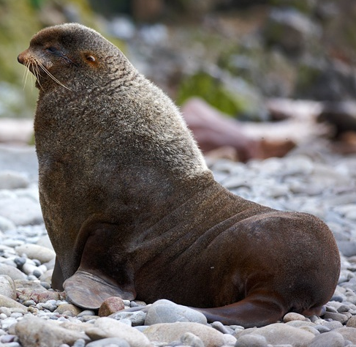
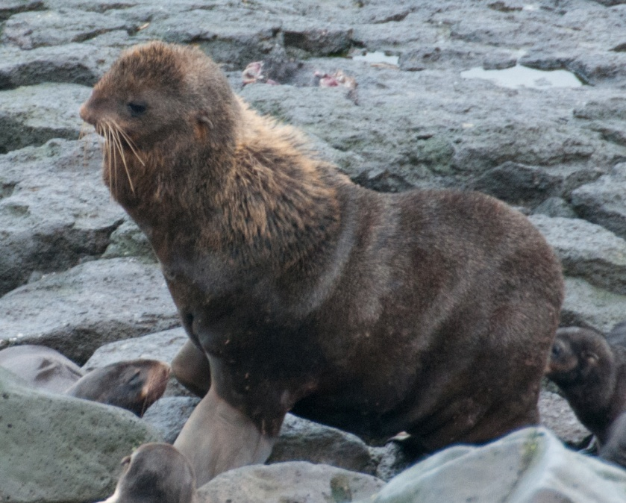
When do adult males eat?
Adult males do not eat on the rookery
Fast from 3 days to 2 months depending on how long the male holds its territory
Lose 32% of body fat while defending a territory on the rookery
Notes:
When do the different age groups eat?
Adult males on the rookery do not leave to eat; they fast for the whole time they are on the rookery. If a male left its territory to feed at sea, another male would move in and take over his territory. Males spend most of the winter feeding and gaining weight for the breeding season.
During the summer, non-territorial males and non-breeding males alternate between time on shore to rest and time at sea to feed.
Inset photo: Mikhail Shlemov (Russian photographer) via Vladimir Burkanov, NOAA, NMML (0K9O2530-Shlemov_cropped)
Photo of thin male: Pam Goddard, www.thalassa-education.com

Slide 6
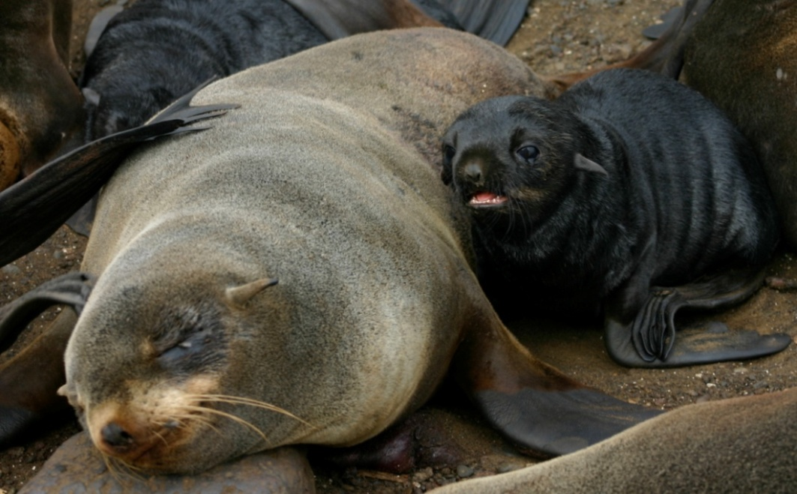
When do adult females eat?
Once on the rookery, females do not go to sea to feed until they have nursed their newborn pup for a week
Females alternate
1-3 days of nursing
with 4-10 days of
feeding at sea until
the pup is weaned
Notes:
The pup is nursed for about 4 months before it weans and starts feeding itself.
As the nursing pup gets older and needs more milk, the female goes out for a longer time to feed.
Females from different rookeries eat different fish and feed in different areas.
Source: NMML website
Photo: Jeremy Sterling, NOAA/AFSC/NMML

Slide 7
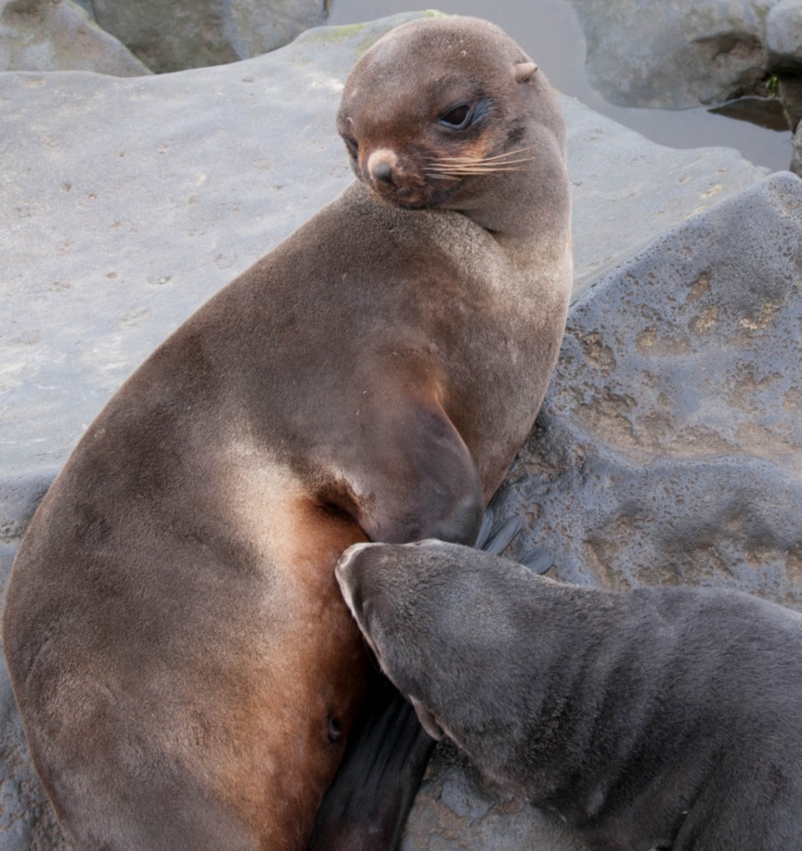
What & when do pups eat?
The pup drinks its mother’s
milk for the first 4 months
  Milk is 49% fat, 37% water, 11% protein
  Pups nurse for 1-3 days, then go without food for
  4-10 days while their mothers are at sea feeding
  Pups learn to eat fish and squid when they leave the rookery at 4 months
Notes:
Pups stay with their mom for one week after they are born, nursing every day. After the first week, the female goes out to sea to feed and to produce more milk; during that time, the pup stays in the rookery and fasts.
The female alternates these feeding trips with one to three day visits ashore to nurse the pup.
After four months, the pup weans itself by leaving its mother; then it learns to hunt and eat its own food.
Photo: Pam Goddard, www.thalassa-education.com, nursing pup

Slide 8
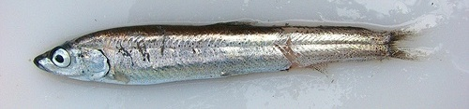
Traditional Knowledge
Pribilof fur seals used to eat more seal-fish (Northern smoothtongue)
Fur seals from different rookeries eat different fish
Fur seal meat may taste different depending on the diet of the fur seal
Sea lions taste different than fur seals
Northern smoothtongue
Notes:
Northern smoothtongue (Leuroglossus schmidti), also known as smoothtongue, was called seal-fish by the Unangan because the seals ate these fish. Elders in the Pribilof Islands told stories that the fur seals ate more seal-fish in the past.
An elder from St. George Island who moved to St. Paul Island said that fur seals from St. George Island tasted different (better) than the fur seals from St. Paul Island. Many years later, scientists studying the diet of seals from the different islands and different rookeries found that the diet of fur seals from St. George contained more squid and salmon than the diet of fur seals from St. Paul Island.
Food habits studies of fur seals have also confirmed that fur seals from different rookeries tend to eat different food.
For more information see the website below.
Source of traditional knowledge: Aquilina Lestenkof and St. Paul community members
Photo: Richard Hipbshman, NOAA/AFSC/REFM

Slide 9
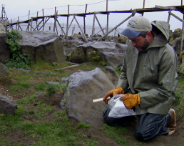
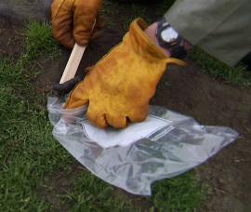
How do we know?
Traditional knowledge of fur seal food habits has been confirmed by scat collections
Analysis of stomachs
and intestines
Analysis of fur,
whiskers, and blood
Observe nursing pups
Notes:
Historically, fur seals were killed for scientific purposes. Scientists collected stomachs from these seals to learn about their diets. Since the 1970s fur seals have not been killed for science.
Today, fur seal diet information is collected while the seals are on the rookery.
Scientists collect seal scat (poop), then wash it through sieves to find bones and squid beaks in the scat. These are identified to find out what fur seals eat.
Bones and beaks are also measured to determine the size of fish and squid that the seals eat.
Fur seal throw up (spew) large bones and squid beaks that cannot pass through the digestive tract. Scientists examine spews to identify fish and squid that are eaten.
Stomachs and intestines from harvested animals are examined to see their contents.
Chemical and fatty acid analyses of fur, whiskers and blood can provide information on the types of food that fur seals eat.
Photos: Paul Hillman, NOAA Ocean Media Center

Slide 10
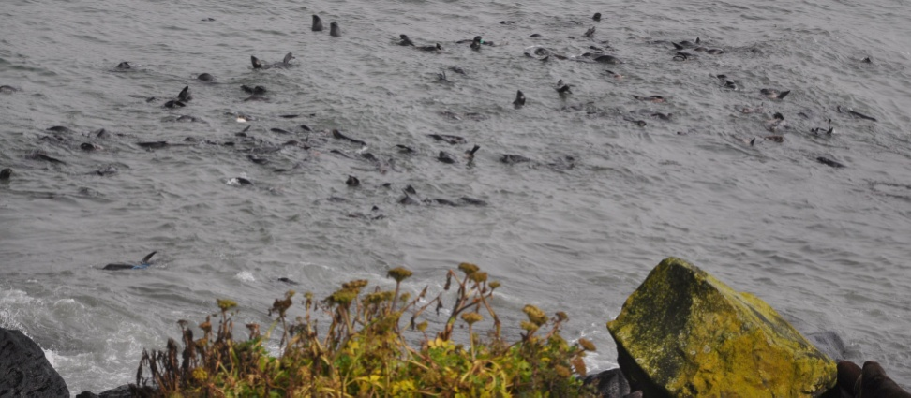
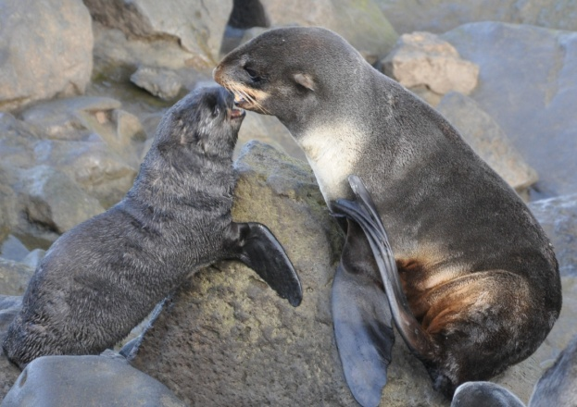
Summary
Fur seals eat different
types of fish and squid
Breeding males don’t
eat while on land
Females alternate feeding trips at sea with visits to the rookery to feed their pups
Pups drink milk for the
first 4 months
Notes:
Photos: Pam Goddard, www.thalassa-education.com

