Slide 1
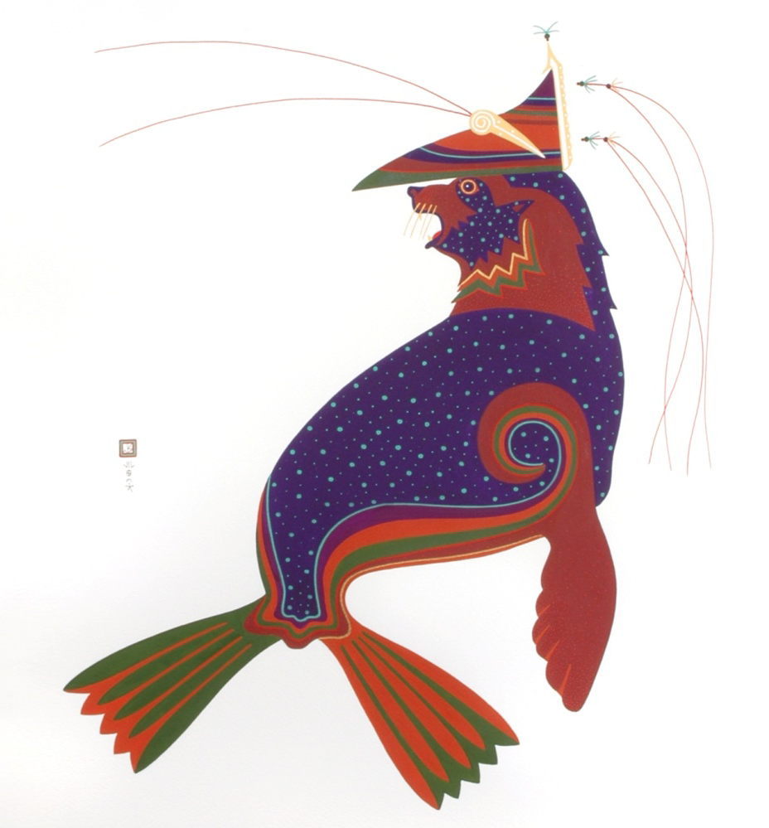
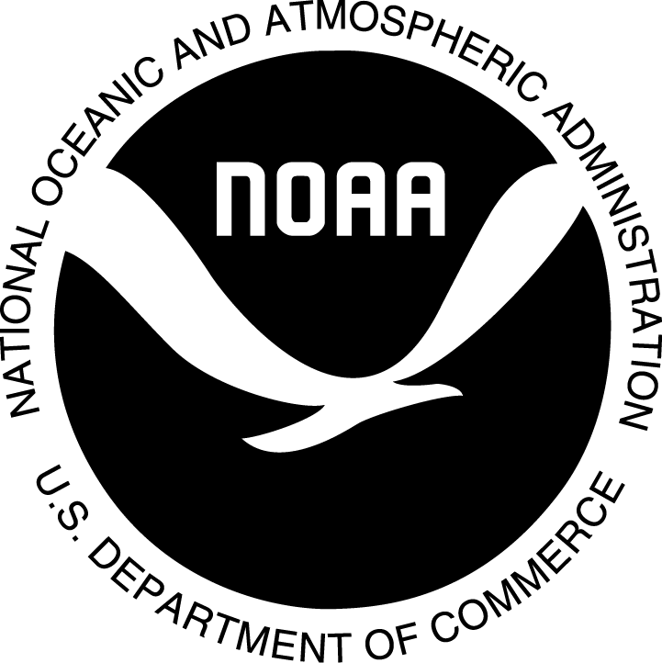
Laaquda{: The Northern Fur Seal
Lesson 7:
Populations, harvest, and management
© Thomas Stream Northern Fur Seal
Notes:
Lesson 7 PowerPoint gives a general overview of the history of the northern fur seal population and harvest, and how the population is managed.

Slide 2
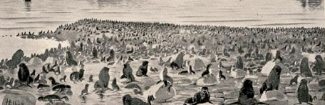
Lesson topics
What is population biology & management?
Why is the fur seal population managed?
How is the fur seal population managed?
What is the history of the fur seal harvest on the Pribilof Islands?
Notes:
Image by Henry Wood Elliott, 1896: Ketavie (now Kitovi) Rookery, St. Paul Island, July 17, 1872.
Pribilof Islands Preserving the Legacy; Image Gallery; Collection of Henry Wood Elliot Maps and Drawings, #93
ftp://ftp.library.noaa.gov/noaa_documents.lib/NOS/ORR/TM_NOS_ORR/TM_NOS-ORR_17/HTML/Pribilof_html/Pages/pribilof_image_gallery.htm

Slide 3
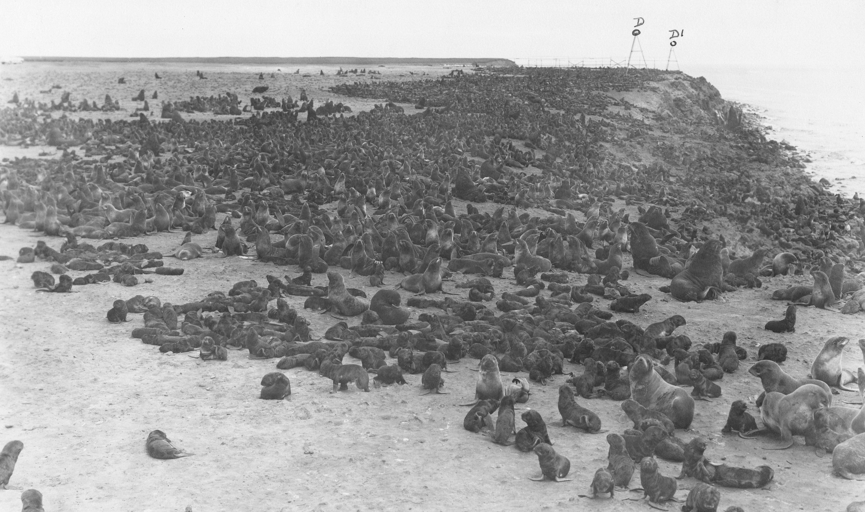
Populations
Population: a group of organisms that live in the same place at the same time
The northern fur seals that live on the Pribilof Islands make up a population
The people who live on the Pribilof Islands make up a population
Notes:
Individuals within a population share the same space, rely on the same resources, and are influenced by the same environmental conditions.
Populations can be studied at different scales. The population of the world is different than the population of St. Paul Island, but both are populations.
Scientists monitor the changes in populations over time to learn more about what influences that population. Having many data points or several years of data allows scientists to see trends (e.g., increasing, decreasing, or stable) and helps them make more informed decisions when managing a population.
Photo: NOAA Preserving the Legacy Gallery: Collection of Charles Howard Baltzo (U.S. Fish & Wildlife Service, 1960-1968)
ftp://ftp.library.noaa.gov/noaa_documents.lib/NOS/ORR/TM_NOS_ORR/TM_NOS-ORR_17/HTML/Pribilof_html/Pages/pribilof_image_gallery.htm

Slide 4
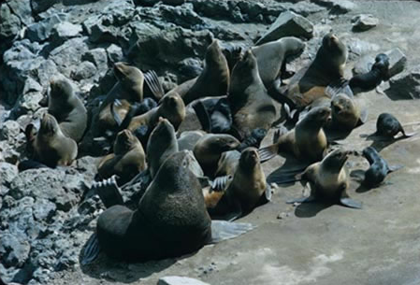
Population dynamics
Population Dynamics: the study of long and short-term changes in the size and age composition of populations and the processes that influence the changes
Scientists from around the world and members of the Pribilof communities study fur seals to learn about their population biology
Notes:
3
The population dynamics of fur seals on the Pribilof Islands have been studied since the Russians arrived in 1787. In order to manage the harvest of a population you must first understand its biology or run the risk of exploiting the population to the point of extinction.
To fully understand a population you must have data on the following: death rate, birth rate, immigration, emigration, prey consumption and availability, habitat, and environmental influences.
Photo: NOAA Preserving the Legacy Gallery: Collection of Charles Howard Baltzo (U.S. Fish & Wildlife Service, 1960-1968)
ftp://ftp.library.noaa.gov/noaa_documents.lib/NOS/ORR/TM_NOS_ORR/TM_NOS-ORR_17/HTML/Pribilof_html/Pages/pribilof_image_gallery.htm

Slide 5
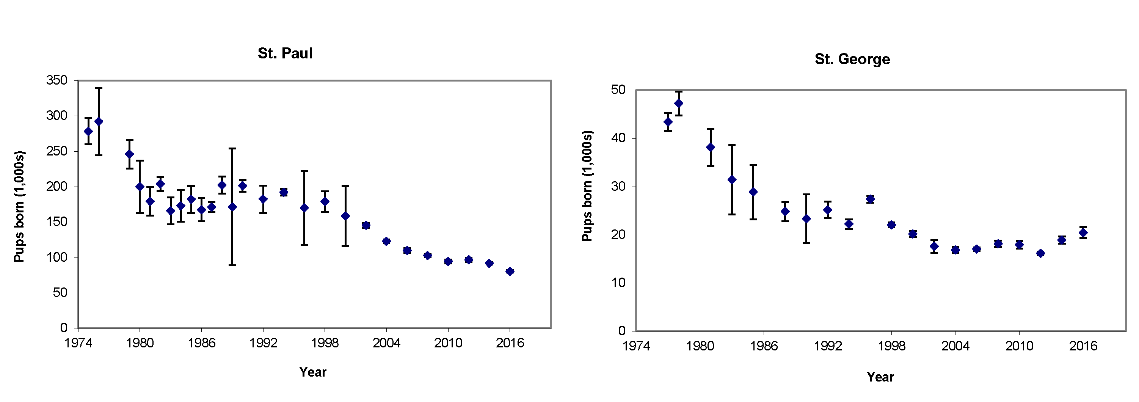
Why manage a population?
To prevent extinction
To prevent overpopulation
These plots show the number of fur seal pups born on St. Paul and St. George Islands since 1974. The bars around each dot are the error bars. The larger the error bars, the less accurate the number.
Notes:
For hundreds of years humans have managed wild populations of animals (deer, elk, moose, bear, cougars, fish, …). Populations are often managed through controlled hunting.
Two major reasons for managing a population:
Make sure the population is in balance with the ecosystem.
If a harvest occurs, make sure it is sustainable. Prevent the population from going extinct and prevent overpopulation.
The plots on this slide show the consistent decline in the pup population on the Pribilof Islands since the mid-1970s. Ideally, the first step in management is to estimate the size of the population. The fur seal population is calculated by estimating the number of pups and males and then extrapolating to calculate the number of females. Counting the number of pups born every two years is a critical part of management.
For most populations, it is virtually impossible to count every single member. Today, scientists estimate the population using a mark-recapture method. For northern fur seals, estimating the population is time consuming and expensive. The animals are constantly moving, many of the juvenile males are not on the rookery, and females must leave every few days to feed.
The northern fur seal population is unique in that it was managed to maximize profits from the sale of seal pelts.
The Russians were the first to institute fur seal harvest management measures in 1806. The U.S. Government has been monitoring and managing the northern fur seal population on the Pribilof Islands since the purchase of Alaska in 1867. Until 1911, the harvest and population management was conducted by private companies under a leasing system with the U.S. Treasury Department. In 1911, the Secretary of Commerce and Labor assumed management of the fur seals. U.S. Government management continued until 1984. A subsistence only harvest was started in 1985 under a co-management agreement established between the U.S. Department of Commerce and the local Unangan leaders of St. Paul and St. George Island. (https://alaskafisheries.noaa.gov/pr/fur-seal)
Image Source: 2016 northern fur seal pup production and adult male counts on the Pribilof Islands, Alaska. (Updated 5/1/2018)
https://www.afsc.noaa.gov/nmml/PDF/NFurSealPupMem2016_Final.pdf

Slide 6
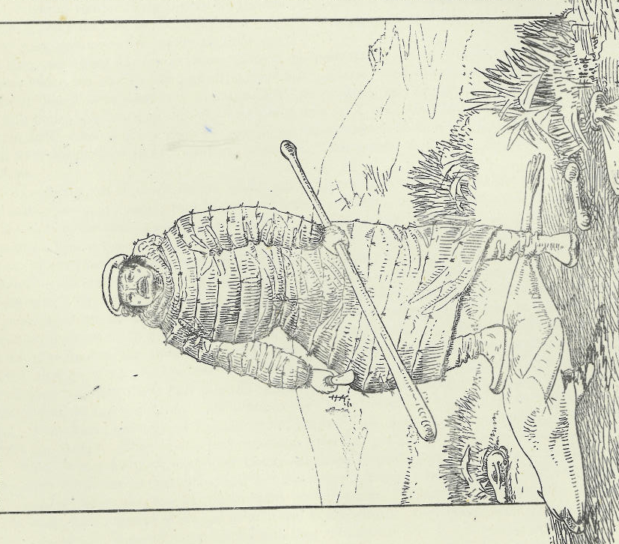
Why manage the fur seal population?
Food: Unangan hunted seals for food and clothing
Money: Russia and the U.S. managed the seal harvest to maximize profits from seal pelts
Prevent Extinction: Today fur seals are co-managed to maintain a subsistence harvest and healthy population
Notes:
The Unangan hunted marine mammals for subsistence purposes for thousands of years, but were forced to commercially harvest sea otters and fur seals for the Russians starting in the 1740s, and fur seals for the Americans after 1867. When subsistence hunting, the Unangan did not need to manage the fur seal population. They only took seals needed for food and clothing.
Subsistence hunting: hunting for the sake of survival rather than entertainment or monetary gain.
Commercial harvesting: to catch, shoot, trap, etc. (fish, or wild animals) usually in and intensive, systematic way as for commercial purposes.
The number of fur seals harvested was determined by Russian and American furriers and U.S. government employees. Harvests were conducted only for the furs. All meat was discarded. Only the Unangan ate the meat. It was not until the seals were commercially harvested for the fur trade that the population needed to be monitored and managed. The commercial harvest was managed to produce the maximum number of furs each year. Scheffer (1984) reports that by 1828 the Russians had harvested more than 3 million fur seals, approximately 71,000 per year or up to 5,000 per day. By the early 1900s the tax and lease revenue generated by the U.S. Government paid for the $7.2 million purchase price of Alaska. Approximately 2.2 million seals were killed during the first 20 year lease alone. (https://alaskafisheries.noaa.gov/pr/fur-seal)
Preventing extinction is one of many reasons to manage harvested populations. Today almost all populations that are harvested or hunted are monitored by a local, state, or federal agency whether the take is for commercial purposes or for subsistence. The Unangan on St. Paul and St. George co-manage the annual subsistence take of juvenile males with the National Marine Fisheries Service. The Pribilof northern fur seal population was listed as depleted in June 1988 under the Marine Mammal Protection Act because the population had declined by more than 50% since the 1950s. The population is still listed as depleted in 2018. (NOAA Fisheries, Office of Protected Resources: https://alaskafisheries.noaa.gov/pr/fur-seal)
Image: Henry Wood Elliot, Report on the Seal Islands of Alaska, 1884.

Slide 7
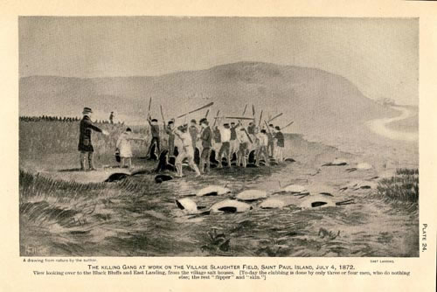
History of U.S. harvest & management
Commercial harvest of fur seals began in the 1780s
Population estimate before harvest = several million
  Exact numbers unknown
Over the next 120 years, more than 7 million fur seals were harvested on the Pribilof Islands and at sea
Notes:
It is thought that the original population for northern fur seals, prior to 1786, was over 2-3 million animals.
Source: https://www.sararegistry.gc.ca/virtual_sara/files/cosewic/sr_northern_fur_seal_e.pdf
The 2016 population estimate for the Eastern Pacific stock is just over 530,000.
Source: NOAA-TM-AFSC-355, Muto, M. M., et al.,
Image: Henry Wood Elliott, 1884.

Slide 8
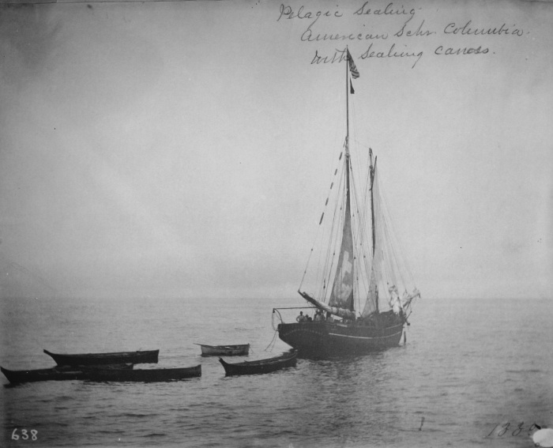
Consequences of
Pelagic Harvest
1868-1910 pelagic sealing was allowed
Pelagic harvest targeted females feeding at sea, with pups on the rookery
Only 50% of seals killed at sea were retrieved whereas 100% of seals killed on land were retrieved and processed
Harvesting females kills 3 seals
  Female
  Pup developing inside her
  Nursing pup on the rookery
Notes:
Pelagic sealing = harvesting of seals at sea.
Pelagic sealing: In 43 years (1868-1911) , 2 million seals were killed at sea; 50% were lost; 60-80% of the ones taken were females
Canada and Japan did most of the harvesting at sea, since only the U.S. and Russia could harvest seals on land
Source: Scheffer, 1984. History of Scientific Study and Management of the Alaska Fur Seal, 1786-1964.
Photo: NOAA Preserving the Legacy Gallery, Pelagic Sealing Vessels

Slide 9
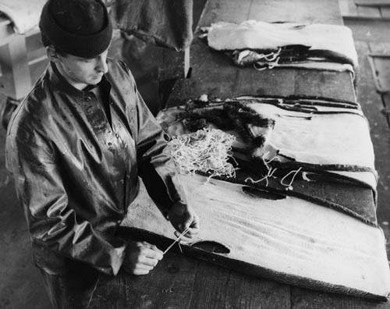
History of Harvest & Management
After just 43 years of U.S. harvest on land and at sea, the fur seal population declines to <200,000
By 1910 the fur seal
population was so low
that the U.S. Government stepped in and took over management of the industry.
Notes:
8
The initial U.S. harvest of 1868 was between 240,000 and 300,000. For the next 40 years of the northern fur seal harvest the U.S. Government leased the land based harvest rights to private companies with very little oversight or regulation.
The first 20 year lease (1870-1889) was awarded to the Alaska Commercial Company, a private fur trading company. The second lease (1890-1910) went to The North American Commercial Company.
From 1890-1911 the pelagic take exceeded the land take every year with the land take ranging from a high of 42,000 between 1890-1900 and declining to 20,000 between 1900-1910.
By 1910 the fur seal population had declined to just over 200,000.
Source: Scheffer, 1984. History of Scientific Study and Management of the Alaska Fur Seal, , 1786-1964.
Photo: Fur seal pelt factory, St. George Island, Alaska. (ftp://ftp.library.noaa.gov/noaa_documents.lib/NOS/ORR/TM_NOS_ORR/TM_NOS-ORR_17/HTML/Pribilof_html/Pages/pribilof_image_gallery.htm)

Slide 10
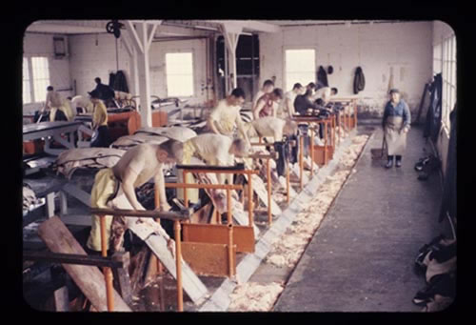
History of Harvest & Management
Fur Seal Treaty of 1911
  Ended harvest at sea
  First international agreement for the protection of wildlife
1911-1984 U.S. Government Managed Harvest
  Sub-adult males harvested
  Maximum harvest to sustain population
  No pelagic harvest
1956-1963 Females harvested
Notes:
9
1911 Fur Seal Treaty ended the pelagic harvest. Takes harvest away from private companies. Harvest now managed by the U.S. Secretary of Commerce and Labor.
Countries signing the Fur Seal Treaty of 1911: US, Russia, Japan, Great Britain (signing for Canada).
Northern fur seal population slowly rebuilds from a low of 200,000 in 1911 to just under 3 millions in the 1940s.
The harvest of females from 1956-1963 and the lack of female pups being born is one of the reasons for the beginning of the decline in population from which the population has never recovered.
Source: York and Hartley, 1981. Pup Production Following Harvest of Female Northern Fur Seals
Photo: (ftp://ftp.library.noaa.gov/noaa_documents.lib/NOS/ORR/TM_NOS_ORR/TM_NOS-ORR_17/HTML/Pribilof_html/Pages/pribilof_image_gallery.htm)

Slide 11

Commercial Harvest
1867-1984 5.6 million fur seals harvested
1970s Pressure from anti-fur groups forces the United States to end the commercial fur seal harvest
1972 last commercial harvest on St. George Island
1984 last commercial harvest on St. Paul Island
Notes:
10
China created the highest demands for furs in the 1800s. It is said that the Chinese perfected the technique used to remove the rough guard hairs from northern fur seal pelts. Very little is known about the process for removing the guard hairs.
Eventually, furs became very fashionable for European and American women as can be seen by the above advertisement from the Fouke Fur Company.
Image: Fouke Fur advertisement from Pribilof Islands: Preserving the legacy.

Slide 12
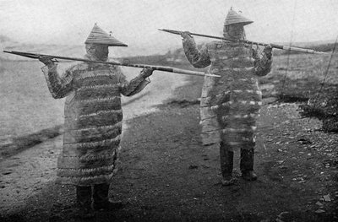
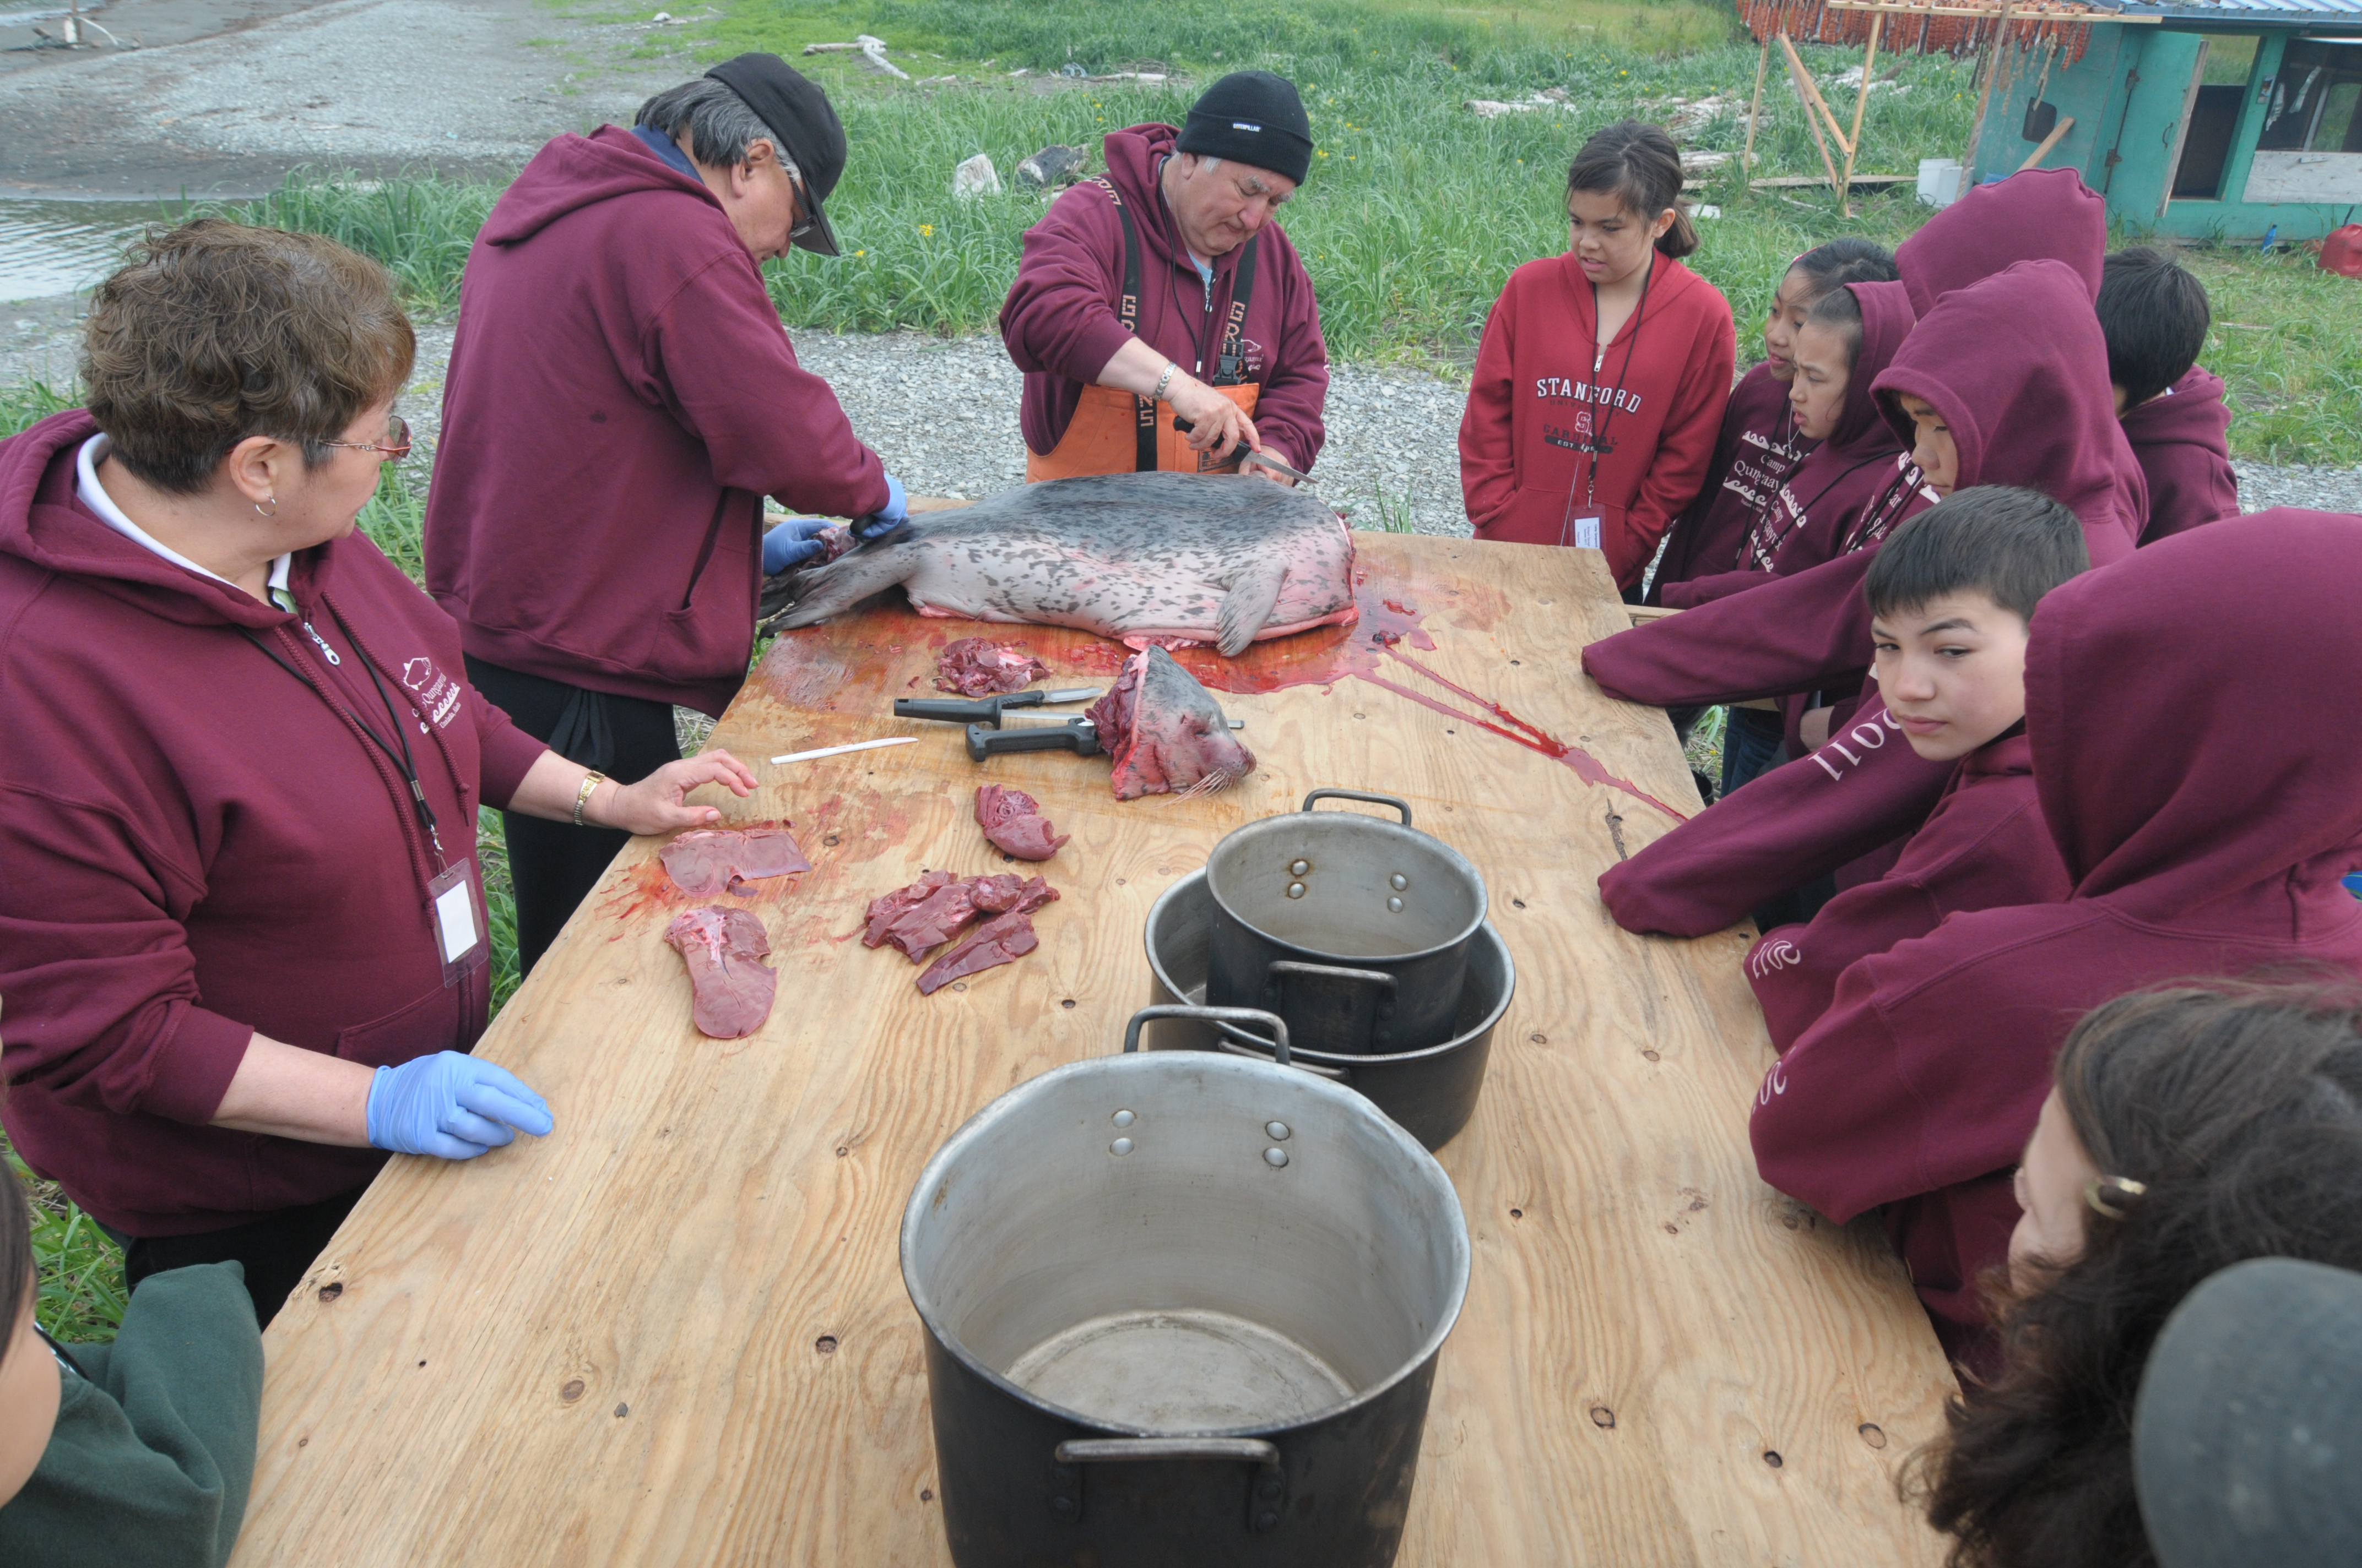
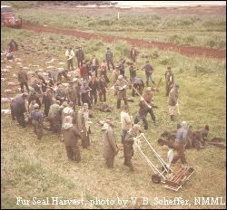
Subsistence Harvest:
Then and Now
Unangam subsistence harvest continues today
Kids learning how to butcher seal at Camp Qungaayux in Unalaska. Photo courtesy of Qawalangin Tribe of Unalaska.
http://aleutembroidery.blogspot.com/
Notes:
11
Traditionally, the Unangan did not use northern fur seal fur for clothing. Due to the very moist environment of the Aleutian Islands, fur was not practical. Most of the waterproof clothing was created from the internal organs of marine mammals.
Before coming to the Pribilof Islands the Unangan ate a variety of marine mammals, birds, and fish. Once on the Pribilofs the Unangan had limited access to traditional foods. Northern fur seal became a staple in their diet.
Today the subsistence harvest is still conducted on both St. Paul and St. George Islands. Many members of the community depend on this source of protein to feed their families throughout the year.
Image Sources:
Two hunters in Kamleika (parkas): http://aleutembroidery.blogspot.com/
Fur seal harvest: V.B. Scheffer, NOAA Preserving the Legacy, Collection of Charles Howard Baltzo (U.S. Fish & Wildlife Service, 1960-1968), ftp://ftp.library.noaa.gov/noaa_documents.lib/NOS/ORR/TM_NOS_ORR/TM_NOS-ORR_17/HTML/Pribilof_html/Pages/pribilof_image_gallery.htm
Butchering seal: Aleut Pribilof Island Association Summer Camp:http://americanindianinstitute.wordpress.com/2012/09/05/apia/

Slide 13
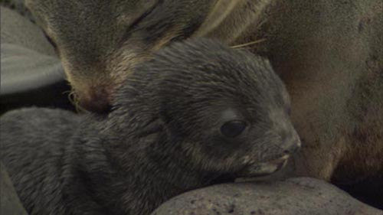
Summary
Managing a population for optimal harvest is not easy
Harvesting seals at sea (pelagic harvest) had a lasting impact on the population
  Half of the seals killed at sea sank before being collected
  Most of the seals taken at sea were females
Harvesting females kills 3 seals
  Female
  Pup growing inside her
  Nursing pup
A small harvest of juvenile
males does not harm the
population
Notes:
12
Source – G. Dallas Hanna, The Alaska Fur-Seal Islands, and NFS Conservation Plan 2007
Image Source: NOAA/AFSC/MML

