Slide 1
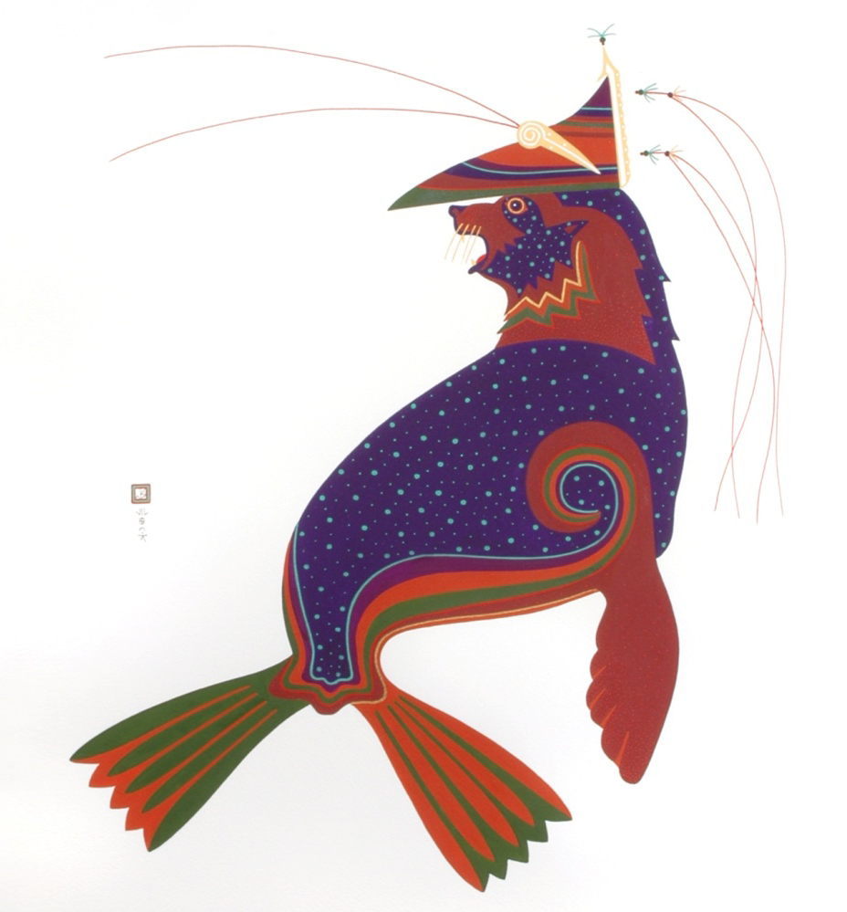

Laaquda{: The Northern Fur Seal
Lesson 3:
What is a fur seal rookery?
Lab 3.4
Paternity and Materity on the Rookery
© Thomas Stream Northern Fur Seal
Notes:
The Lab 3.4 presentation gives an overview of the hands-on activity with some background information.

Slide 2
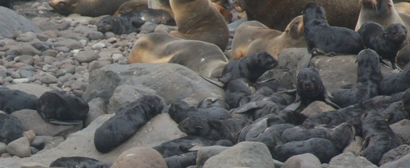
What will you learn?
How do you tell who the parents of a northern fur seal pup are?
What is DNA?
How are traits passed from parents to offspring?
How can you use genetics to determine maternity and paternity?
Notes:
Photo: Lisa-Hiruki Raring, NOAA/AFSC

Slide 3
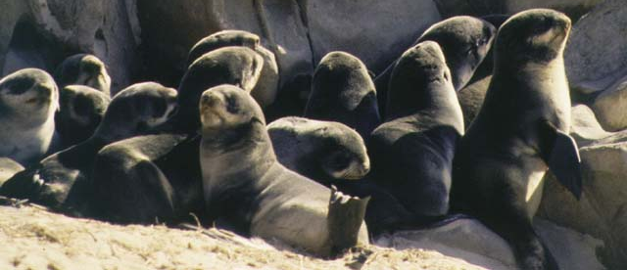
Why study parents and relatedness?
Northern fur seal population is declining
Long-term population distribution- the genetic structure of a population (who’s related to whom) helps scientists figure out if seals move from one area to another over the long term
Population trends - can find out how many pups each seal can have over its lifetime to model future population trends
2
Notes:
2
The Pribilof Island/Eastern Pacific stock of northern fur seals was listed as depleted under the Marine Mammal Protection Act in 1988 due to a population decline of more than 50% since the 1950s.
Source: NOAA Fisheries, http://www.fisheries.noaa.gov/pr/species/mammals/seals/northern-fur-seal.html
Photo: Rolf Ream, NOAA/AFSC/MML

Slide 4
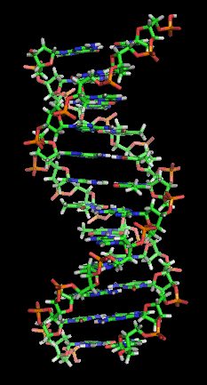
What is DNA?
All living things have DNA
DNA is a special molecule in every cell that carries instructions for what the cell does
For example:
  Which cells should make hair, what color
  Which cells should grow legs, how long
DNA contains an incredible amount of information
  DNA from one of your cells is more than 3 feet long when stretched out!
Each piece of information is carried on a different section of DNA, called a gene
3
Notes:
3
DNA (deoxyribonucleic acid) is the material that carries all the information about how a living thing will look and function.
For instance, DNA in humans determines such things as what color the eyes are, and how different organs (like heart, lungs, liver) work. Each piece of information is carried on a different section of the DNA. These sections are called genes.

Slide 5
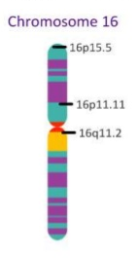
What is a locus?
Chromosome
  Tightly coiled DNA in the nucleus of each cell
  Each chromosome is made up of one DNA molecule
  Every animal has a given number of chromosomes
    Humans have 46 chromosomes (23 pairs)
    Northern fur seals have 36 chromosomes (18 pairs)
Gene
  Each chromosome contains many genes
  A gene is one section of a chromosome
  Genes are inherited from a parent
Locus
  A specific location of the gene on the chromosome,
  like a genetic street address
locus
locus
locus
4
Notes:
4
Each piece of information is carried on a different section of the DNA. These sections are called genes.
Resources:
Genome Unlocking Life’s Code video (https://unlockinglifescode.org/media/animations/659#660)
GeneEd Genetics, Education, Discovery (https://geneed.nlm.nih.gov/topic_subtopic.php?tid=15&sid=17)
NIH National Human Genome Research Institute Talking Glossary of Genetic Terms (https://www.genome.gov/glossary/index.cfm)
Chromosome: https://www.genome.gov/glossary/index.cfm?id=33
Gene: https://www.genome.gov/glossary/index.cfm?id=70
DNA: https://www.genome.gov/glossary/index.cfm?id=48
Locus: https://www.genome.gov/glossary/index.cfm?id=116
Allele: https://www.genome.gov/glossary/index.cfm?id=4
DNA Learning Center (https://www.dnalc.org/)
Image Source: IB Biology 3.1 Slides: Genes, slide 6
Jacob Cedarbaum, Teacher at Nicholas Senn High School
http://www.slideshare.net/jcedarbaum1/ib-biology-31-slides-genes
Original image from http://www.ornl.gov/sci/techresources/Human_Genome/posters/chromosome/chooser.shtml

Slide 6
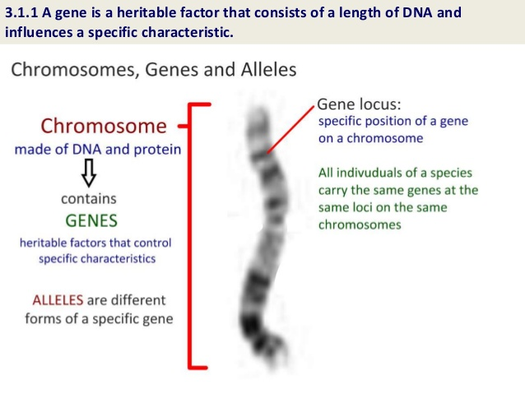
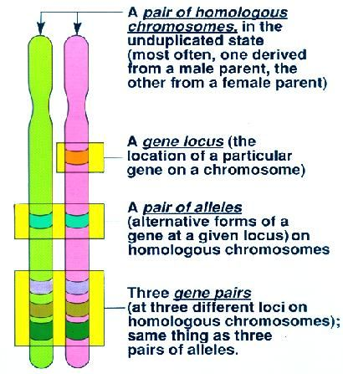
What is a locus?
All individuals of a species
carry the same genes at the
same loci on the same
chromosomes
5
Notes:
5
Resources:
Slide Share:
IB Biology 3.1 Slides: Genes, slides 3 and 6
Jacob Cedarbaum, Teacher at Nicholas Senn High School
http://www.slideshare.net/jcedarbaum1/ib-biology-31-slides-genes
Teacher Web: Alleles, posted Jan. 17, 2016
(http://www.teacherweb.com/Blog/CA/NogalesHighSchool/mespinoza/7/default.aspx?year=2012&month=1)

Slide 7
Inheritance
We get half our DNA from our dad, and half from our mom
This is why children look like their mom and dad
Also why sisters and brothers can look alike
We match copies of DNA from pups to their mom and dad
  Match genetic code at a LOCUS on a gene
  One copy from mom, one from dad
  Can use several LOCI to confirm a match
Notes:
DNA is inherited from parents – one copy from the mother, one copy from the father.
In this way, we can use DNA to look for the parents of a northern fur seal pup
We look at specific places on a gene in the DNA, called a locus, and match the genetic code at the locus to the genetic codes at the same locus on the mother’s and father’s gene in the DNA. We use several of these loci to make sure the match is correct.

Slide 8
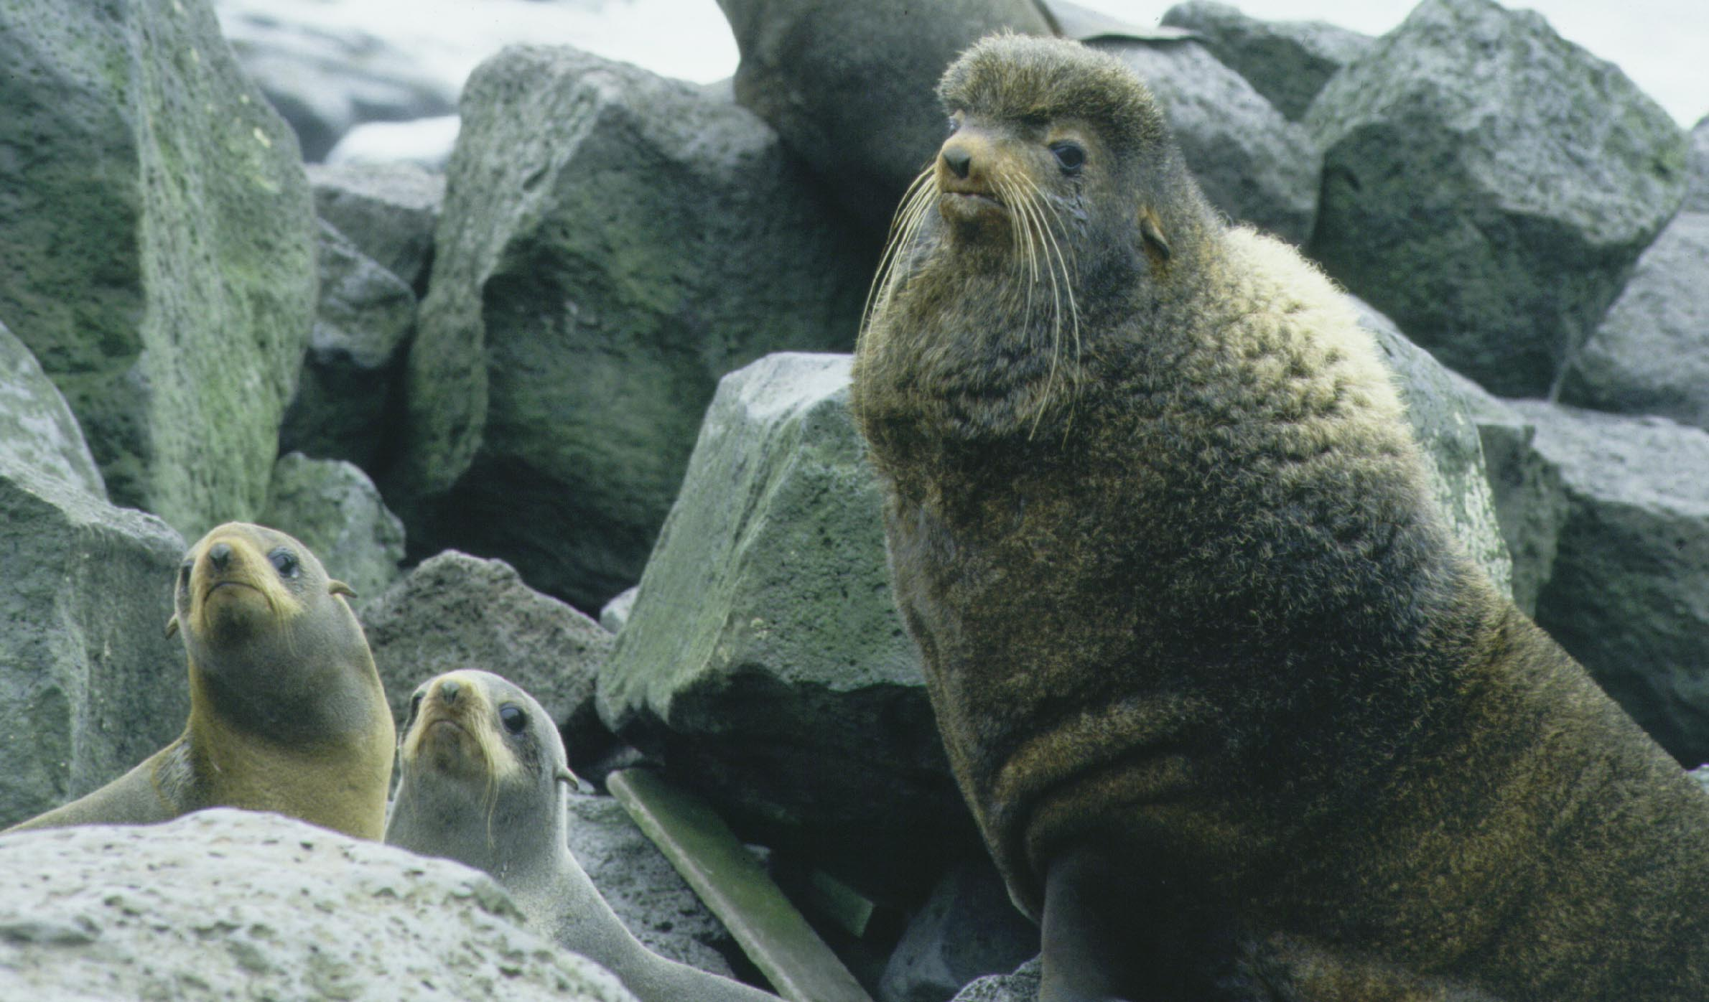
How do you get a DNA sample from a northern fur seal?
Tissue sample (from darting or tagging)
Scat
Blood sample
Saliva
Swab
7
Notes:
7
Scientists can get DNA samples in many different ways –
If the seal is not restrained (remote sampling):
Darting (using specially modified dart guns to get small tissue samples from unrestrained seals)
Feces (picking up scats from the rookery – only if you can identify which animal the scat came from)
If the seal is restrained for tagging:
Blood sample – taken from femoral vein in the ankle
Tissue – can get a tissue plug from flipper when the seal is tagged with a plastic tag
Saliva
Swab - can get a swab from the mouth or other areas
Photo: NOAA/AFSC/MML

Slide 9
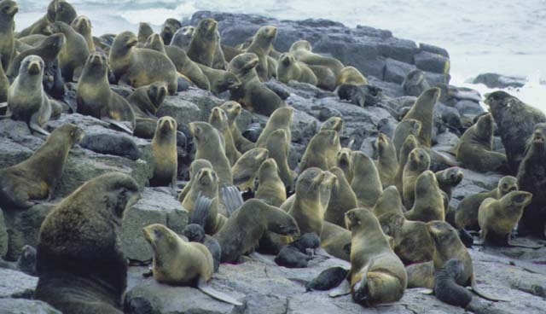
Northern Fur Seal Life History:
Quick Review
Breed in rookeries – males have territories
Males 4x larger than females
In a rookery, there are a small number of territorial males and lots of females
Each female has one pup; males may father many pups
Females nurse pups for about 4 months, then pups are on their own
Notes:
Background on fur seal life history
Northern fur seals spend much of the year at sea, but return to land to breed (mate and have pups) during the summer. They gather in large groups at specific areas, called rookeries, on islands in Alaska, California, and Russia.
Most female fur seals return to the same spot year after year to give birth (a behavior called philopatry).
Philopatry – returning to the location where an individual was born
Some females return to the same island and rookery but not the site where they were born (a behavior called site fidelity).
Site fidelity – returning to the same place (can be in relation to the destination of a feeding place, a migration, or a breeding area, among other things)
Because of this, males gather in areas where female fur seals will arrive each year to breed, and set up territories that they defend against other males.
The biggest, strongest, most dominant males have the most females in their territories.
Use the picture to talk about the physical differences between males and females to lead into the main questions with this.
Eg. Who can show me which are the males, which are the females and which are the pups, how do you know that?
Sources: Riedman, M. 1990. The Pinnipeds. Gentry, R. 1998. Behavior and ecology of the northern fur seal.
Photo: NOAA/AFSC/MML
During a given year, a female has one pup.
Males can mate with many females.
Only about 10% of male pups become breeding males, whereas most females become breeding females.
Source: Gentry, R. 1990. Behavior and ecology of the northern fur seal.
Photo: NOAA/AFSC/MML

Slide 10
Northern Fur Seal Parentage
Activity Example
One Locus Matching
Male 1
M2B
Male 2
M2B
Female 1
M2B
Female 2
M2B
Pup 1
M2B
Notes:
We will walk through a couple of examples of the activity – the simplest example is matching one locus on a gene. The locus names used in this activity (in this example, “M2B”) are actual locus names that NOAA geneticists use when analyzing seal DNA. The genetic codes at the locus are represented here by colors. If a color on the pup’s locus matches a color at the same locus of one of the parents, that means that the genetic code is the same.
Here, we have an example where you have one pup, and 2 possible fathers (male 1 and 2) and 2 possible mothers (female 1 and female 2).
When looking at the 2 copies of the pup’s gene, remember that one copy comes from the father and one from the mother.
Which parent should you look at first? Mom or dad?
Remember the life history information from slide 6 - few territorial males; many females.
Easier to identify the father (male) because there are fewer possible choices.

Slide 11
Northern Fur Seal Parentage
Activity Example
One Locus Matching
Male 1
M2B
Male 2
M2B
Female 1
M2B
Female 2
M2B
Pup 1
M2B
Notes:
When looking at the 2 copies of the pup’s gene, remember that one copy comes from the father and one from the mother.
Look for a color on the pup’s M2B locus that matches one of the males.

Slide 12
Northern Fur Seal Parentage
Activity Example
One Locus Matching
Male 1
M2B
Male 2
M2B
Female 1
M2B
Female 2
M2B
Pup 1
M2B
Notes:
You can see that Male 2 has a light blue color that matches the pup’s color, so we can say that Male 2 is the father.

Slide 13
Northern Fur Seal Parentage
Activity Example
One Locus Matching
Male 1
M2B
Male 2
M2B
Female 1
M2B
Female 2
M2B
Pup 1
M2B
Notes:
Now we match the remaining color for the pup (green) to one of the females.

Slide 14
Northern Fur Seal Parentage
Activity Example
One Locus Matching
Male 1
M2B
Male 2
M2B
Female 1
M2B
Female 2
M2B
Pup 1
M2B
Notes:
Only Female 1 has a green color on the M2B locus, so she is identified as the mother of Pup 1.

Slide 15
Northern Fur Seal Parentage
Activity Example
One Locus Matching
Male 1
M2B
Male 1
M2B
Male 2
M2B
Male 2
M2B
Female 1
M2B
Female 1
M2B
Female 2
M2B
Female 2
M2B
Pup 1
M2B
Notes:
From matching one locus (M2B), we have found that Male 2 is the father and Female 1 is the mother of Pup 1.

Slide 16
Northern Fur Seal Parentage
Activity Example
Multi Loci Matching
1 Male
Hg3.7 M2B Pv29 SPGv11
2 Male
Hg3.7 M2B Pv29 SPGv11
Do you want this loci highlighted on this slide?
1 Female
Hg3.7 M2B Pv29 SPGv11
2 Female
Hg3.7 M2B Pv29 SPGv11
Pup
Hg3.7 M2B Pv29 SPGv11
Notes:
In reality, we need to use many loci to match pups to their parents – an analogy is if we were to use eye color to match kids to their parents. There are a lot of people with the same eye color, so we need to use several traits to match kids to their mother and father.
Here is an example with 4 loci – Hg3.7, M2B, Pv29, SPGv11. Again, loci are specific locations on a gene that can be used to compare between different individual animals.
When starting the match, ask students: which do we match first, males or females?
(Answer: males, because there are fewer territorial males to choose from)
Here, the males are across the top, the females are in the second row.

Slide 17
Northern Fur Seal Parentage
Activity Example
Multi Loci Matching
1 Male
Hg3.7 M2B Pv29 SPGv11
2 Male
Hg3.7 M2B Pv29 SPGv11
1 Female
Hg3.7 M2B Pv29 SPGv11
2 Female
Hg3.7 M2B Pv29 SPGv11
Pup
Hg3.7 M2B Pv29 SPGv11
Notes:
Look at the males to see if there is a match to one of the colors at each locus for the pup.
We want to look at each locus individually, so we generally start from the left side (Hg3.7) and match one locus at a time. Remember that you are looking for one color match between the pup and the male at each locus.

Slide 18
Northern Fur Seal Parentage
Activity Example
Multi Loci Matching
1 Male
Hg3.7 M2B Pv29 SPGv11
2 Male
Hg3.7 M2B Pv29 SPGv11
1 Female
Hg3.7 M2B Pv29 SPGv11
2 Female
Hg3.7 M2B Pv29 SPGv11
Pup
Hg3.7 M2B Pv29 SPGv11
Notes:
We want to look at each locus individually.
Here we are looking at the first locus, Hg3.7 Remember that you are looking for one color match between the pup and the male at each locus. Which male has a color match to either of the pup’s colors at this locus?
(Answer: Male 1 has a match to both colors at the pup’s Hg3.7 locus. Male 2 does not have any matches, so we know that Male 1 is the father.)

Slide 19
Northern Fur Seal Parentage
Activity Example
Multi Loci Matching
1 Male
Hg3.7 M2B Pv29 SPGv11
2 Male
Hg3.7 M2B Pv29 SPGv11
1 Female
Hg3.7 M2B Pv29 SPGv11
2 Female
Hg3.7 M2B Pv29 SPGv11
Pup
Hg3.7 M2B Pv29 SPGv11
Notes:
Male 1 has a match to both colors at the pup’s Hg3.7 locus. Male 2 does not have any matches, so we know that Male 1 is the father.

Slide 20
Northern Fur Seal Parentage
Activity Example
Multi Loci Matching
1 Male
Hg3.7 M2B Pv29 SPGv11
2 Male
Hg3.7 M2B Pv29 SPGv11
1 Female
Hg3.7 M2B Pv29 SPGv11
2 Female
Hg3.7 M2B Pv29 SPGv11
Pup
Hg3.7 M2B Pv29 SPGv11
Notes:
Now we need to double-check (verify) the other loci for Male 1 to make sure that there is a match at each locus. Does Male 1 have at least one color at each of the other loci that matches one of the pup’s colors?

Slide 21
Northern Fur Seal Parentage
Activity Example
Multi Loci Matching
1 Male
Hg3.7 M2B Pv29 SPGv11
2 Male
Hg3.7 M2B Pv29 SPGv11
1 Female
Hg3.7 M2B Pv29 SPGv11
2 Female
Hg3.7 M2B Pv29 SPGv11
Pup
Hg3.7 M2B Pv29 SPGv11
Notes:
Does Male 1 have at least one color at each of the other loci that matches one of the pup’s colors?
Answer: yes: M2B – blue; Pv29 – both brown and orange; SPGv11 – purple
This verifies that Male 1 is the pup’s father.

Slide 22
Northern Fur Seal Parentage
Activity Example
Multi Loci Matching
1 Male
Hg3.7 M2B Pv29 SPGv11
2 Male
Hg3.7 M2B Pv29 SPGv11
1 Female
Hg3.7 M2B Pv29 SPGv11
2 Female
Hg3.7 M2B Pv29 SPGv11
Pup
Hg3.7 M2B Pv29 SPGv11
Notes:
Now we do the same for the females to find the mother.

Slide 23
Northern Fur Seal Parentage
Activity Example
Multi Loci Matching
1 Male
Hg3.7 M2B Pv29 SPGv11
2 Male
Hg3.7 M2B Pv29 SPGv11
1 Female
Hg3.7 M2B Pv29 SPGv11
2 Female
Hg3.7 M2B Pv29 SPGv11
Pup
Hg3.7 M2B Pv29 SPGv11
Notes:
Again, start with Hg3.7 – Do either of the females have one of the same colors as the pup at Hg3.7?

Slide 24
Northern Fur Seal Parentage
Activity Example
Multi Loci Matching
1 Male
Hg3.7 M2B Pv29 SPGv11
2 Male
Hg3.7 M2B Pv29 SPGv11
1 Female
Hg3.7 M2B Pv29 SPGv11
2 Female
Hg3.7 M2B Pv29 SPGv11
Pup
Hg3.7 M2B Pv29 SPGv11
Notes:
Do either of the females have one of the same colors as the pup at Hg3.7?
Answer: both females have yellow, so we have to go to the next locus to see if we can determine which one is the mother.

Slide 25
Northern Fur Seal Parentage
Activity Example
Multi Loci Matching
1 Male
Hg3.7 M2B Pv29 SPGv11
2 Male
Hg3.7 M2B Pv29 SPGv11
1 Female
Hg3.7 M2B Pv29 SPGv11
2 Female
Hg3.7 M2B Pv29 SPGv11
Pup
Hg3.7 M2B Pv29 SPGv11
Notes:
Go to the next locus, M2B -Do either of the females have one of the same colors as the pup at M2B?

Slide 26
Northern Fur Seal Parentage
Activity Example
Multi Loci Matching
1 Male
Hg3.7 M2B Pv29 SPGv11
2 Male
Hg3.7 M2B Pv29 SPGv11
1 Female
Hg3.7 M2B Pv29 SPGv11
2 Female
Hg3.7 M2B Pv29 SPGv11
Pup
Hg3.7 M2B Pv29 SPGv11
Notes:
Do either of the females have one of the same colors as the pup at M2B?
Answer: Female 1 has blue, and Female 2 has pink (i.e., both have one color from the pup), so we have to go to the next locus to see if we can determine which one is the mother.

Slide 27
Northern Fur Seal Parentage
Activity Example
Multi Loci Matching
1 Male
Hg3.7 M2B Pv29 SPGv11
2 Male
Hg3.7 M2B Pv29 SPGv11
1 Female
Hg3.7 M2B Pv29 SPGv11
2 Female
Hg3.7 M2B Pv29 SPGv11
Pup
Hg3.7 M2B Pv29 SPGv11
Notes:
Go to the next locus, Pv29 -Do either of the females have one of the same colors as the pup at Pv29?

Slide 28
Northern Fur Seal Parentage
Activity Example
Multi Loci Matching
1 Male
Hg3.7 M2B Pv29 SPGv11
2 Male
Hg3.7 M2B Pv29 SPGv11
1 Female
Hg3.7 M2B Pv29 SPGv11
2 Female
Hg3.7 M2B Pv29 SPGv11
Pup
Hg3.7 M2B Pv29 SPGv11
Notes:
Do either of the females have one of the same colors as the pup at Pv29?
Answer: Female 2 has brown, but Female 1 does not have any colors the same as the pup, so Female 2 is the mother!

Slide 29
Northern Fur Seal Parentage
Activity Example
Multi Loci Matching
1 Male
Hg3.7 M2B Pv29 SPGv11
2 Male
Hg3.7 M2B Pv29 SPGv11
1 Female
Hg3.7 M2B Pv29 SPGv11
1 Female
Hg3.7 M2B Pv29 SPGv11
2 Female
Hg3.7 M2B Pv29 SPGv11
Pup
Hg3.7 M2B Pv29 SPGv11
Notes:
Double check the last locus, SPGv11

Slide 30
Northern Fur Seal Parentage
Activity Example
Multi Loci Matching
1 Male
Hg3.7 M2B Pv29 SPGv11
2 Male
Hg3.7 M2B Pv29 SPGv11
1 Female
Hg3.7 M2B Pv29 SPGv11
2 Female
Hg3.7 M2B Pv29 SPGv11
Pup
Hg3.7 M2B Pv29 SPGv11
Notes:
Female 2 has pink, the same as one of the colors from the pup. The match is verified.

Slide 31
Northern Fur Seal Parentage
Activity Example
Multi Loci Matching
1 Male
Hg3.7 M2B Pv29 SPGv11
2 Male
Hg3.7 M2B Pv29 SPGv11
1 Female
Hg3.7 M2B Pv29 SPGv11
2 Female
Hg3.7 M2B Pv29 SPGv11
1 Pup
Hg3.7 M2B Pv29 SPGv11
Notes:
From matching one color from the pup to one color from each parent, we were able to determine that Male 1 and Female 2 were the pup’s parents.
Pup’s genetic codes:
At locus Hg3.7 – yellow from mom, peach from dad
At locus M2B – pink from mom, blue from dad
At locus Pv29 – brown from mom, orange from dad
At locus SPGv11 – purple from dad, magenta from mom

Slide 32
Filling out the family tree
Female
Male
Pup
Notes:
Now we fill out the identification numbers of the parents and pup on the family tree
Triangle – female
Square – male
Circle – pup

Slide 33
Find Identification Numbers
1 Male
Hg3.7 M2B Pv29 SPGv11
2 Male
Hg3.7 M2B Pv29 SPGv11
1 Female
Hg3.7 M2B Pv29 SPGv11
2 Female
Hg3.7 M2B Pv29 SPGv11
1 Pup
Hg3.7 M2B Pv29 SPGv11
Notes:
Find identification numbers from our table (circled in red)

Slide 34
Filling out the family tree
Female
Male
2
1
1
Pup
Notes:
Fill in numbers on family tree.

Slide 35
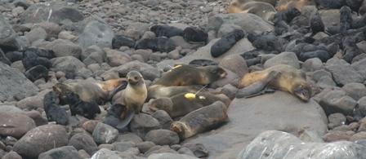
What can we learn from genetics?
Which seals are related
Reproductive success
Larger scale studies – population structure
Identify prey species from DNA in spew, stomach, and scat, tissue
34
Notes:
34
What can we learn from genetics?
Which seals are related – this is the activity we did today. In reality, computer does matching, but final decision is still done by a scientist who looks over the final computer matches to verify them.
Reproductive success – analyzing paternity by genetics can show scientists how many pups each territorial male fathers, as well as record how many pups a female has over her reproductive life.
Population structure – scientists can look at genetics from different rookeries to see if there is genetic exchange between rookeries
Prey species identification – scientists can identify prey from tissue in seal scats, spews, or stomach contents.
Photo: Rolf Ream, NOAA/AFSC/MML

Slide 36
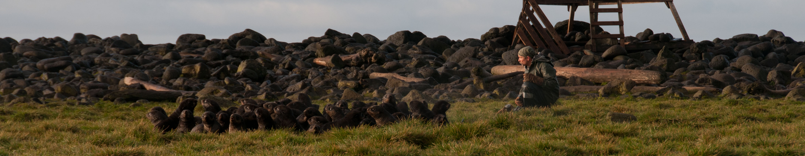
Summary
Scientists can use genetics to find out who the parents of a northern fur seal pup are
DNA is the material that carries all the information about how a living thing will look and function
Pups get one copy of their DNA from each parent
Looking at specific locations on the DNA, scientists can match the DNA from the pup to each parent
35
Notes:
35
Photo: Pam Goddard, Thalassa

Slide 37
Background slides
The following slides provide background on northern fur seal life history if this activity is being done as a stand-alone lesson

Slide 38
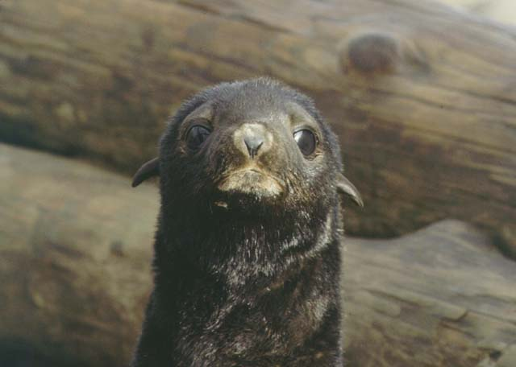
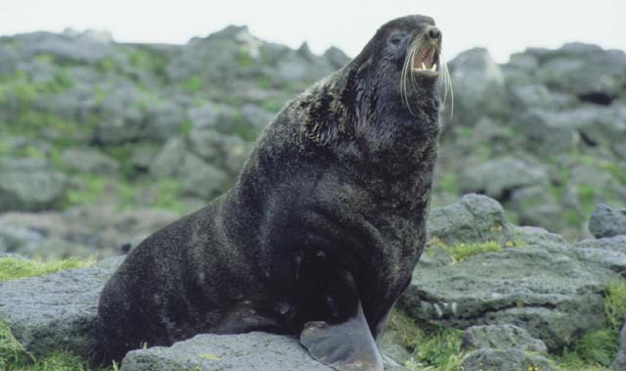
Background…
What is a fur seal?
Notes:
Review from Lesson 1
Pinnipeds are divided into three groups:
True seals (phocid seals) – these are seals like harbor seals and ringed seals
Eared seals (otariid seals) – these are fur seals and sea lions
Walrus (odobenid)
Characteristics of an eared seal:
external ear flaps
Large flippers used for propulsion when swimming (eared seal “flies through the water”)
hind flippers rotated under the body so that the fur seal can walk on all four flippers on land
Northern fur seal is an eared seal (otariid seal).
Photos: Rolf Ream, NOAA/AFSC/MML

Slide 39
Fur seal life history
Breed in rookeries – males have territories; lots of females
Males 4x larger than females
Each female has one pup
Females nurse pups for about 4 months
38
Notes:
38
Main points:
During a given year, a female has one pup.
Males can mate with many females.
Only about 10% of male pups become breeding males, whereas most females become breeding females.
Source: Gentry, R. 1990. Behavior and ecology of the northern fur seal.
Photo: NOAA/AFSC/MML
Background on fur seal life history
Northern fur seals spend much of the year at sea, but return to land to breed (mate and have pups) during the summer. They gather in large groups at specific areas, called rookeries, on islands in Alaska, California, and Russia.
Most female fur seals return to the same spot year after year to give birth (a behavior called philopatry).
Philopatry – returning to the location where an individual was born
Some females return to the same island and rookery but not the site where they were born (a behavior called site fidelity).
Site fidelity – returning to the same place (can be in relation to the destination of a feeding place, a migration, or a breeding area, among other things)
Because of this, males gather in areas where female fur seals will arrive each year to breed, and set up territories that they defend against other males.
The biggest, strongest, most dominant males have the most females in their territories.
Use the picture to talk about the physical differences between males and females to lead into the main questions with this.
Eg. Who can show me which are the males, which are the females and which are the pups, how do you know that?
Sources: Riedman, M. 1990. The Pinnipeds.; Gentry, R. 1998. Behavior and ecology of the northern fur seal.
Male fur seals may take up to 7-10 years to become breeding males and may only keep a territory on the rookery for a few years.
If they become territorial males (adult males who hold a territory on the rookery) they may father many pups per year during the time that they have a territory. Not all males become breeding males; some are idle males (defend a territory but don’t have females) and some remain on the haulout areas.
Female fur seals begin to breed at 3-5 years of age and then have one pup per year until they are 18-20 years old. Females choose a location on the rookery that increases their chances of weaning a pup.
Pups are born in July and remain on the rookery until they are weaned, 4 months later.
The pregnancy rate for females is approximately 60% for females age 3 and greater, and 68% for females age 4 and greater (York 1987). Nearly 90% of females in their reproductive prime, 8-13 years old, are pregnant every year with the pregnancy rate gradually decreasing after 13 years of age.
Source: Antonelis G. (1992) Northern fur seal techniques manual. U.S. Dep. Commer, Seattle. NOAA Tech Memo NMFS F/NWC-214, 47 p. (adult males); York (1987) – female reproduction

Slide 40
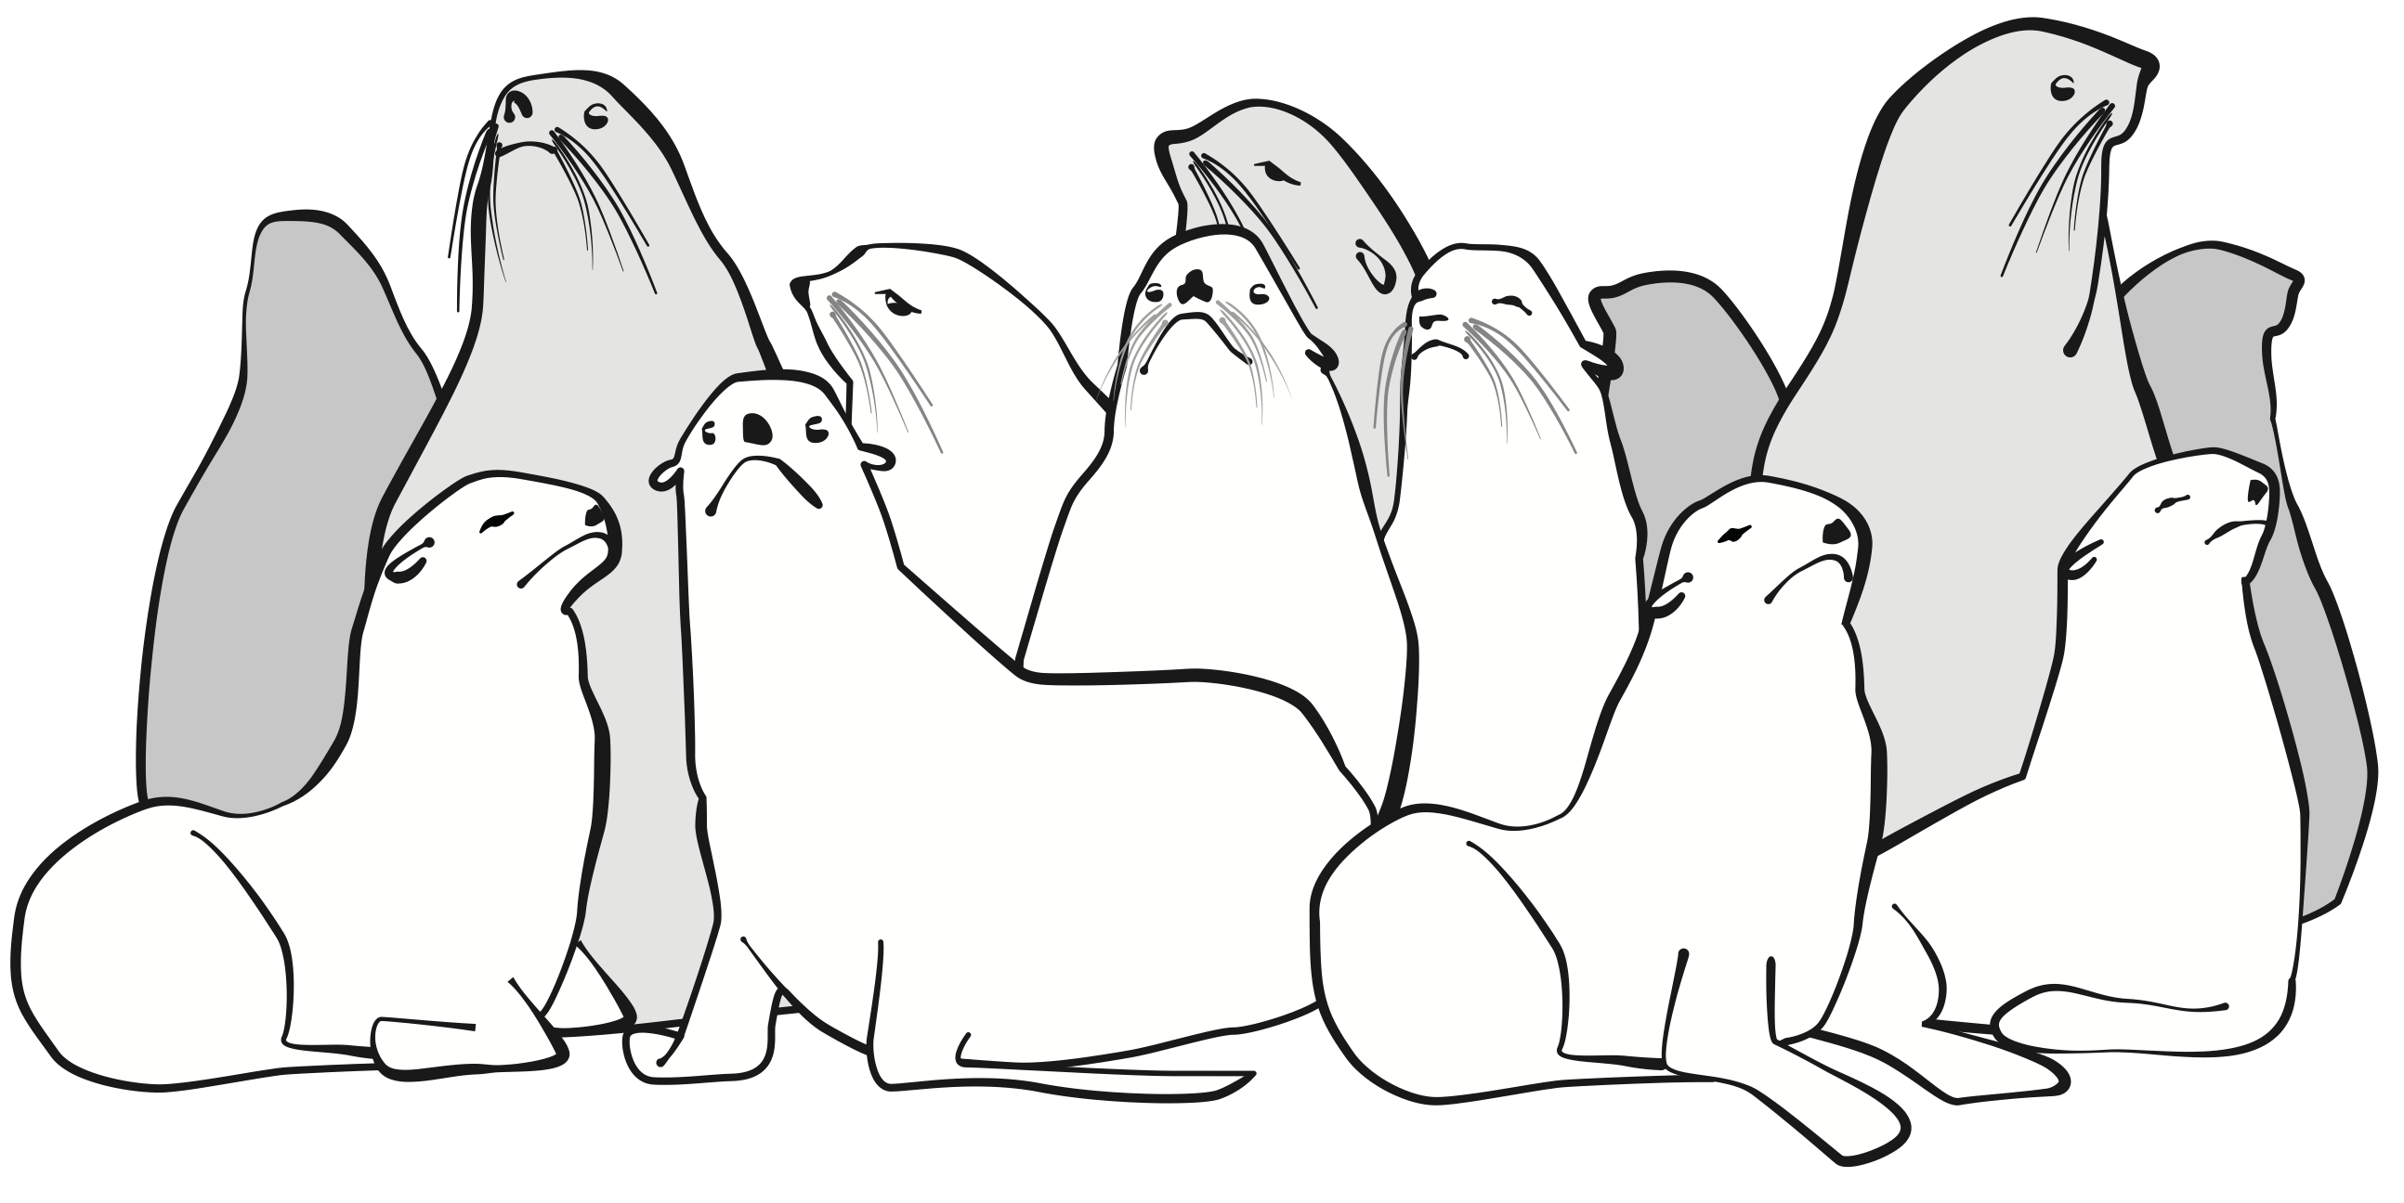
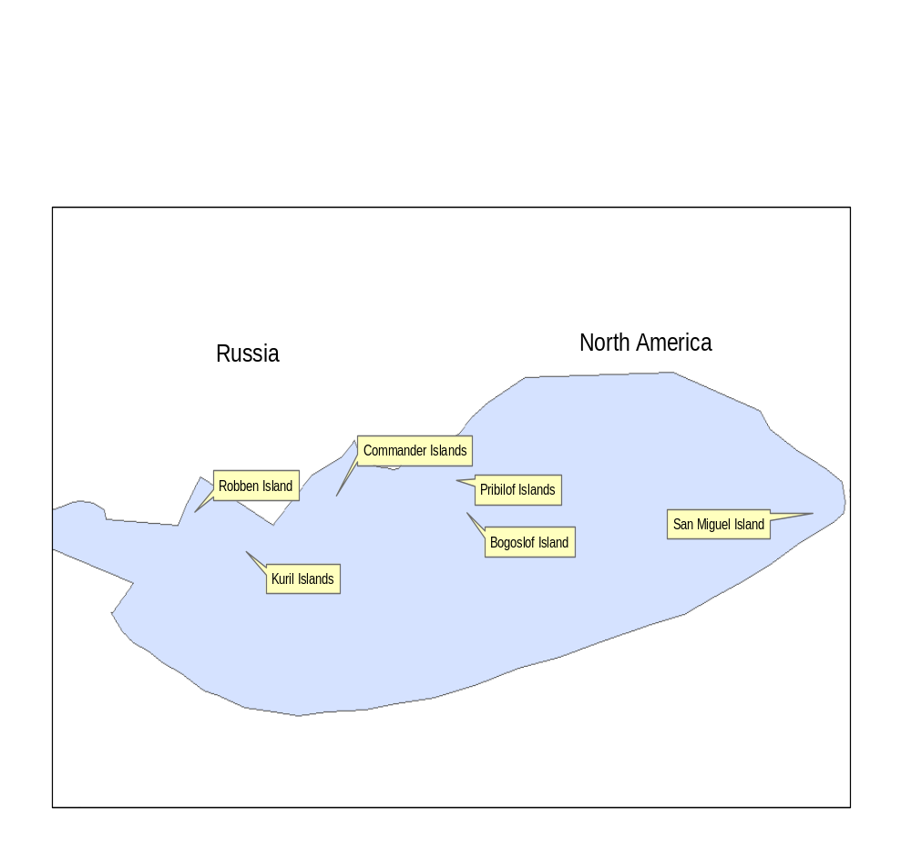
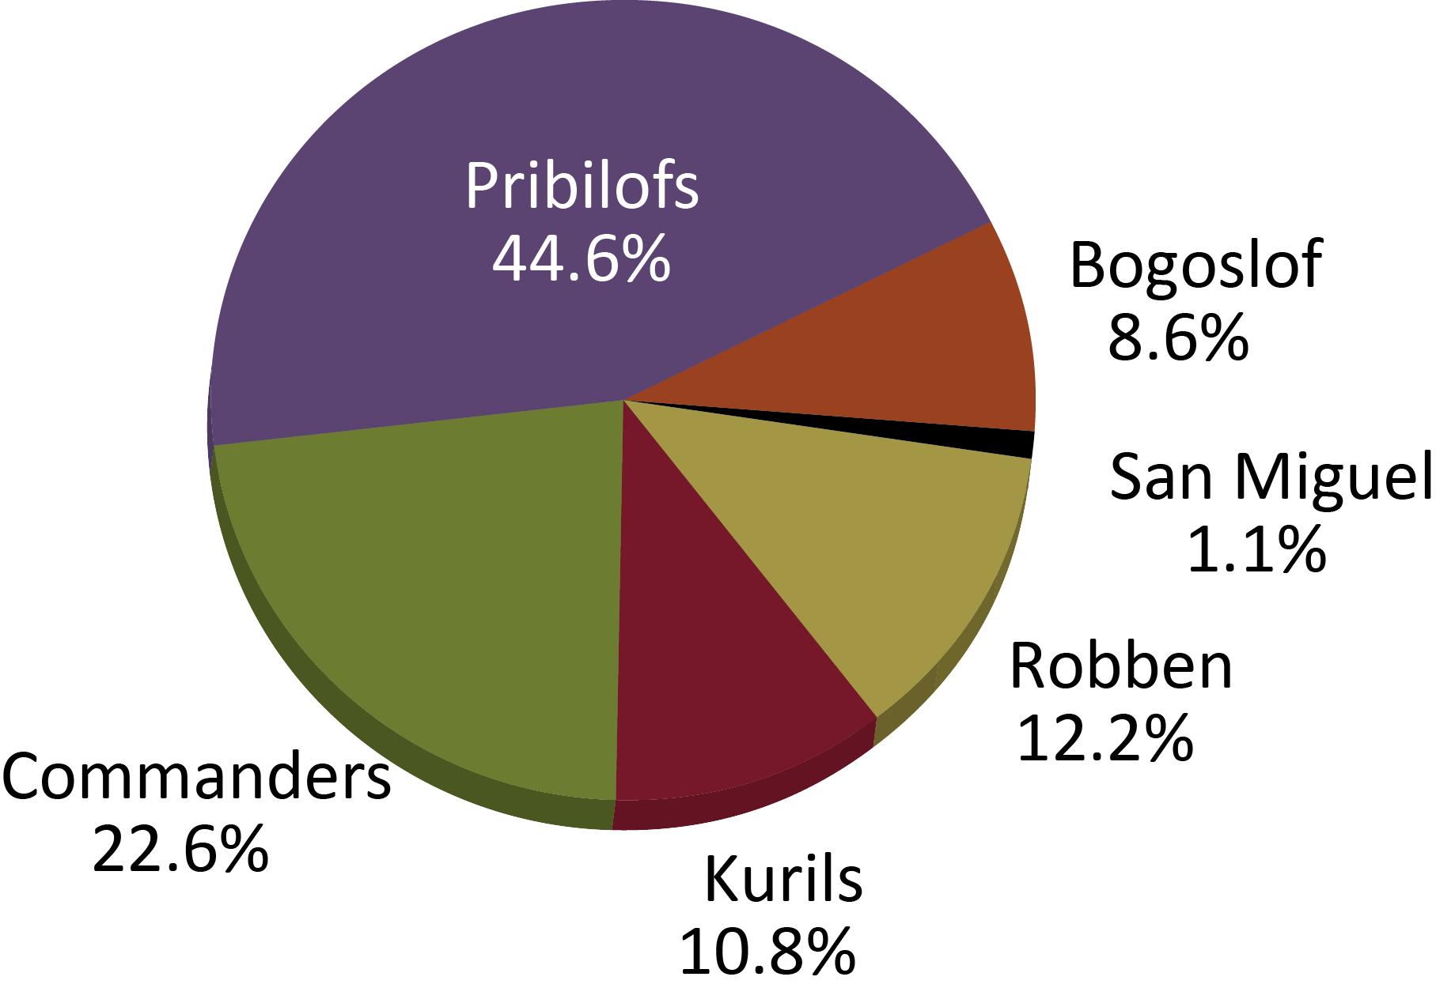
Where are northern fur seal rookeries?
Alaska
Notes:
Unangam names:
Tanax^-Amix^ - Pribilof Islands
Ag^asaag^ux^ - Bogoslof Island
There are five northern fur seal breeding rookery locations: three in Russia (Commander Islands, Robben Island, Kuril Islands), two in the Bering Sea (Pribilof Islands, Bogoslof Island), and one in California (San Miguel Island). The largest proportion of the northern fur seal population is on the Pribilof Islands. At each location, fur seals breed at specific rookeries (e.g., in the Pribilof Islands, there are 15 rookeries on St. Paul Island and 6 on St. George Island.
Percentage of the worldwide northern fur seal population in different rookery locations (2012):
44.6% Pribilof Islands
22.6% Commander Islands
12.2% Robben Island
10.8% Kuril Islands
8.6% Bogoslof Island
1.1% San Miguel Island
Map from NOAA/AFSC/MML observer PowerPoint

Slide 41
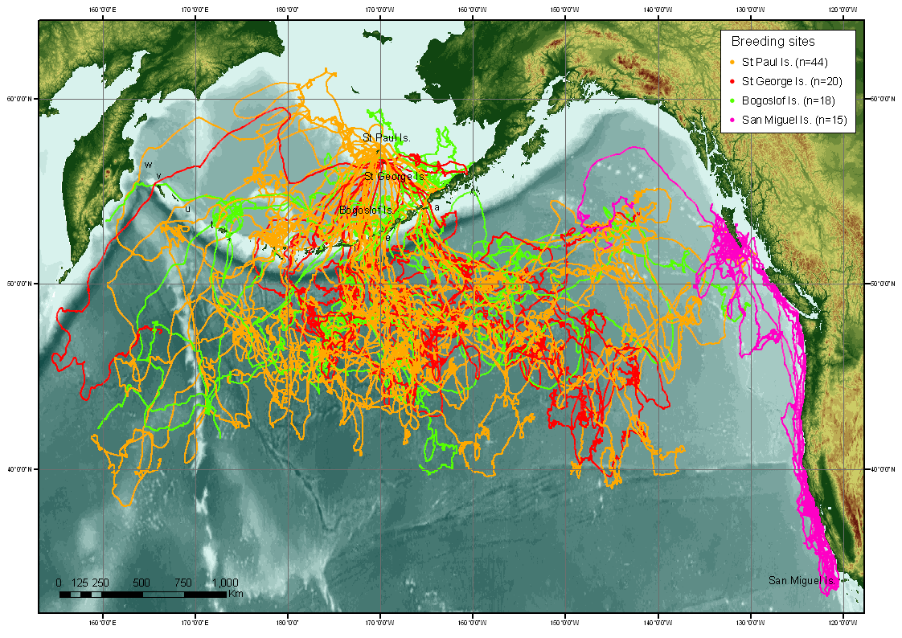
But they’re not there all the time…
In the fall,
fur seals leave rookeries and spend the winter at sea…
40
Notes:
40
See more details in Lesson 6 - Where do fur seals go in the winter?
Map: NOAA/AFSC

